Slide 1
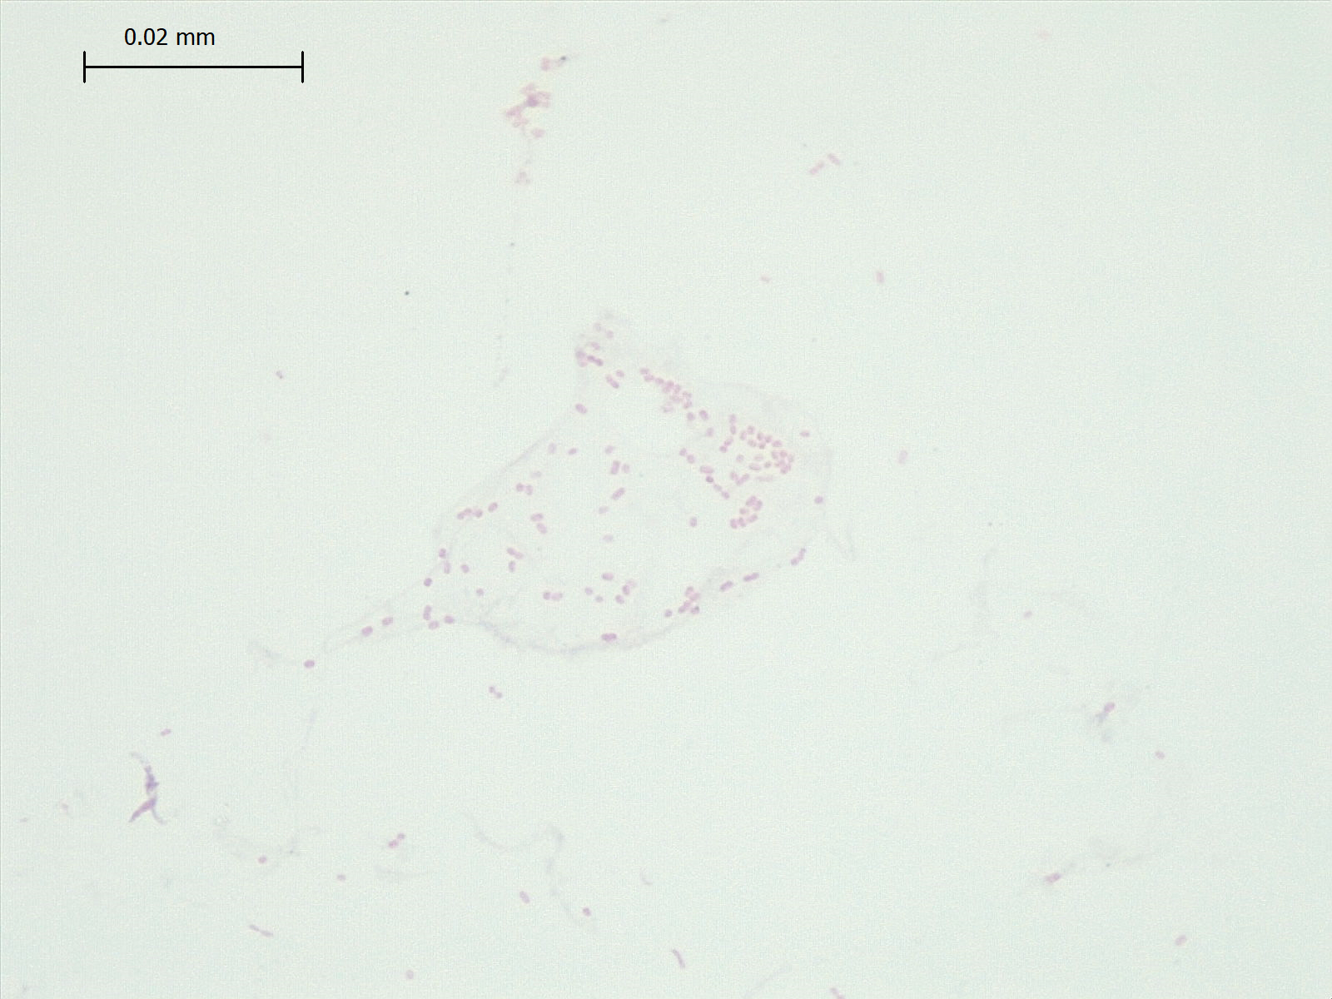
Gram Stain Results:

Slide 2
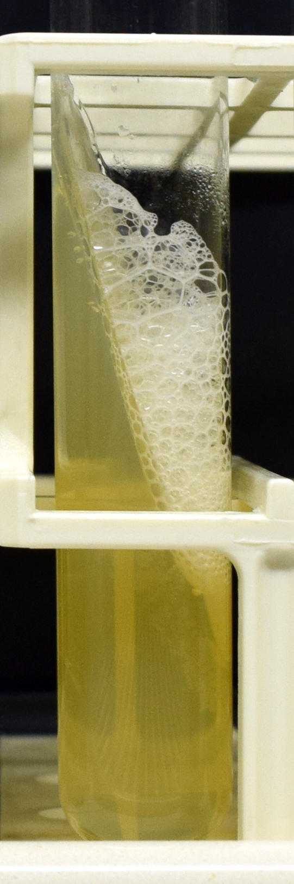

Biochemical Activities Results:
Catalase:
TSI:

Slide 3



Carbohydrate fermentation:
Glucose:
Lactose:
Sucrose:

Slide 4



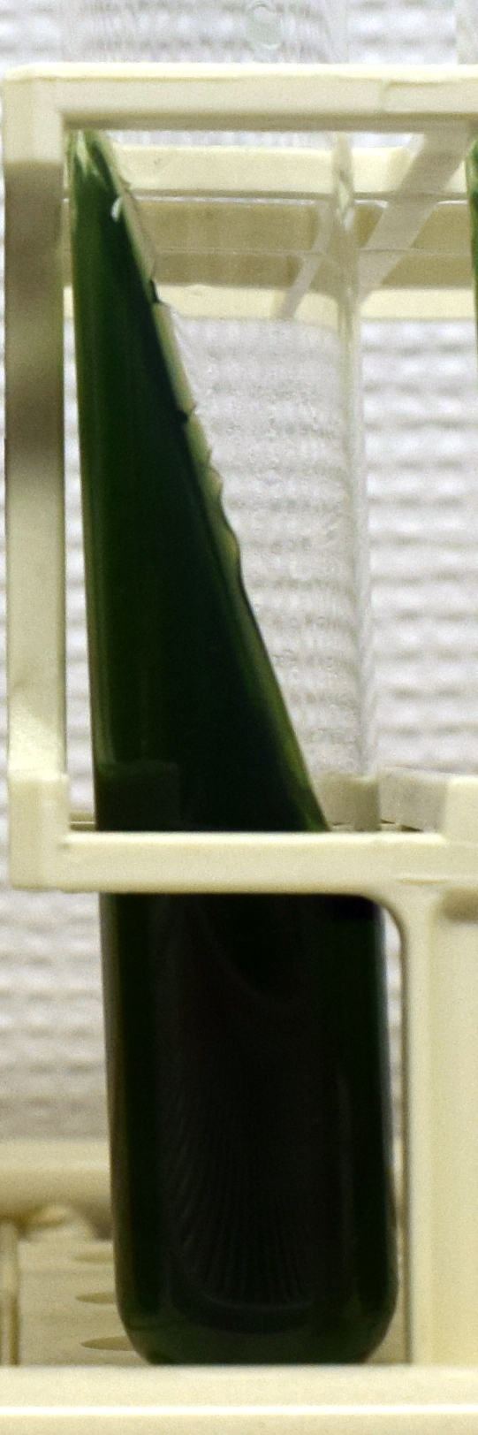
Indole:
MR:
VP:
Citrate:

Slide 5

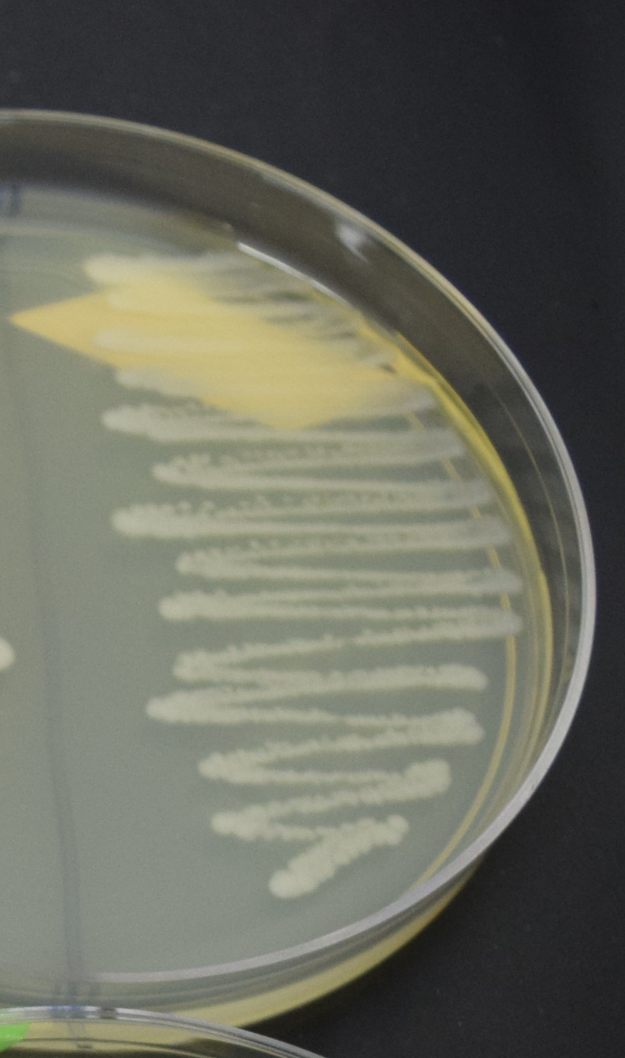
Coagulase:
DNAse:

