Slide 1
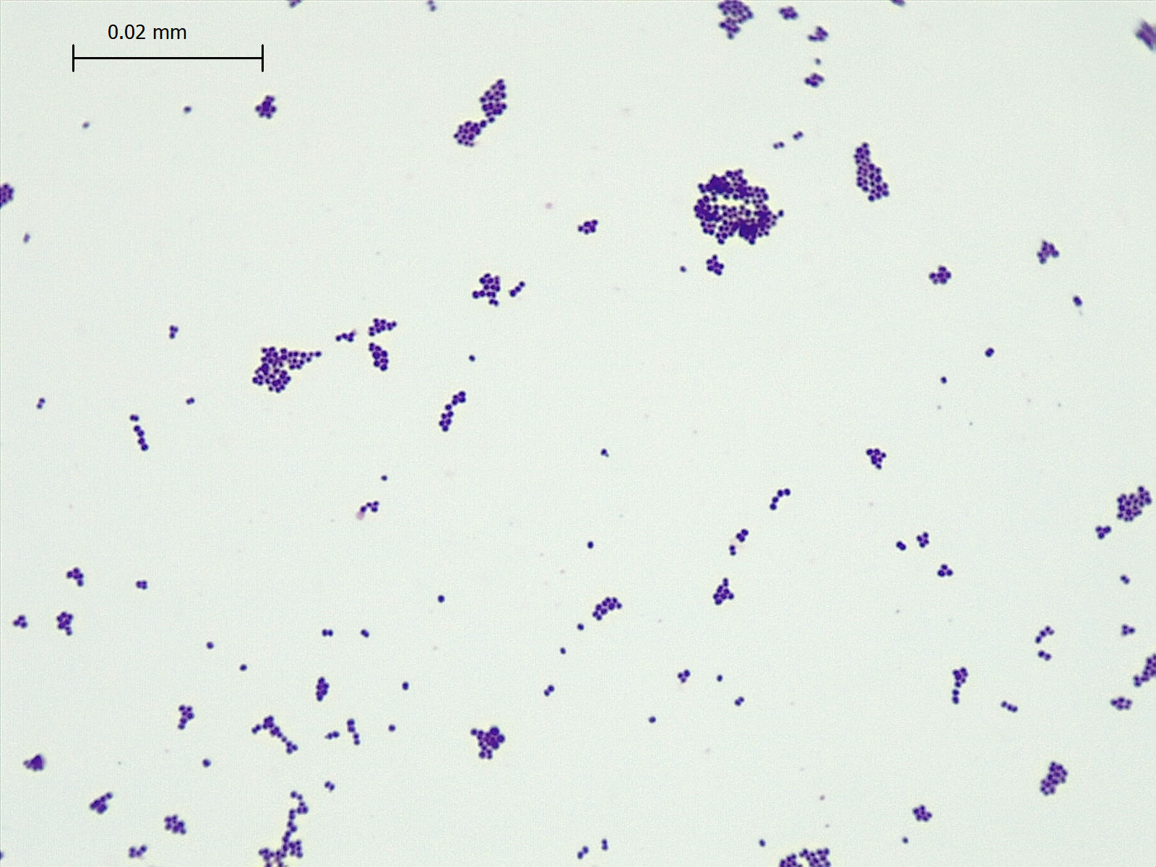
Gram Stain Results:

Slide 2
Biochemical Activities Results:
Catalase:
TSI:

Slide 3
Carbohydrate fermentation:
Glucose:
Lactose:
Sucrose:

Slide 4
Indole:
MR:
VP:
Citrate:

Slide 5
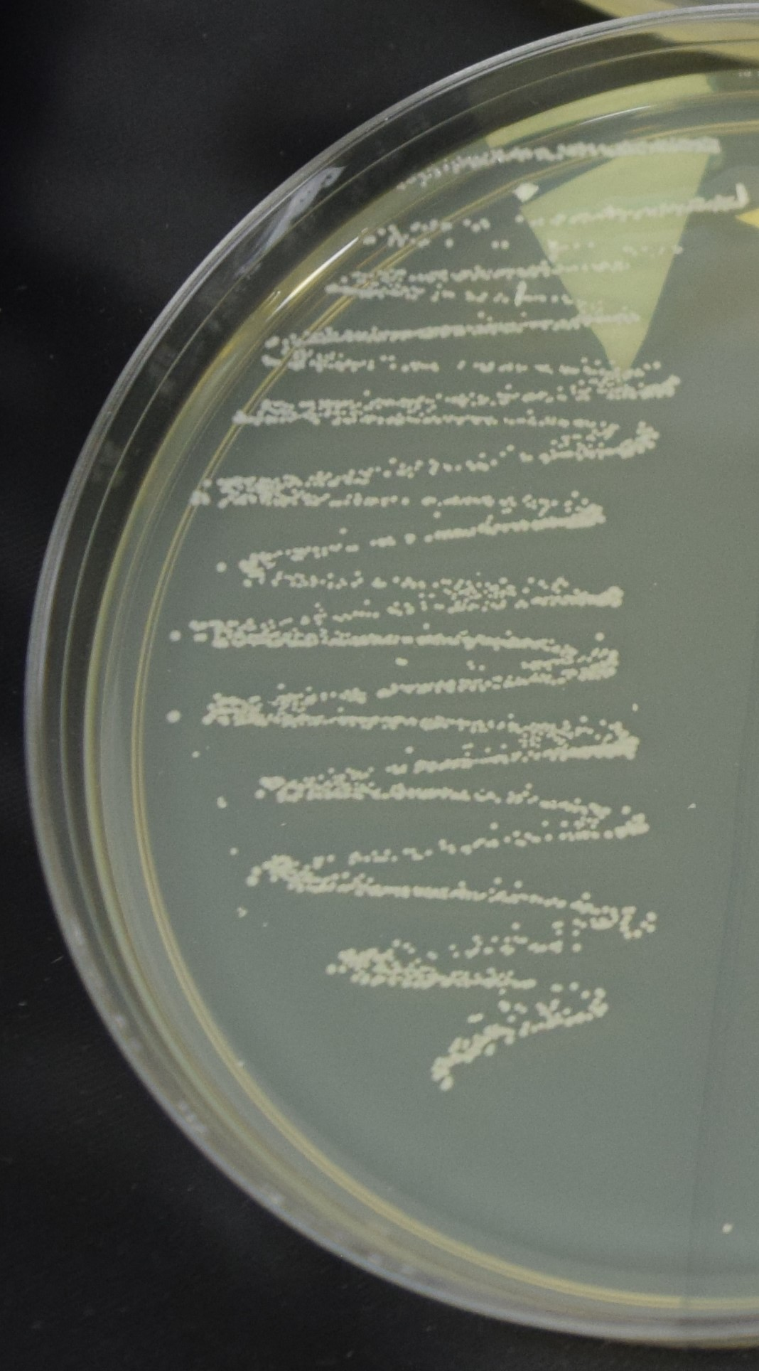
Coagulase:
DNAse:

