Slide 1
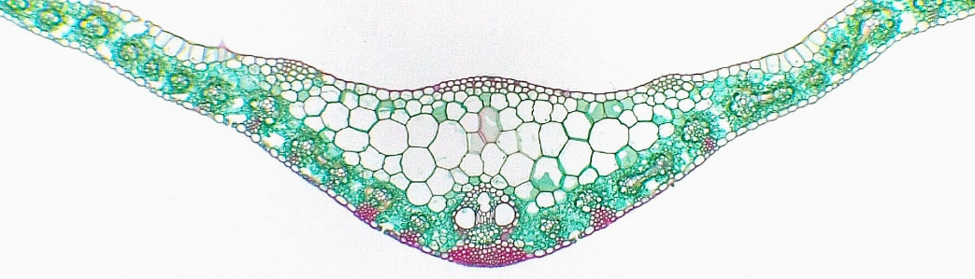
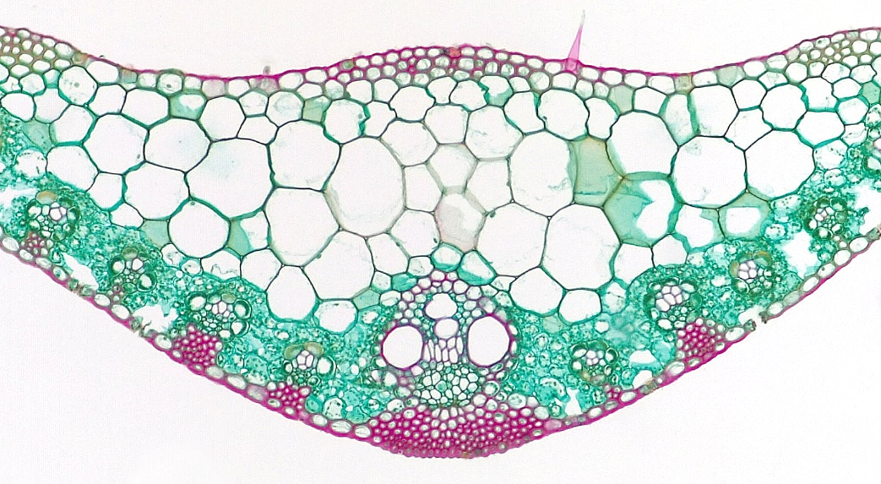
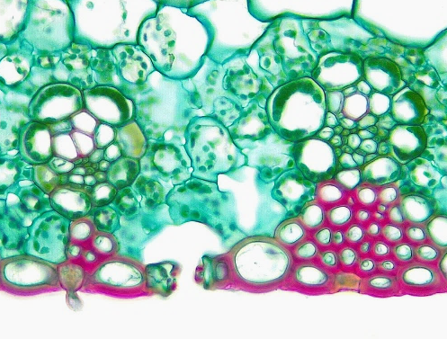
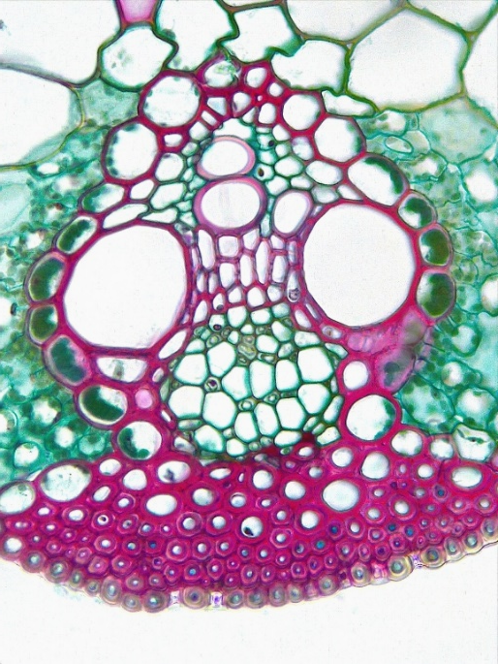
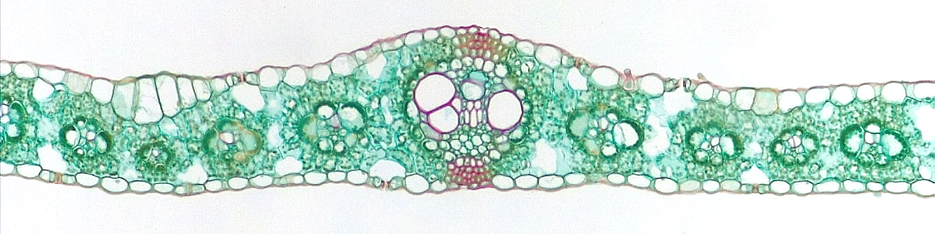
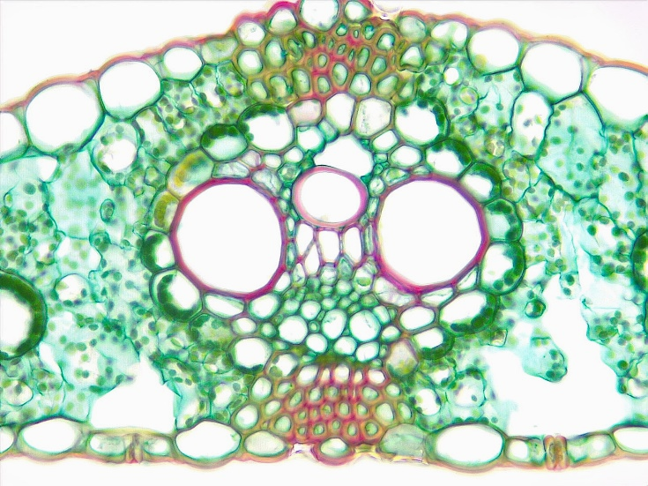
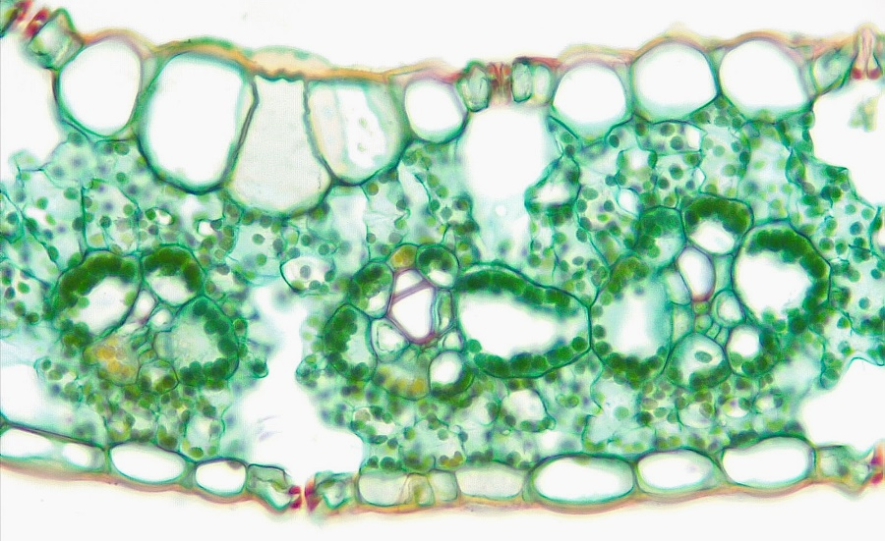
1
Monocot Leaf
Midrib region
Epidermis (adaxial)
Epidermis (abaxial)
Bulliform cell
Mesophyll
Vascular bundle
Protoxylem
Protoxylem lacuna
Metaxylem
Primary phloem
Bundle sheath cell
Sclerenchyma
Guard cell
Stoma
Substomatal cavity
2
2
5
6
6
`
3
6
3
12
12
12
5
6
5
6
11
11
7
11
7
14
9
9
15
12
Transverse sections
10
3
13
Bar = 100 μm
Horton Lai and Carol Wenzel. 2020
4
14
15
14
15
2
12
6
6
4
6
6
4
6
3
4
5
3
5
12
13
2
2
4
2
4
4
15
14
8
5
11
9
7
5
11
9
11
10
6
6
13
13
15
14
15
12
3
15
3
3

