Slide 1
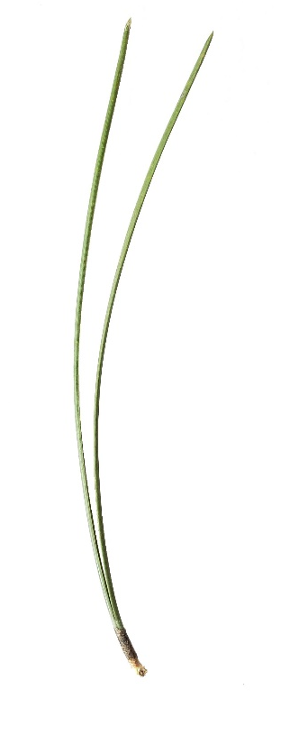
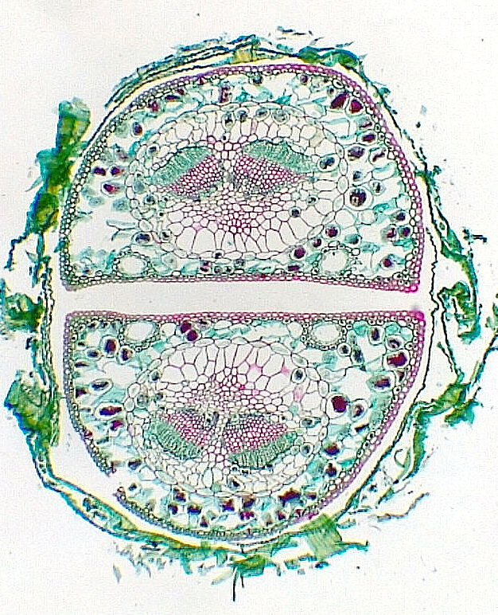
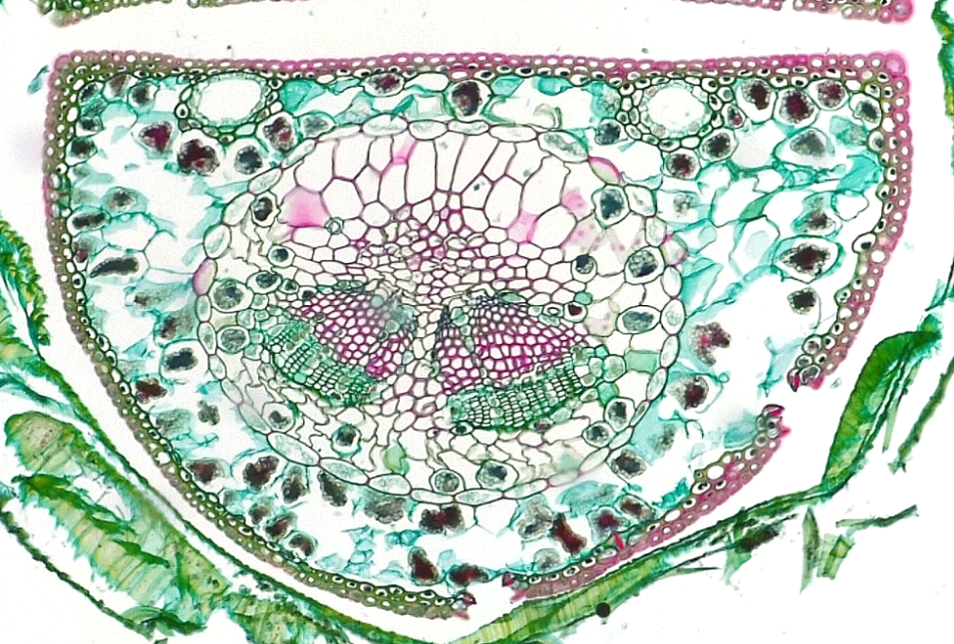
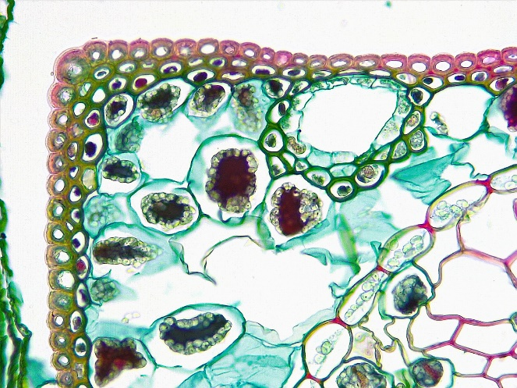
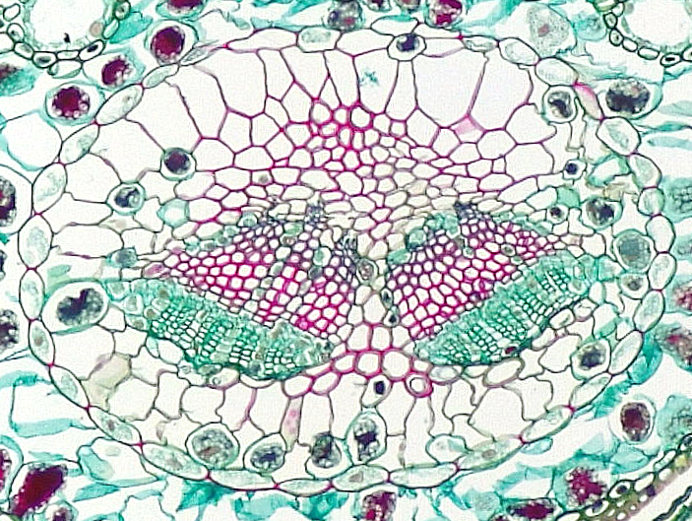
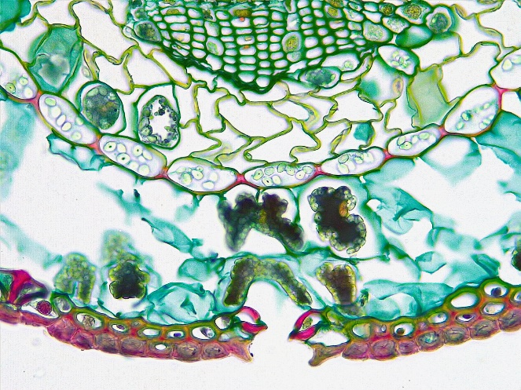
3
Gymnosperm Leaf
Pinus (Pine)
Needle
1
1
1
Needle
Fascicle sheath
Fascicle sheath remnant
Epidermis (adaxial)
Epidermis (abaxial)
Hypodermis
Mesophyll
Resin duct
Endodermis
Transfusion tissue
Vascular bundle
Primary xylem
Primary phloem
Stoma
Substomatal cavity
1
2
3
Section
1 cm
4
4
4
8
8
7
10
7
5
Transverse sections
11
11
Bar = 100 μm
Horton Lai and Carol Wenzel. 2020
10
4
6
5
14
3
14
8
5
7
5
7
7
8
8
9
7
9
10
9
13
12
12
10
13
13
9
6
7
7
9
10
10
7
9
15
14
7
5

