Slide 1
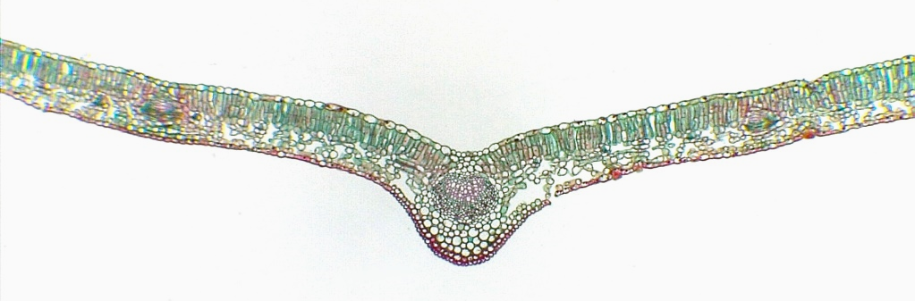
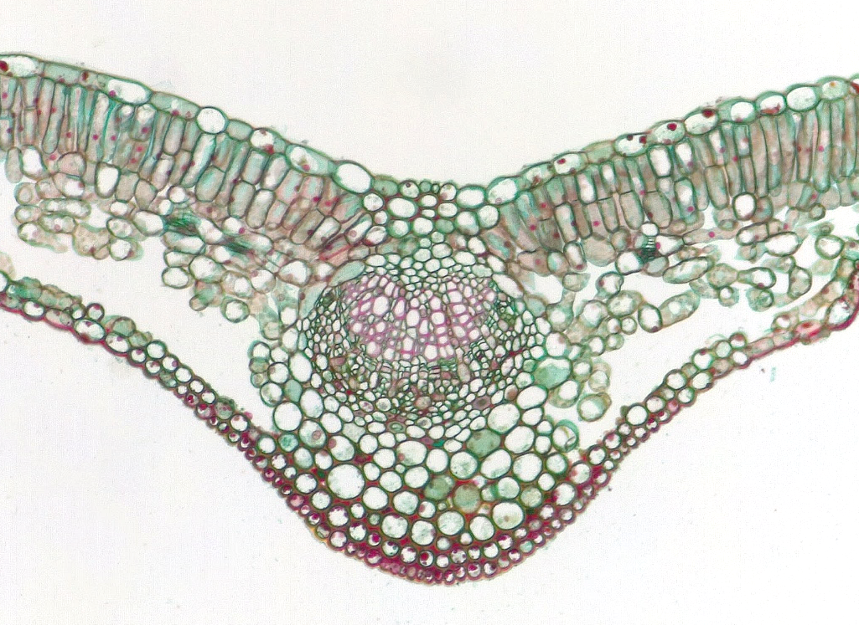
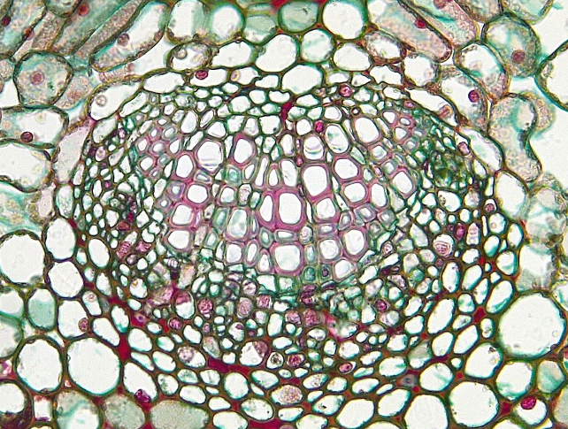
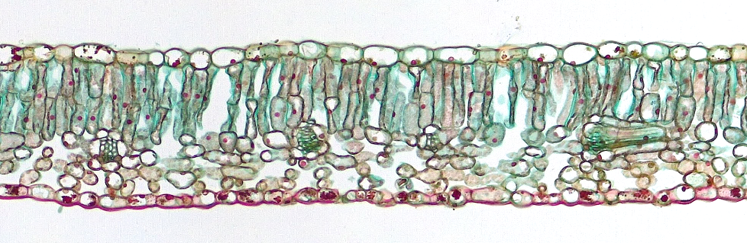
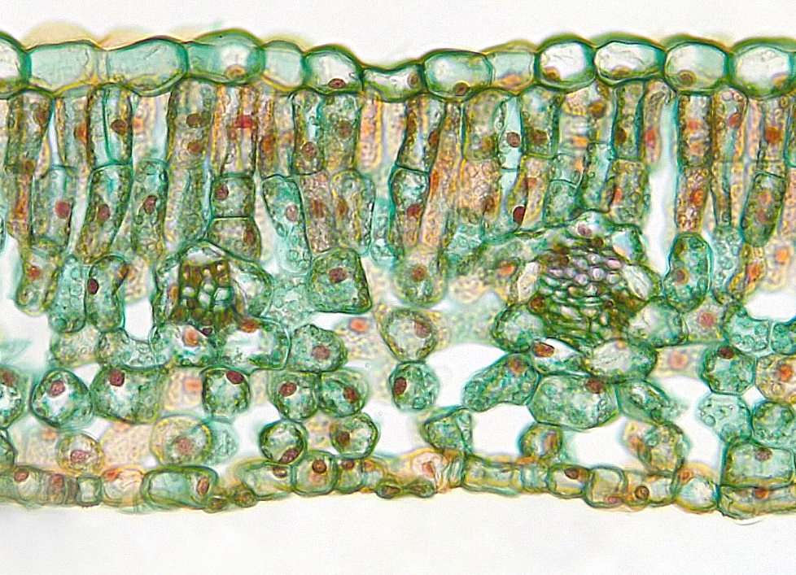
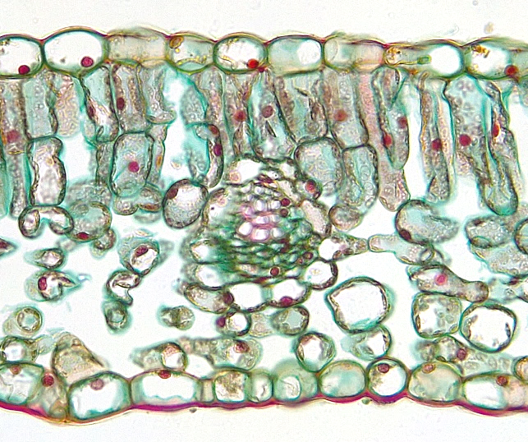
1
Dicot Leaf
Midrib region
Epidermis (adaxial)
Epidermis (abaxial)
Palisade mesophyll
Spongy mesophyll
Vascular bundle
Primary xylem
Primary phloem
Bundle sheath cell
Guard cell
Stoma
Substomatal cavity
2
2
4
4
5
5
6
3
3
Transverse sections
Bar = 100 μm
Horton Lai and Carol Wenzel. 2020
4
2
9
9
6
6
4
7
5
3
5
8
2
2
4
6
9
9
4
6
9
7
5
9
8
12
12
11
9
5
11
3
3
10
10

