Slide 1
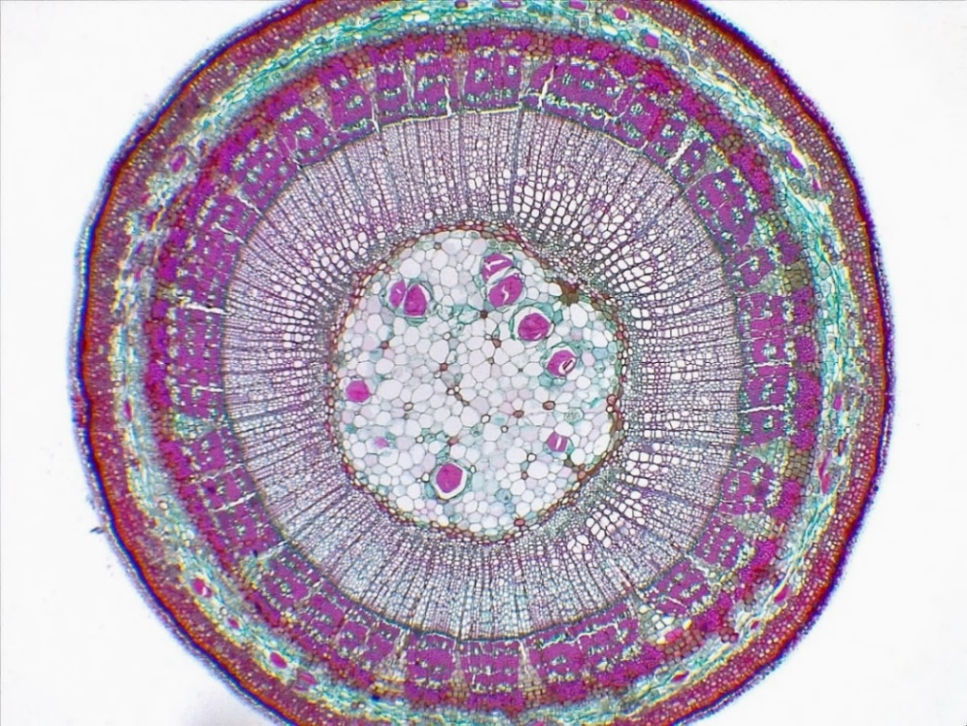
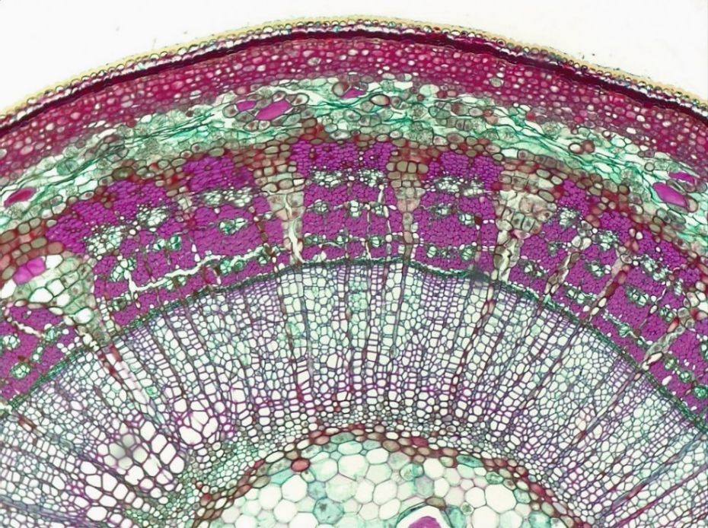
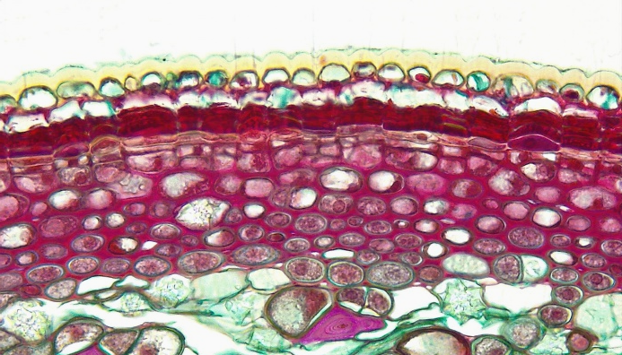
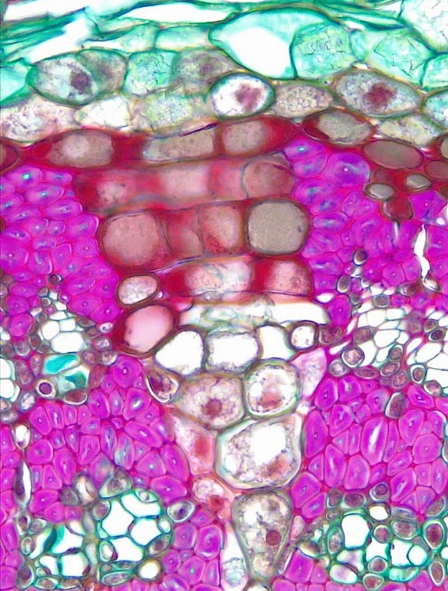
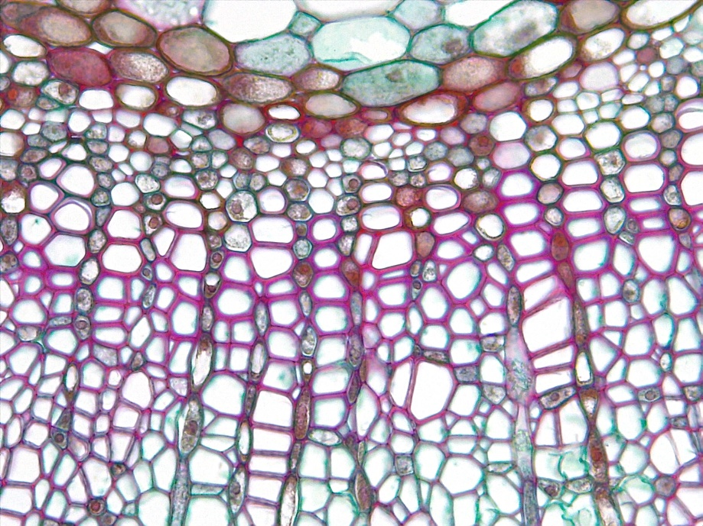
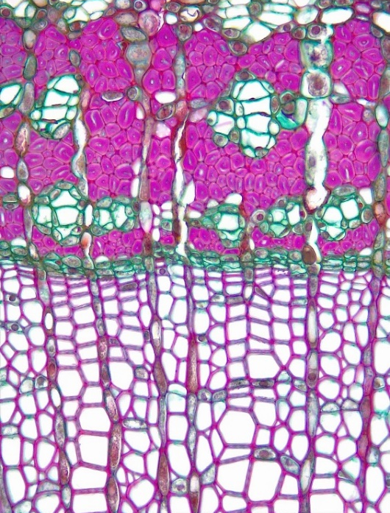
1, 3
Dicot Stem
Tilia (Basswood)
Year 1
1 of 3
6
4
10
10
5
Year
1
Epidermis
Cuticle
Periderm
Outer cortex
Inner cortex
Primary phloem region
Secondary phloem
Secondary phloem fiber
Secondary phloem parenchyma
Vascular cambium
Secondary xylem
Rays
Primary xylem
Pith
14
13
11
7
10
4
3
6
5
6
Transverse sections
7
Bar = 100 μm
Horton Lai and Carol Wenzel. 2020
1
2
10
11
3
4
14
13
5
5
9
9
8
8
11
9
8
8
8
9
12
9
9
10
13
8
8
11
9
9
12
14

Slide 2
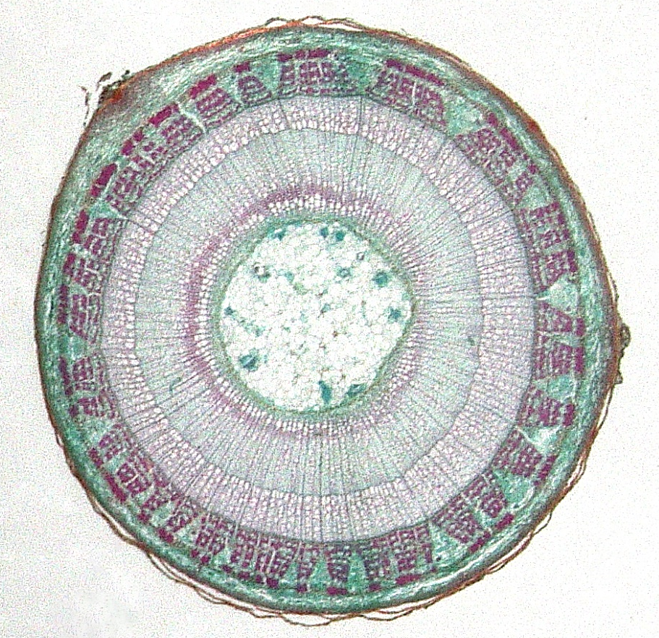
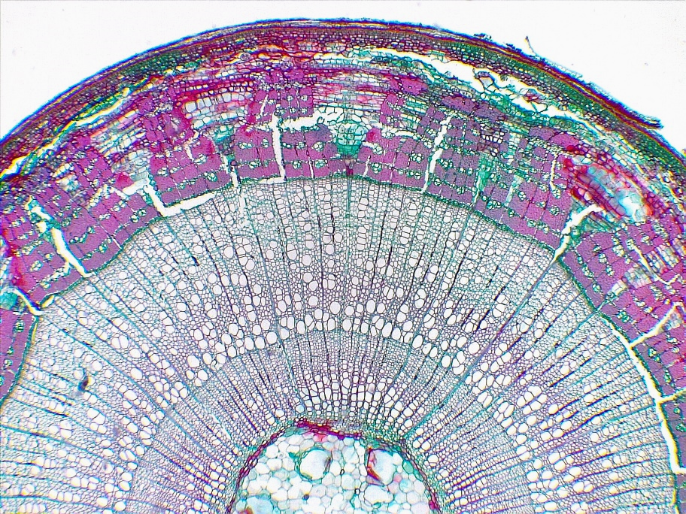
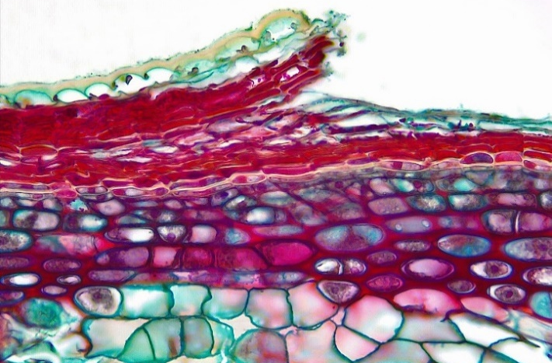
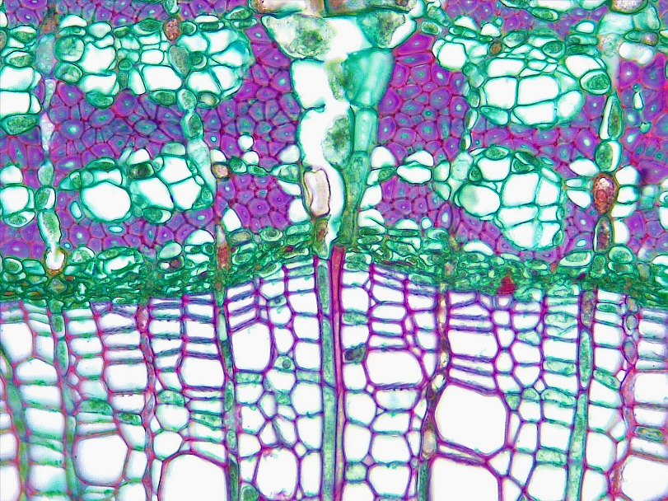
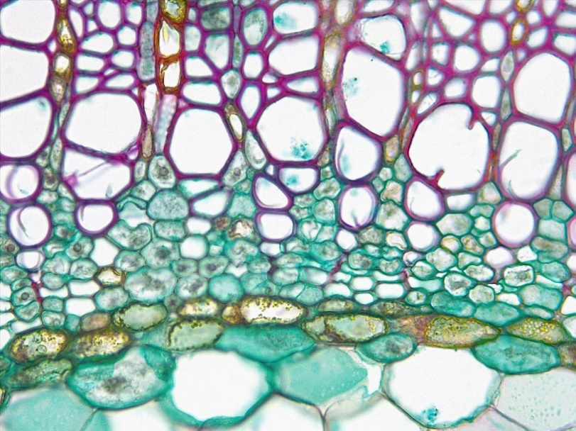
Dicot Stem
Tilia (Basswood)
Year 2
2 of 3
1, 2, 3
9
9
4
Epidermis
Periderm
Outer cortex
Inner cortex
Primary phloem region
Secondary phloem
Secondary phloem fiber
Secondary phloem parenchyma
Vascular cambium
Secondary xylem
Annular ring
Rays
Primary xylem
Pith
Year
1 2
14
10
6
9
5
5
Transverse sections
6
Bar = 100 μm
Horton Lai and Carol Wenzel. 2020
9
1
10
2
11
3
14
4
8
8
8
10
7
7
7
8
8
13
13
13
13
9
10
12
14

Slide 3
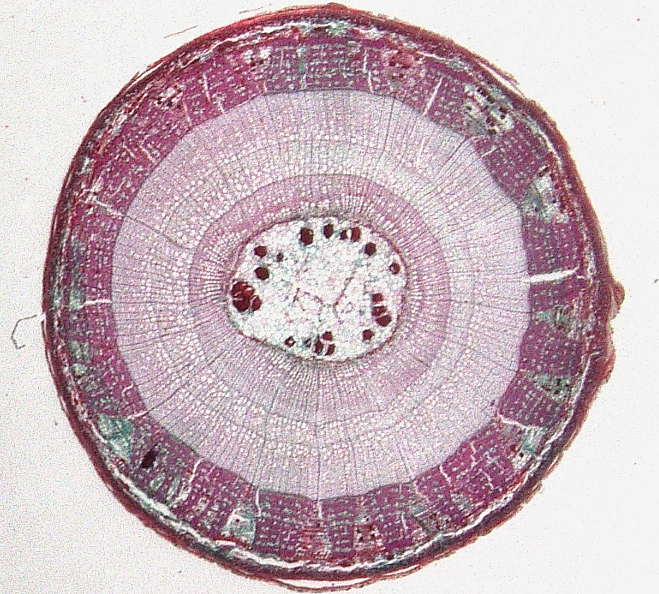
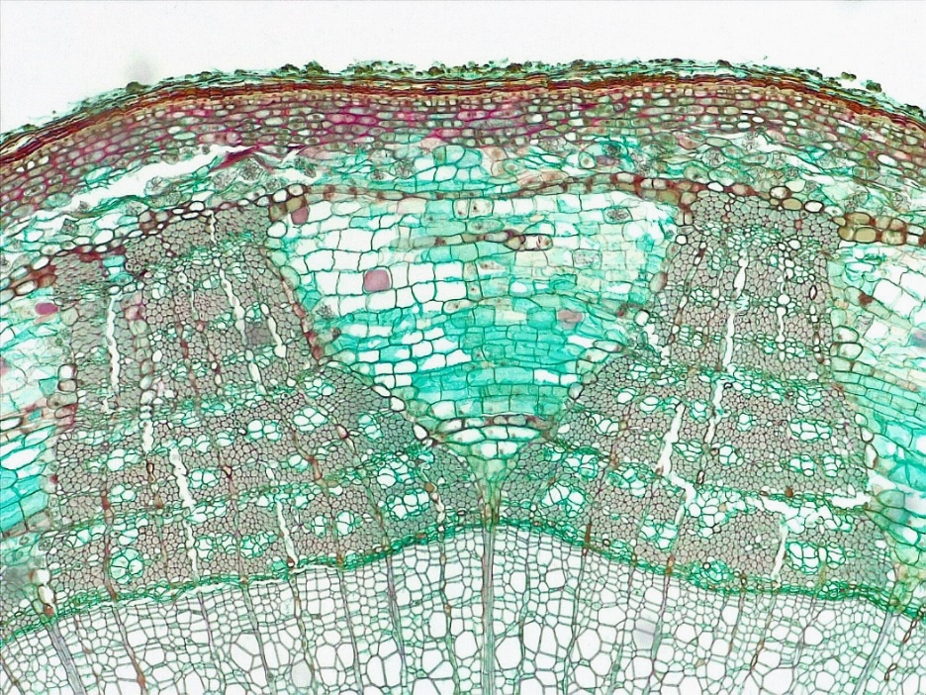
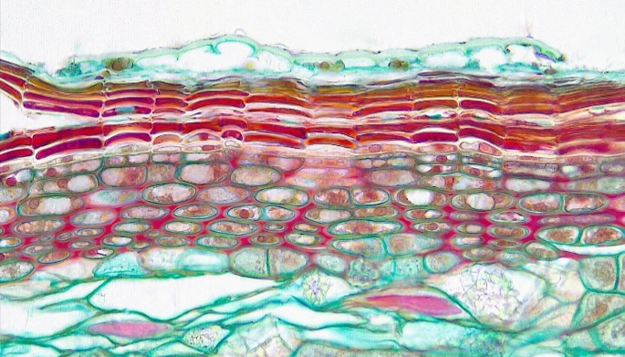
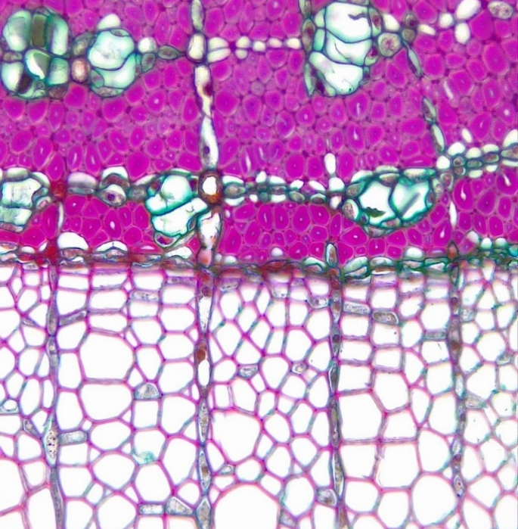
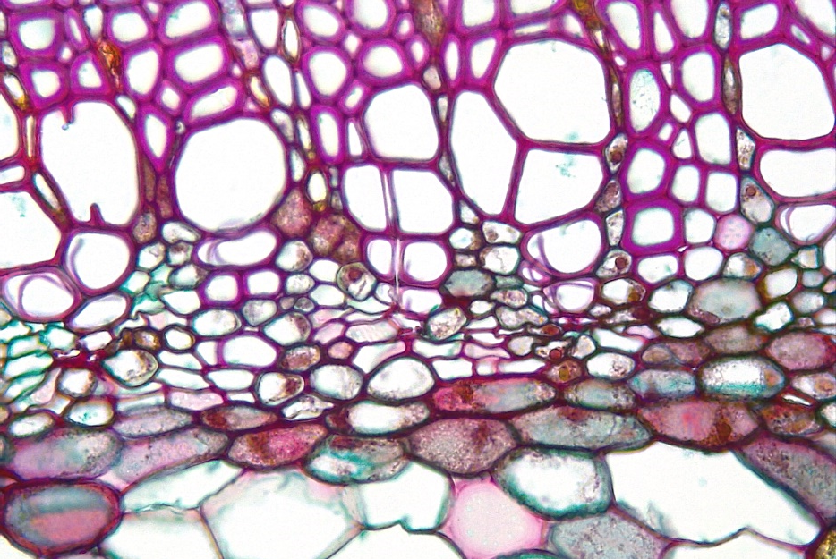
4
Dicot Stem
Tilia (Basswood)
Year 3
3 of 3
1, 2, 3
9
9
Epidermis
Periderm
Outer cortex
Inner cortex
Primary phloem region
Secondary phloem
Secondary phloem fiber
Secondary phloem parenchyma
Vascular cambium
Secondary xylem
Rays
Primary xylem
Pith
Year
1 2 3
13
11
10
6
9
5
3
Transverse sections
4
Bar = 100 μm
Horton Lai and Carol Wenzel. 2020
1
7
8
7
6
6
2
3
10
4
9
8
8
7
7
7
10
7
8
12
12
12
9
10
11
13

