Slide 1
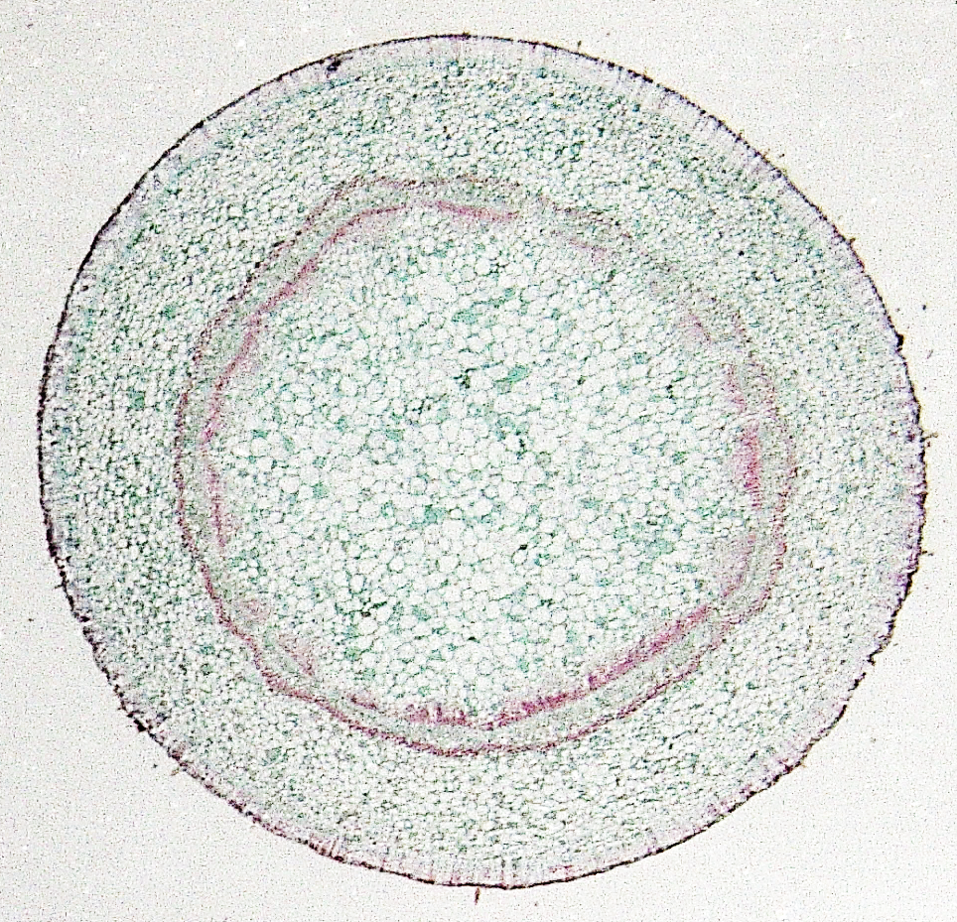
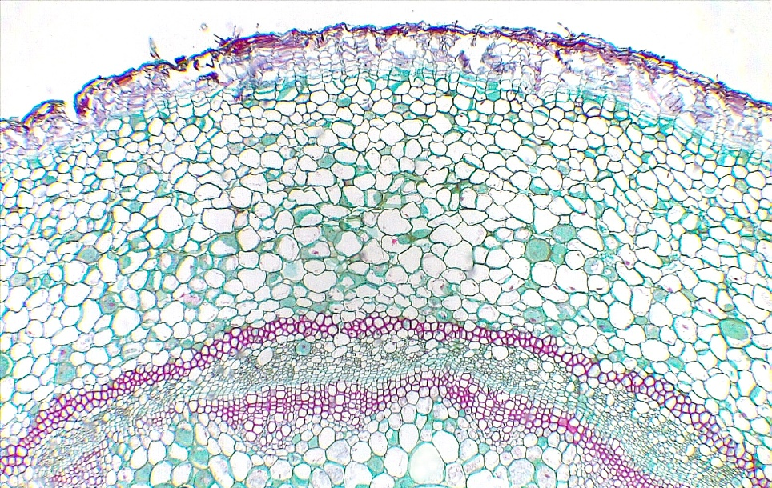
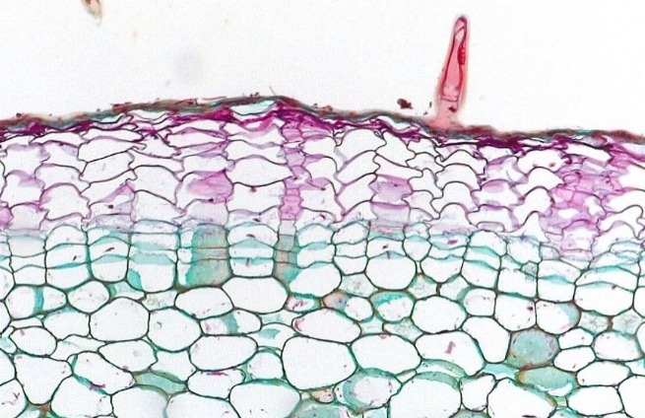
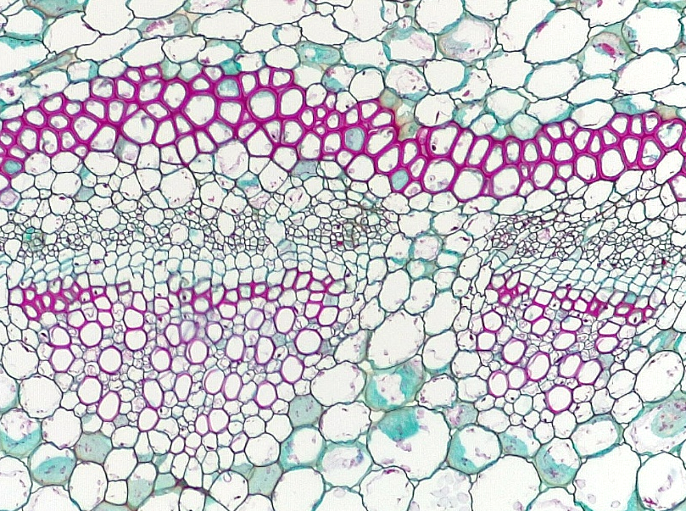
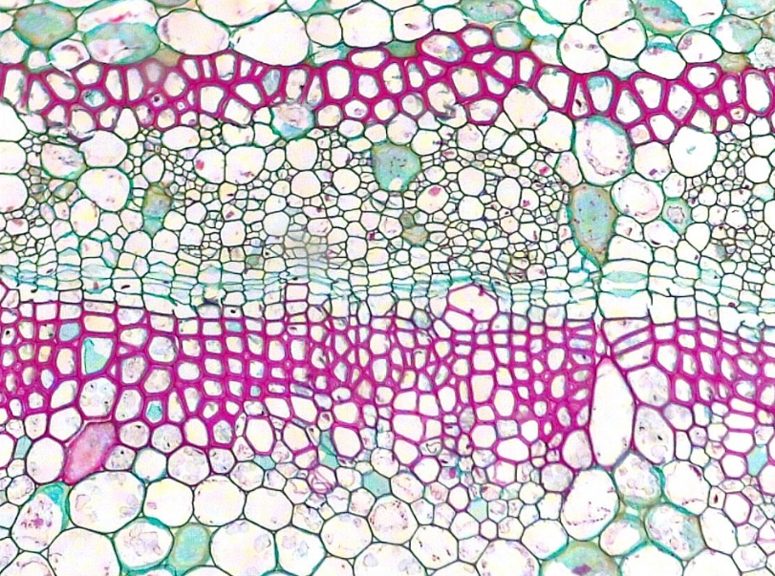
1 of 2
Dicot Stem
Pelargonium (Geranium)
Older
Epidermis
Periderm
Cork (phellem)
Cork cambium (phellogen)
Phelloderm
Cortex
Primary phloem fiber
Primary phloem
Vascular cambium
Secondary xylem
Primary xylem
Pith
12
6
2
Transverse sections
Bar = 200 μm
Horton Lai and Carol Wenzel. 2020
6
1
10
7
8
3
2
4
12
6
5
6
7
6
7
8
8
8
9
8
9
9
8
8
8
10
11
11
11
11
12
11
12

Slide 2
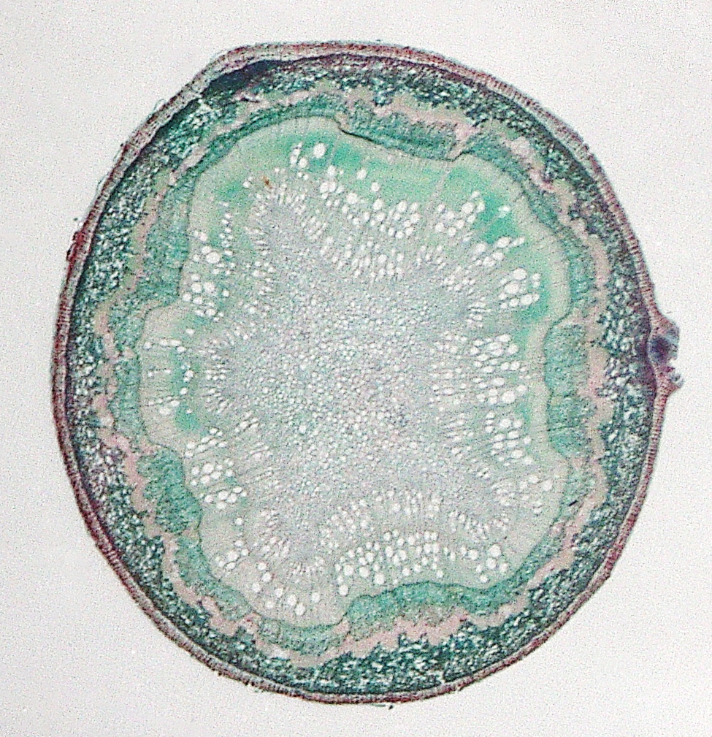
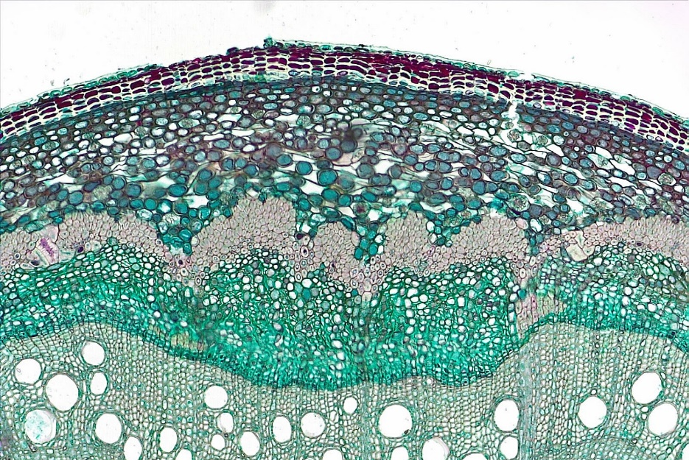
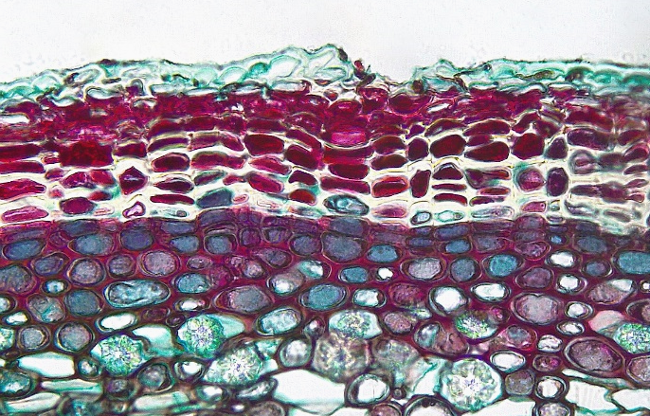
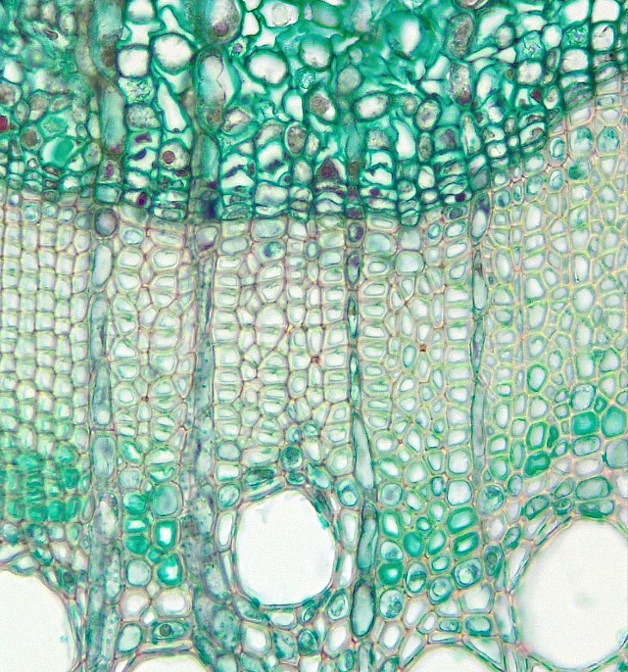
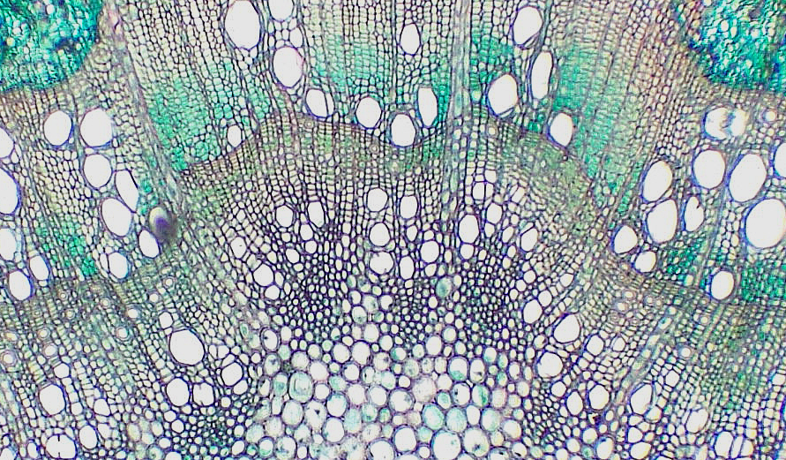
Dicot Stem
Secondary growth
2 of 2
7
4
Epidermis
Periderm
Cortex
Primary phloem fiber
Primary phloem
Secondary phloem
Vascular cambium
Secondary xylem
Tracheid
Xylem vessel element
Rays
Primary xylem
Pith
7
6
5
13
Year
1 2
3
8
7
Transverse sections
Bar = 100 μm
Horton Lai and Carol Wenzel. 2020
1
2
3
2
4
3
5
7
6
8
6
Year
2
7
8
8
9
Year
1
11
12
10
10
13

