Slide 1
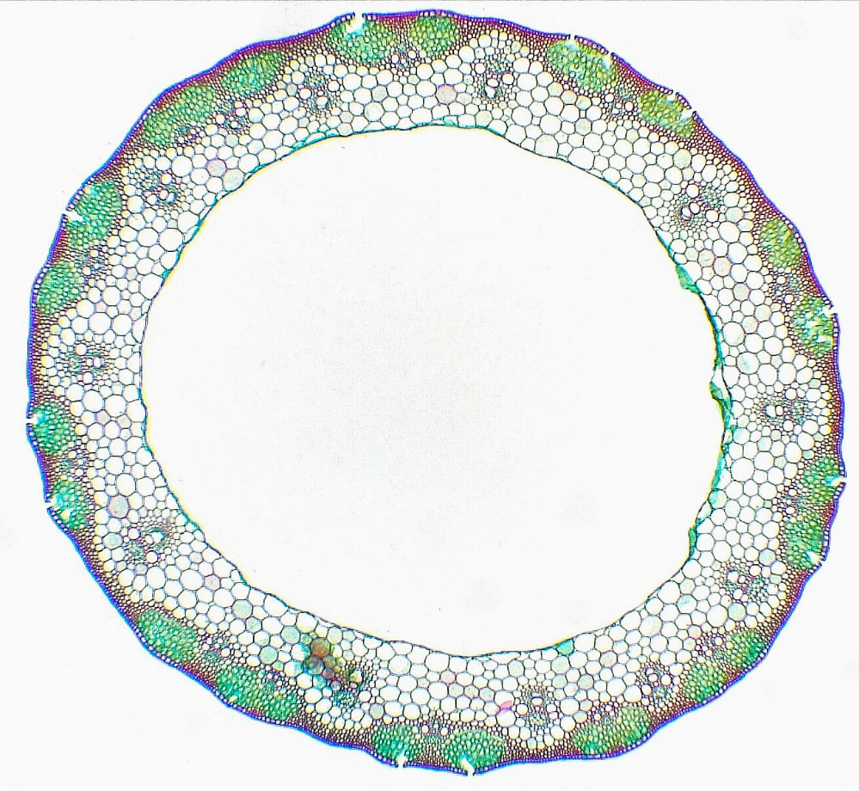
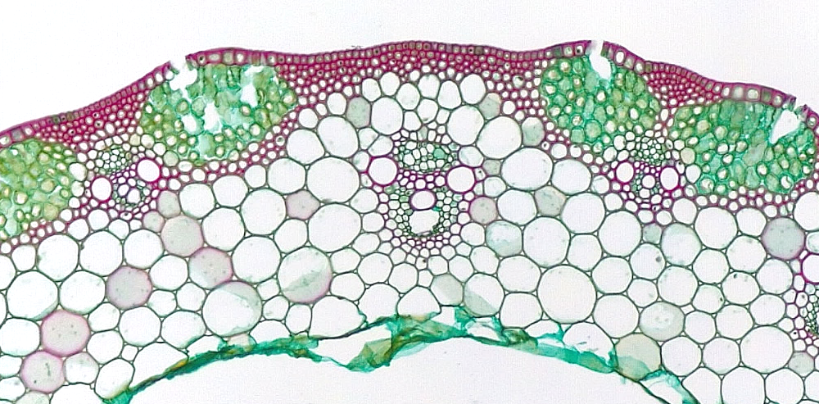
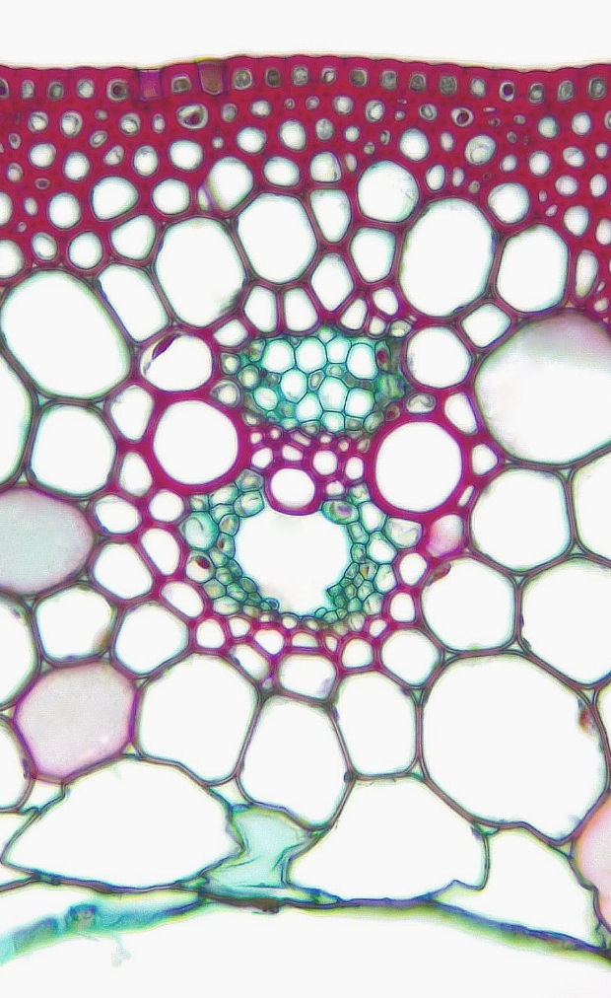
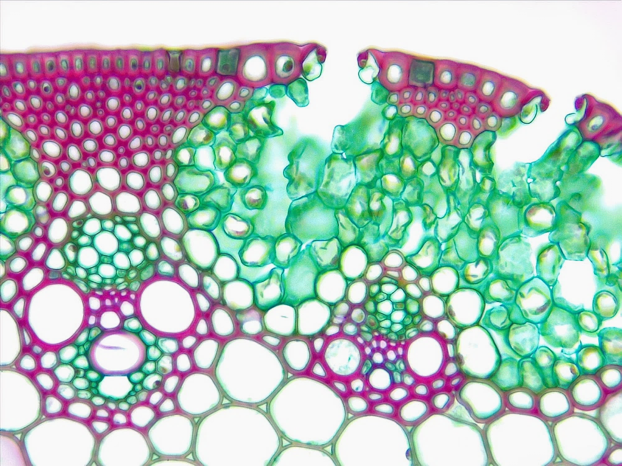
1 of 2
Monocot Stem
Triticum (Wheat)
Mature
5
5
5
Epidermis
Sclerenchyma
Chlorenchyma
Parenchyma
Vascular bundle
Protoxylem
Protoxylem lacuna
Metaxylem
Xylem parenchyma
Primary phloem
Pith region
Pith cell remnant
Stoma
Substomatal cavity
4
11
2
3
Transverse sections
5
3
Bar = 100 μm
Horton Lai and Carol Wenzel. 2020
5
1
12
4
2
2
11
13
1
13
10
2
14
8
14
6
8
3
9
7
9
10
8
8
10
4
6
8
6
8
12
7
9
9
4
11

Slide 2
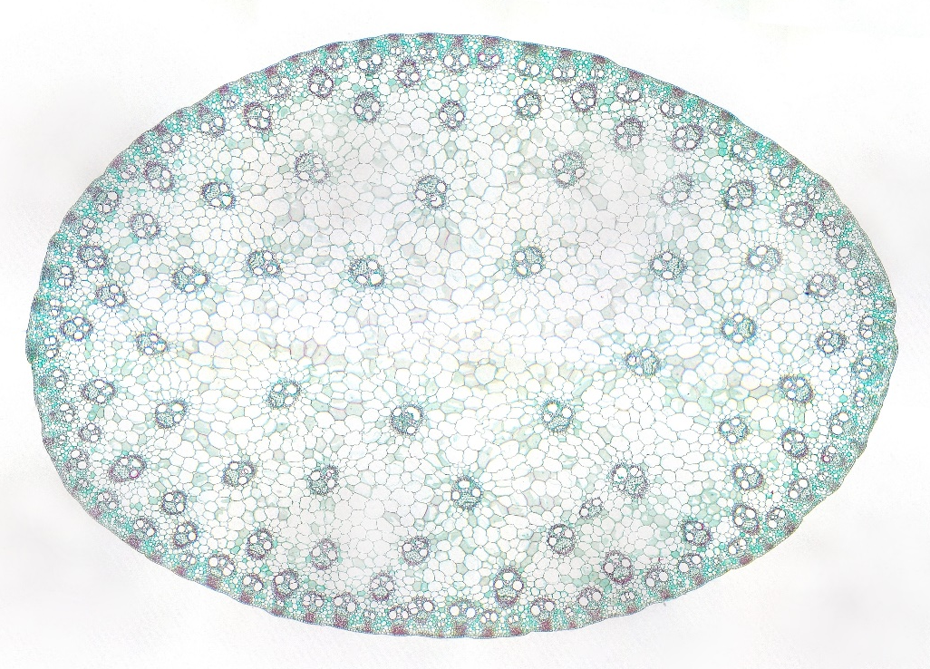
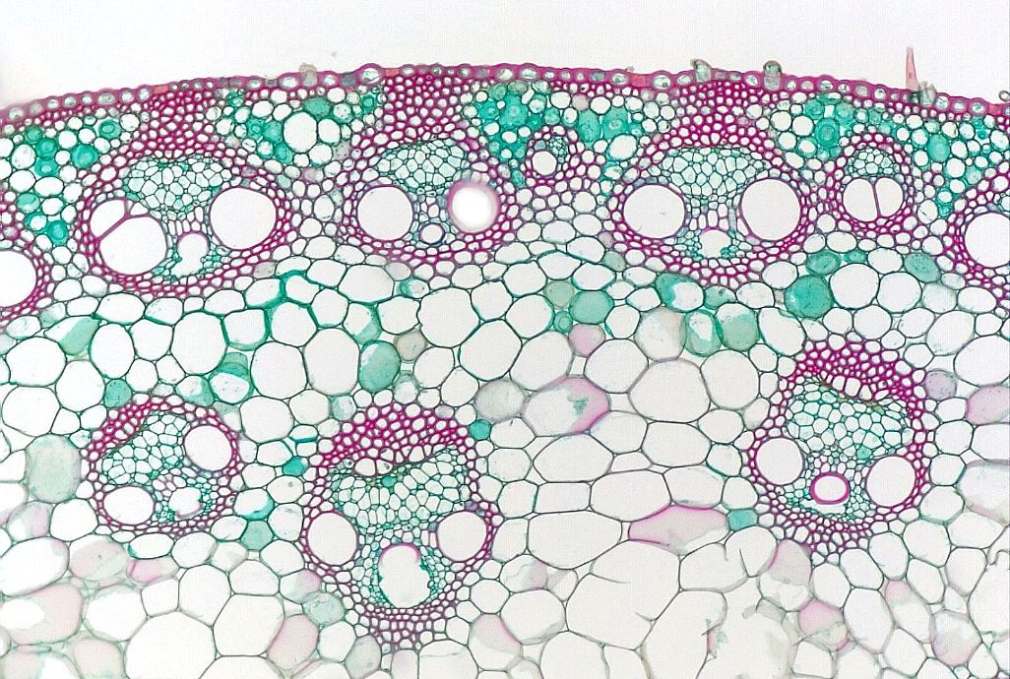
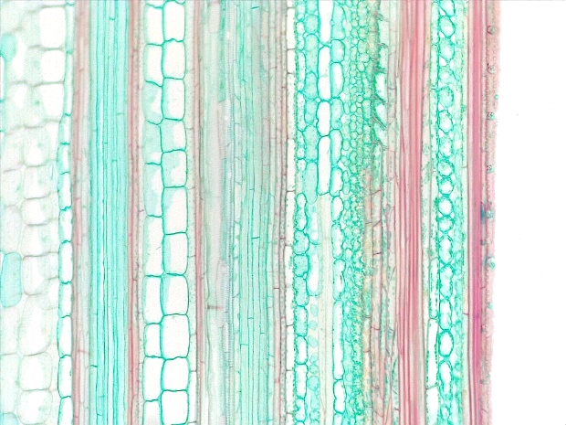
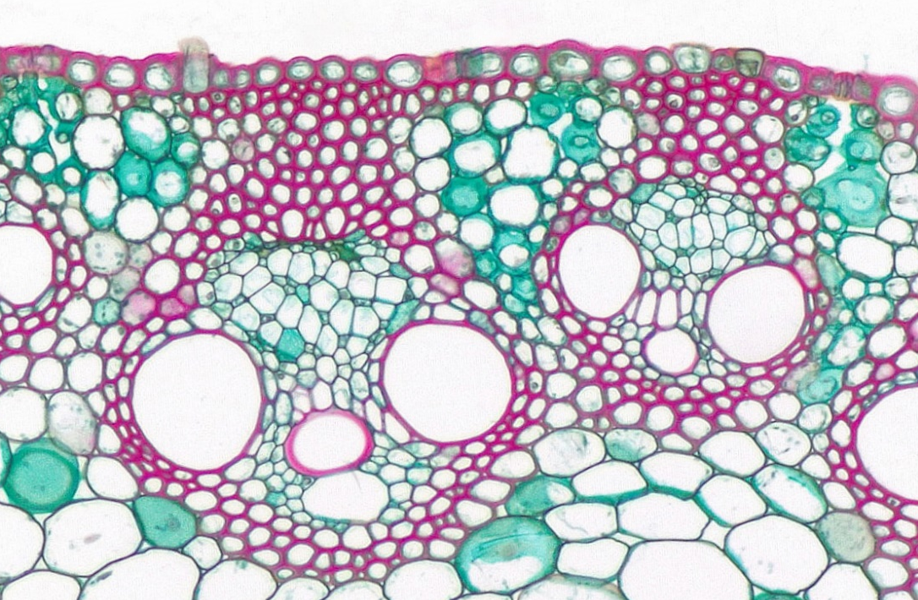
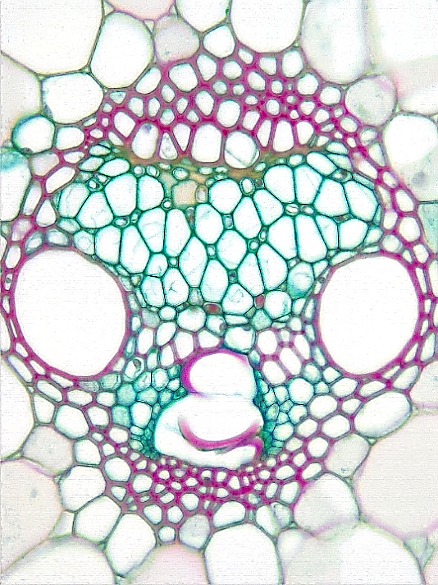
2 of 2
Monocot Stem
Zea mays (Corn)
Epidermis
Chlorenchyma
Parenchyma
Vascular bundle
Protoxylem
Protoxylem lacuna
Metaxylem
Xylem parenchyma
Primary phloem
Sclerenchyma
3
4
1
2
Transverse sections
unless otherwise stated
2
2
4
Bar = 200 μm
Horton Lai and Carol Wenzel. 2020
4
3
2
1
3
2
4
3
4
4
4
Longitudinal
1
3
10
10
2
10
2
2
9
9
9
7
7
7
7
7
5
8
6
8
7
8
5
8
6
3

