Slide 1
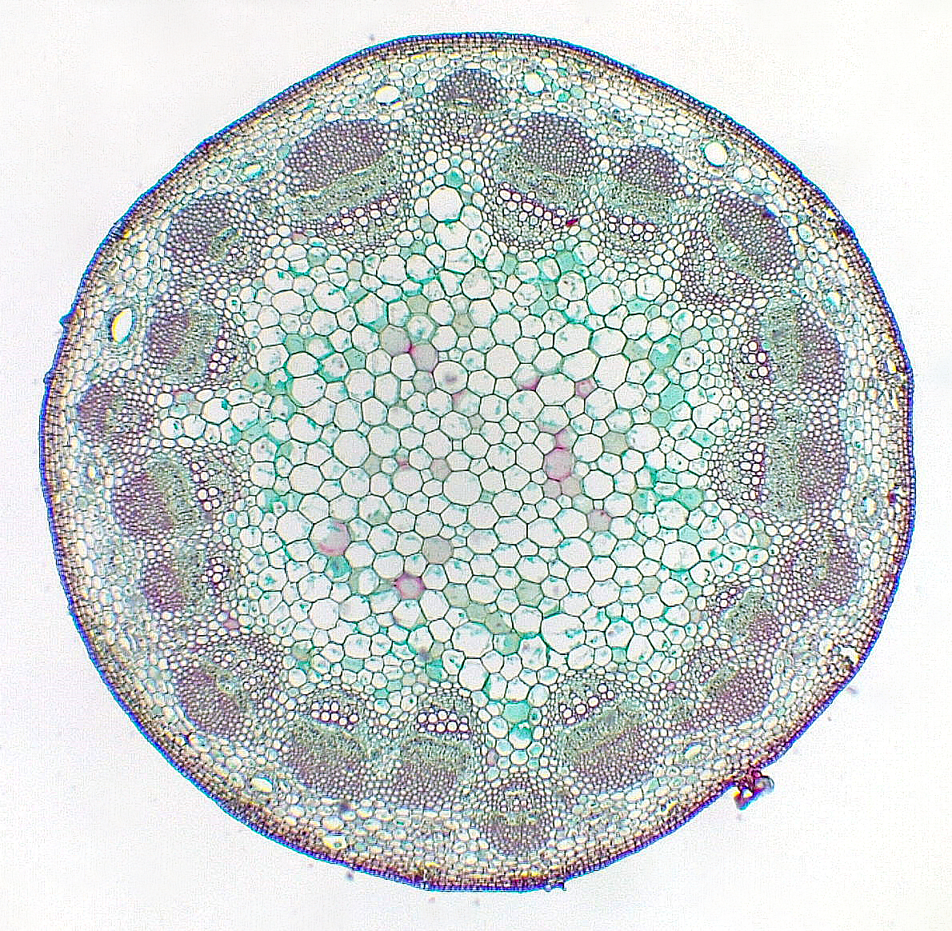
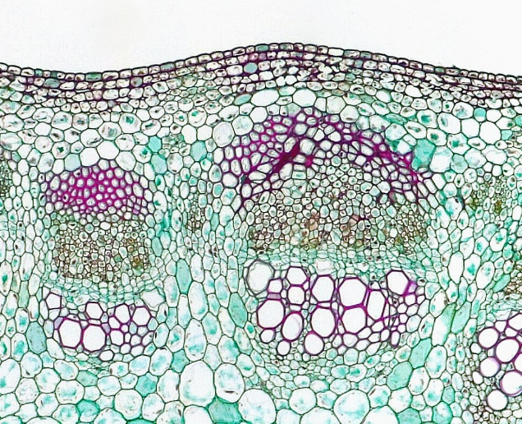
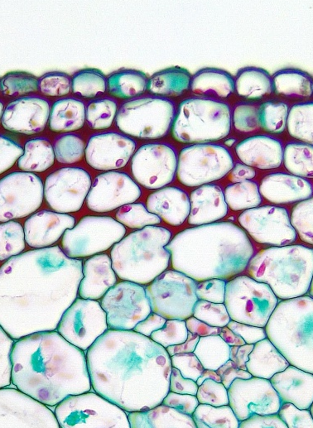
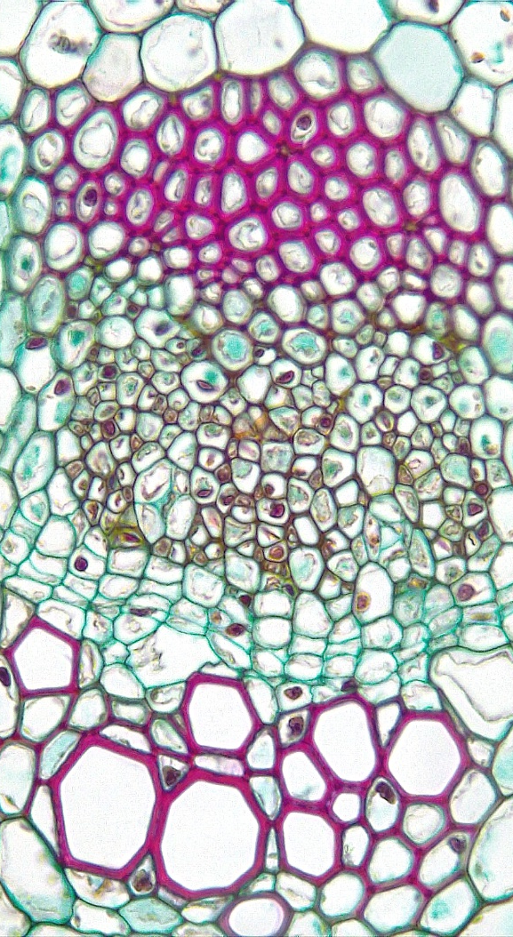
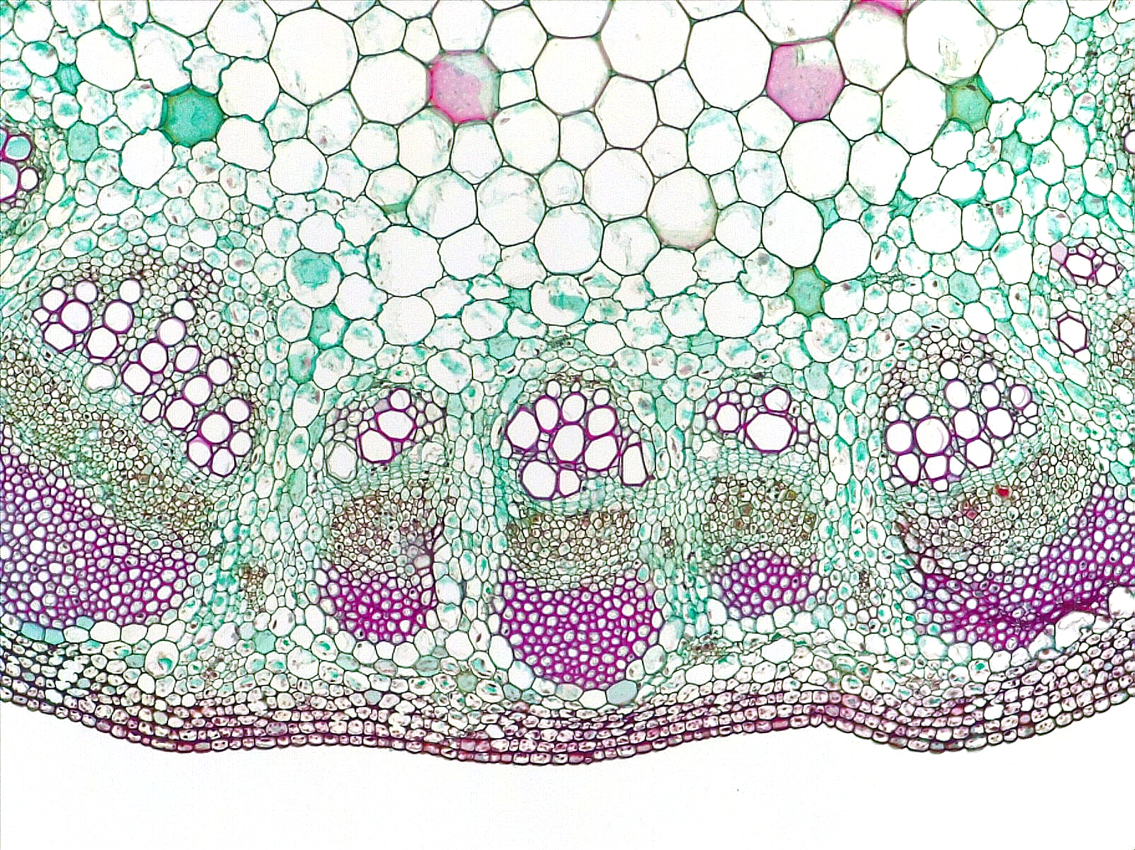
1 of 3
Dicot Stem
Helianthus (Sunflower)
4
4
3
Epidermis
Collenchyma
Cortex
Vascular bundle
Primary xylem
Primary phloem
Primary phloem fiber
Fascicular cambium
Interfascicular cambium
Pith
10
4
Transverse sections
2
1
1
Bar = 100 μm
Horton Lai and Carol Wenzel. 2020
3
7
2
3
7
6
6
4
4
7
10
5
3
5
7
6
6
8
9
8
9
5
5
5
5
5
5
10

Slide 2
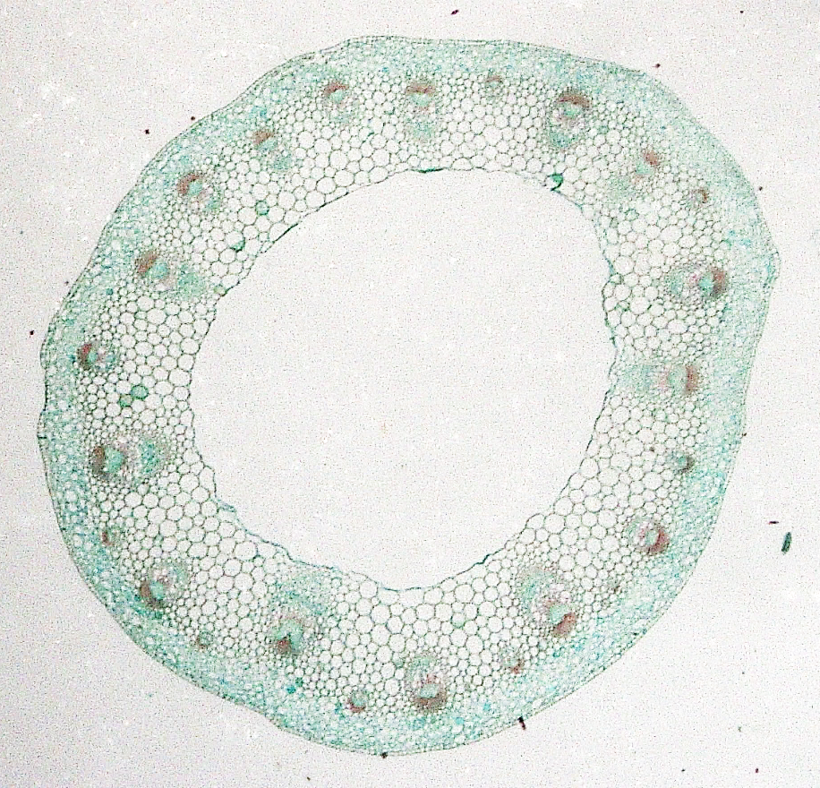
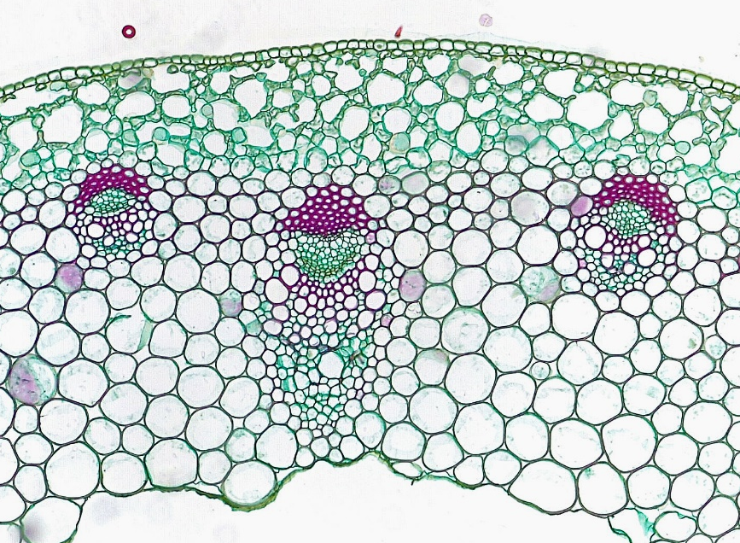
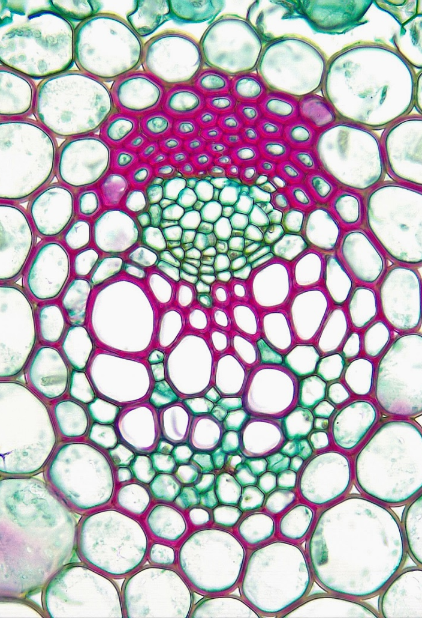
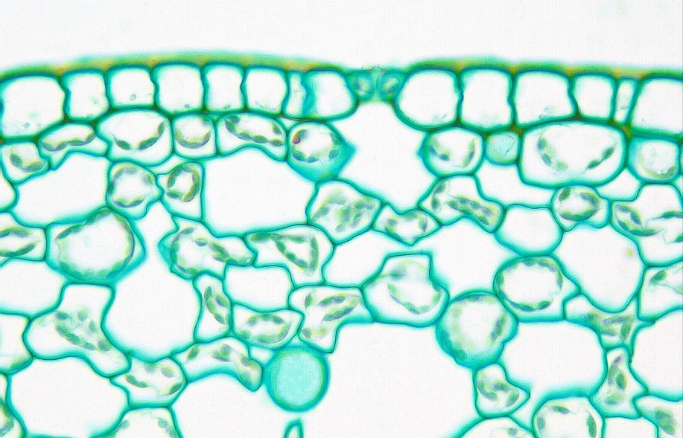
2 of 3
Dicot Stem
3
Epidermis
Cortex
Vascular bundle
Protoxylem
Metaxylem
Xylem parenchyma
Primary phloem
Primary phloem fiber
Fascicular cambium
Pith region
Pith cell remnant
Guard cell
Stoma
Substomatal cavity
10
2
1
2
Transverse sections
3
Bar = 100 μm
Horton Lai and Carol Wenzel. 2020
2
3
8
11
10
7
12
9
1
1
1
1
1
5
9
5
5
14
13
4
4
4
2
6

Slide 3
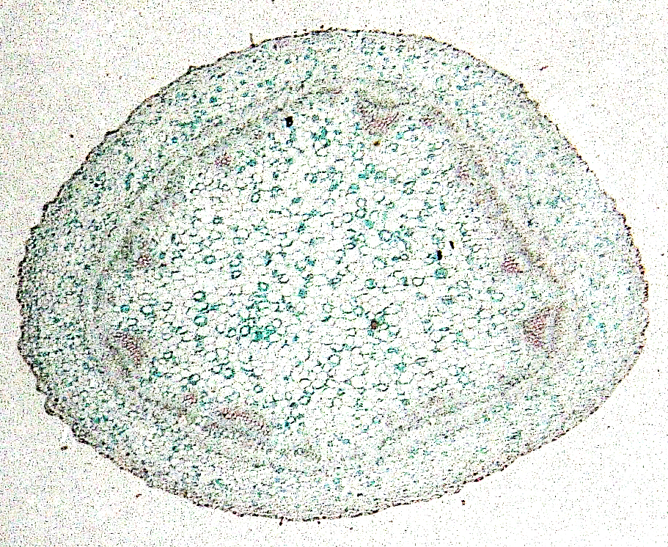
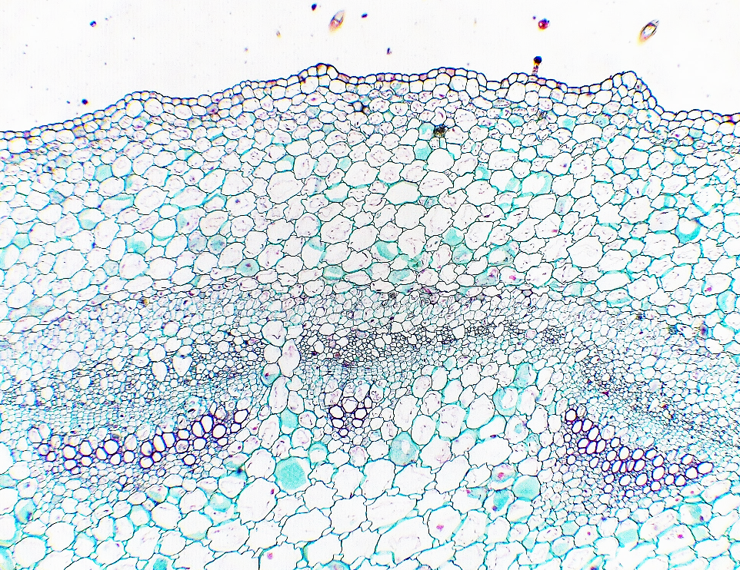
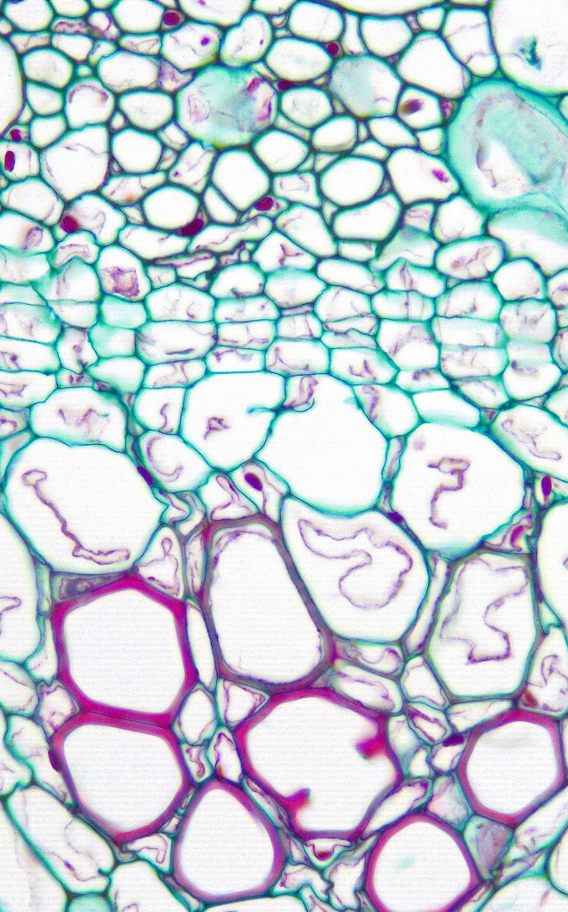
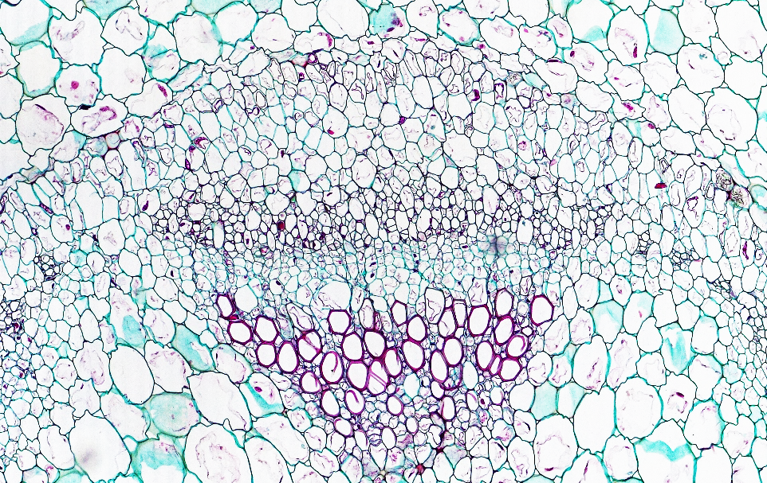
3 of 3
Dicot Stem
Pelargonium (Geranium)
Immature
Epidermis
Cortex
Vascular bundle
Primary xylem
Protoxylem
Immature metaxylem
Mature metaxylem
Primary phloem
Fascicular cambium
Interfascicular cambium
Pith
11
2
1
2
Transverse sections
Bar = 100 μm
Horton Lai and Carol Wenzel. 2020
8
8
3
8
3
9
9
4
11
4
9
2
6
6
6
9
9
10
6
10
8
7
7
7
7
7
5
11

