Slide 1
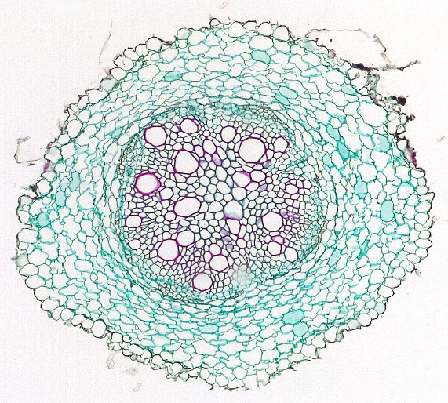
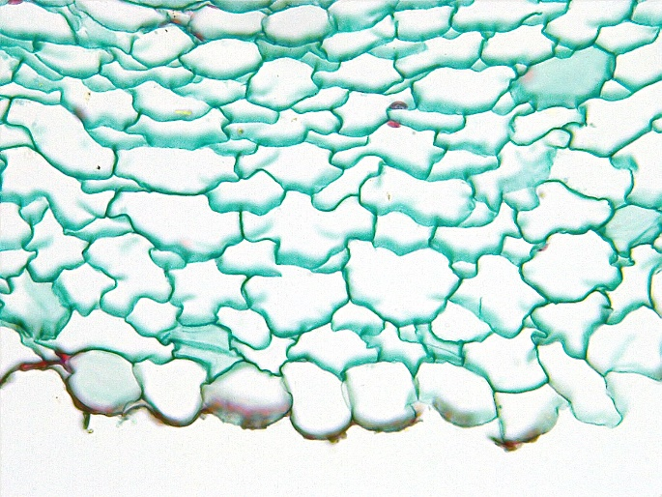
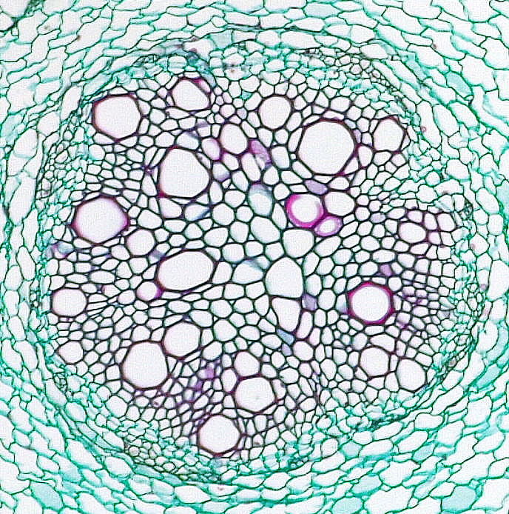
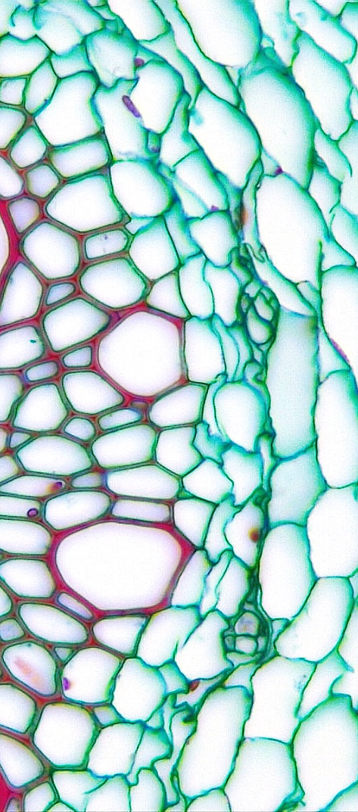
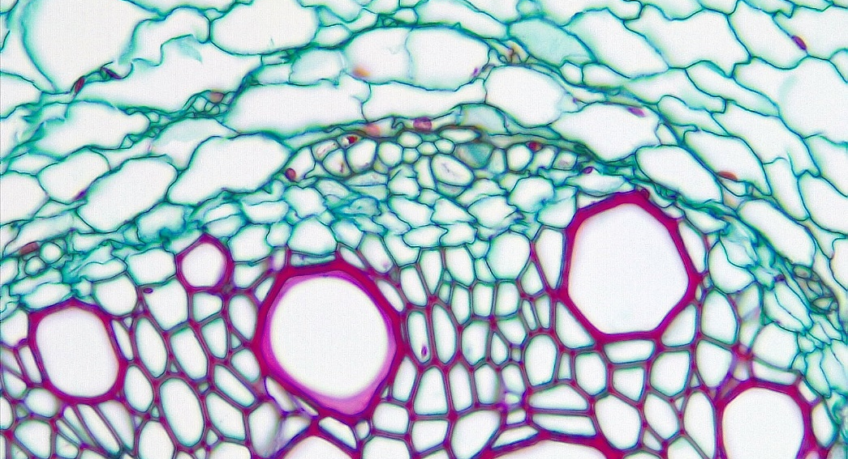
1 of 2
1
1
1
Dicot Root
Helianthus (Sunflower)
3
2
Epidermis
Cortex
Vascular cylinder (stele)
Primary phloem
Vascular cambium
Xylem vessel element
2
5
4
2
4
5
Transverse sections
6
6
Bar = 50 μm
Horton Lai and Carol Wenzel. 2020
6
6
2
6
4
6
6
5
4
5
2
5
4
6
5
6
6
2

Slide 2
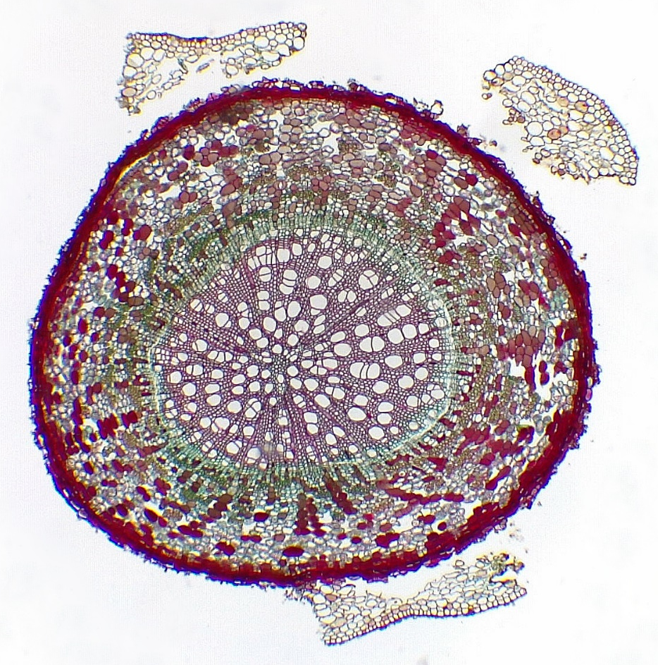
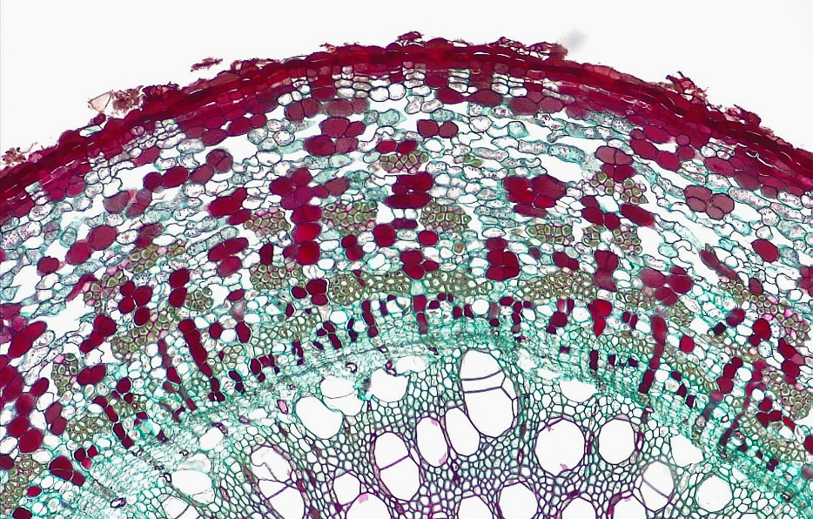
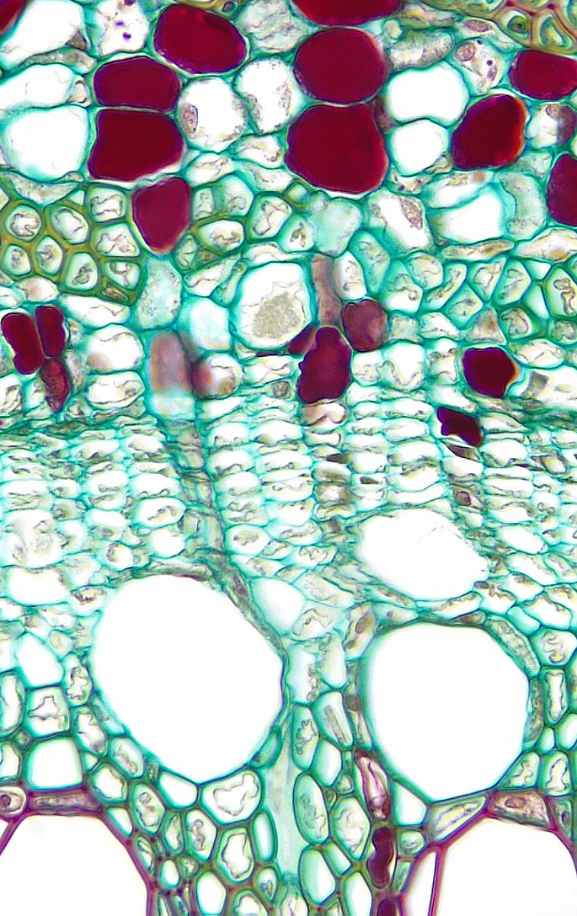
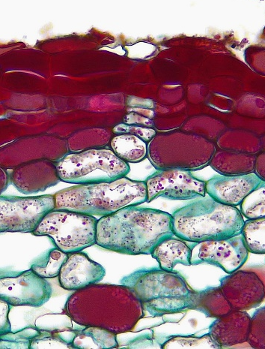
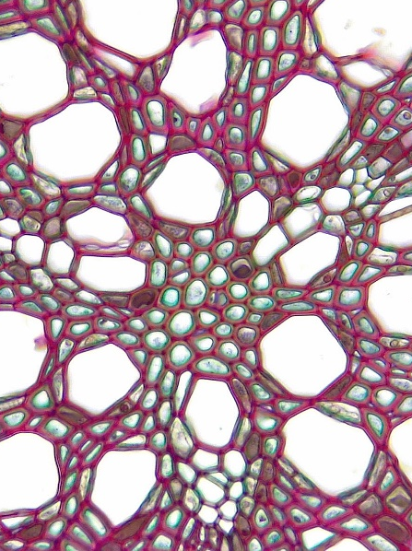
1
2 of 2
1
Dicot Root
Secondary growth
2
Epidermis & cortex remnant
Periderm
Secondary phloem
Secondary phloem fiber
Secondary phloem parenchyma
5*. Secondary phloem parenchyma,
filled with 2° metabolites
Vascular cambium
Secondary xylem
Tracheid
Xylem vessel element
Primary xylem
6
6
7
3
6
1
2
Transverse sections
Bar = 100 μm
Horton Lai and Carol Wenzel. 2020
3
5*
5*
5
5
5*
5
5*
4
4
6
7
6
2
9
9
9
10
8
8
9
9
8
9
9
8
7
3
8
8
8

