Slide 1
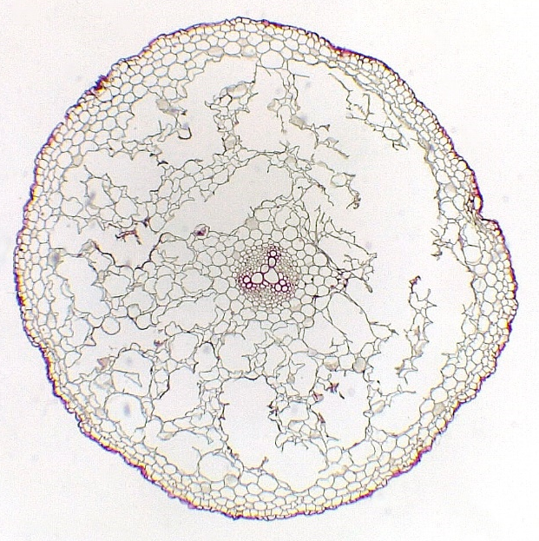
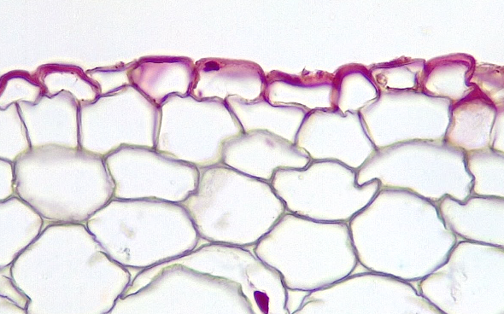
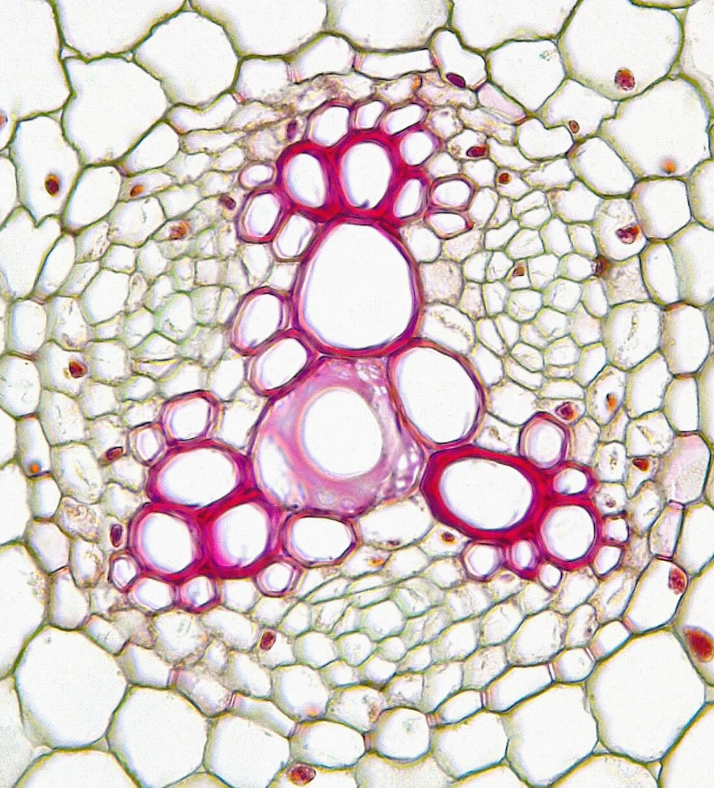
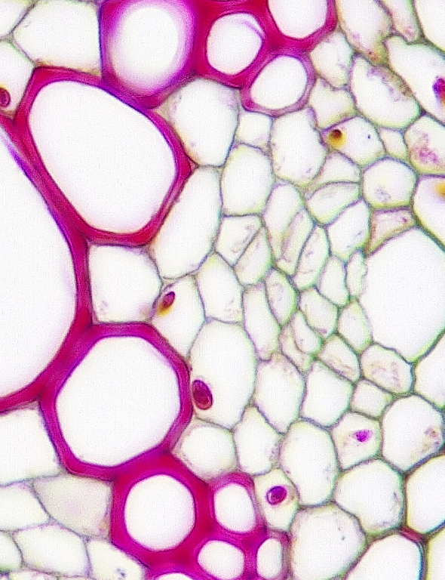
1 of 3
Dicot Root
Ranunculus (Buttercup)
Immature
Epidermis
Hypodermis
Cortex
Endodermis
Vascular cylinder (stele)
Pericycle
Primary phloem
Vascular cambium
Protoxylem
Metaxylem
3
5
3
Transverse sections
Broken cortex
Bar = 50 μm
Horton Lai and Carol Wenzel. 2020
4
3
1
1
1
6
2
2
2
2
6
9
4
9
3
7
10
8
7
9
9
10
10
10
9
9
9
9
10
8
7
8
7
10
6
4
9

Slide 2
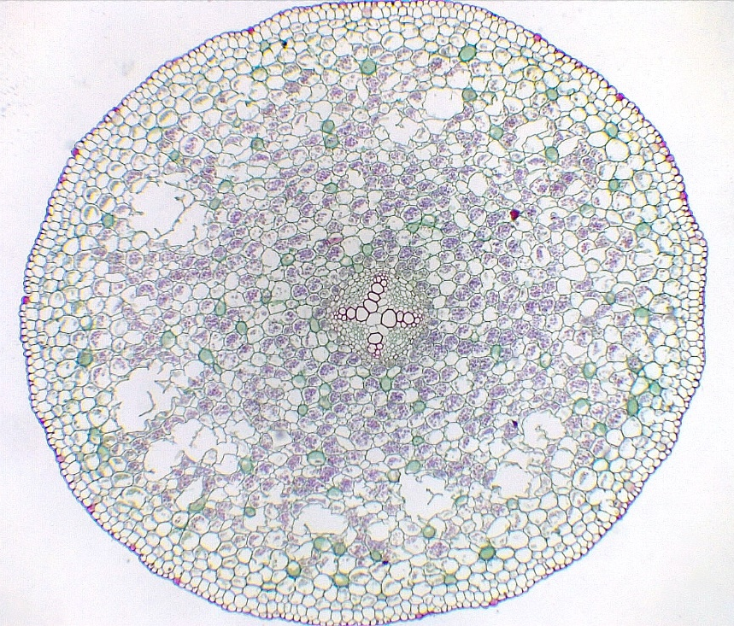
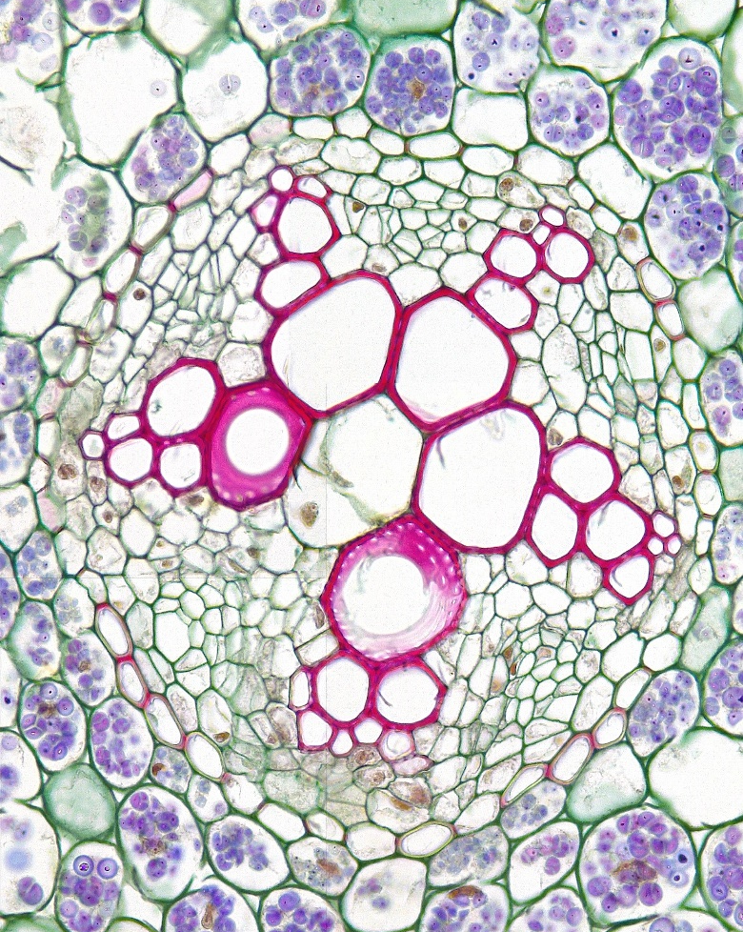
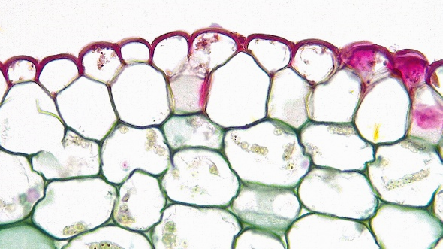
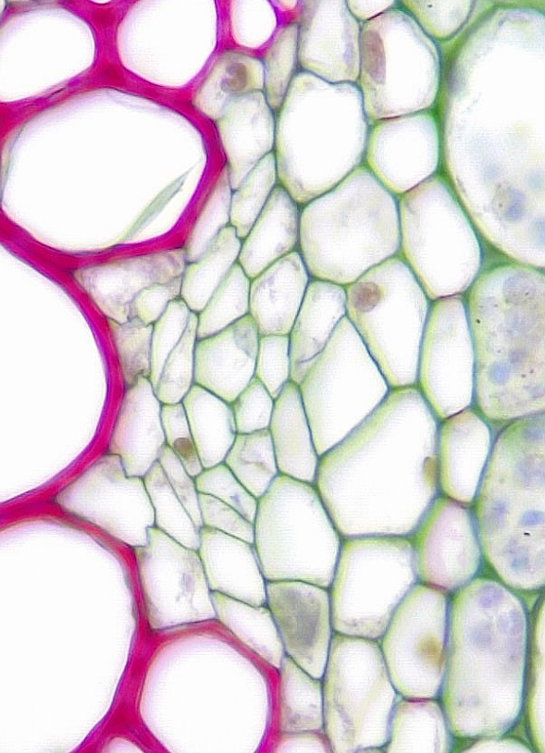
2 of 3
Dicot Root
Ranunculus (Buttercup)
Mature
3
Epidermis
Hypodermis
Cortex
Endodermis
Vascular cylinder (stele)
Pericycle
Primary phloem
Vascular cambium
Protoxylem
Metaxylem
5
Transverse sections
3
Bar = 100 μm
Horton Lai and Carol Wenzel. 2020
6
1
1
1
4
7
2
2
2
9
9
4
3
10
10
7
9
8
9
10
10
9
6
4
9
10
6
7
8
4
3
8
9
7
8
7
9
6
4
6
4
6
4
4
10
9

Slide 3
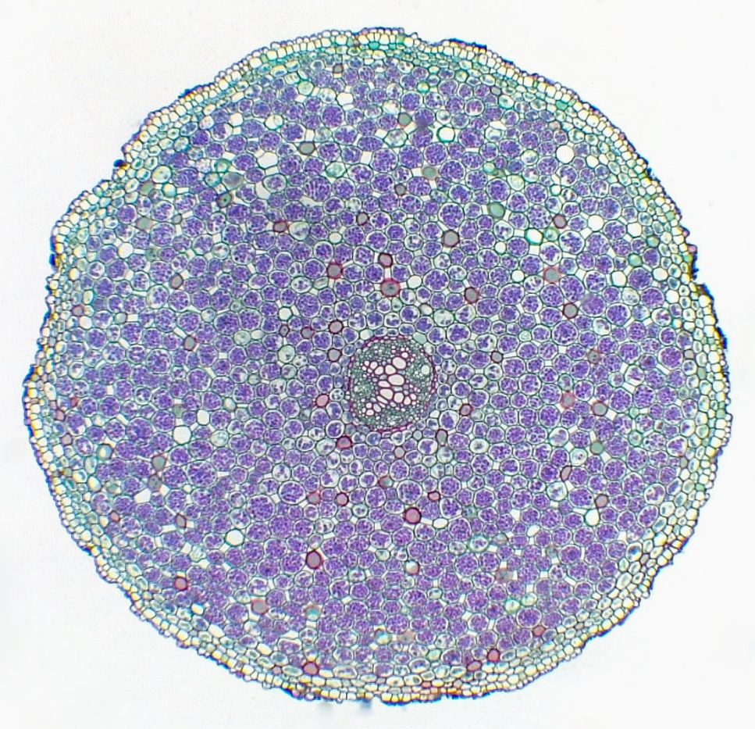
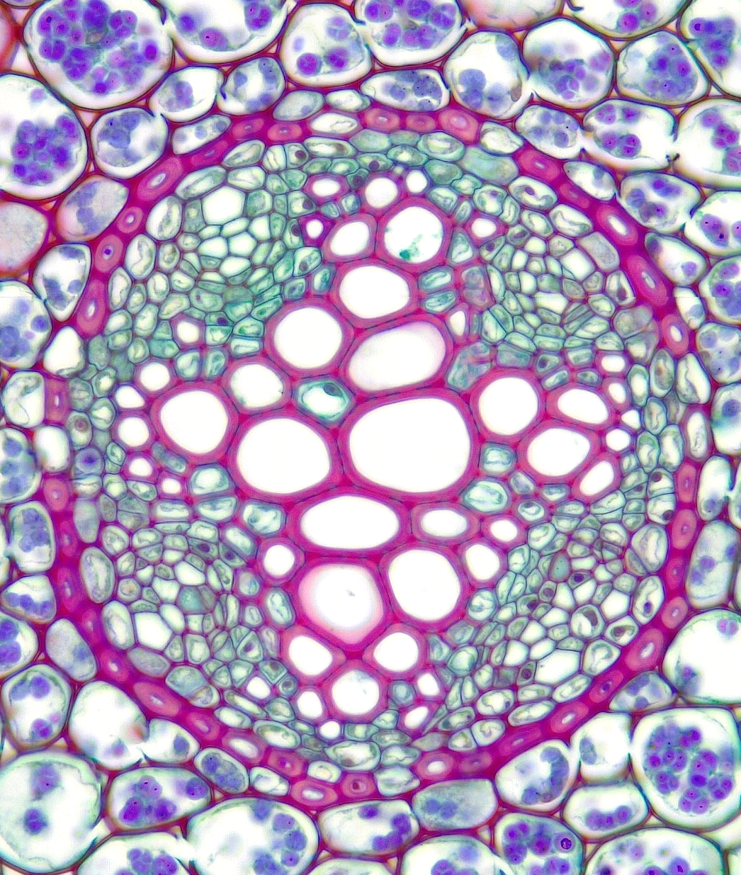
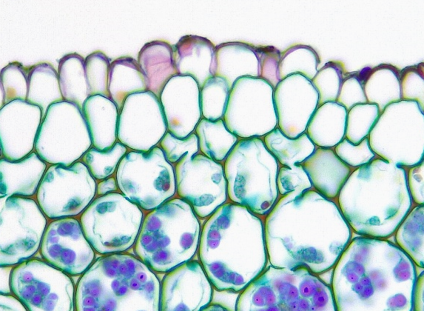
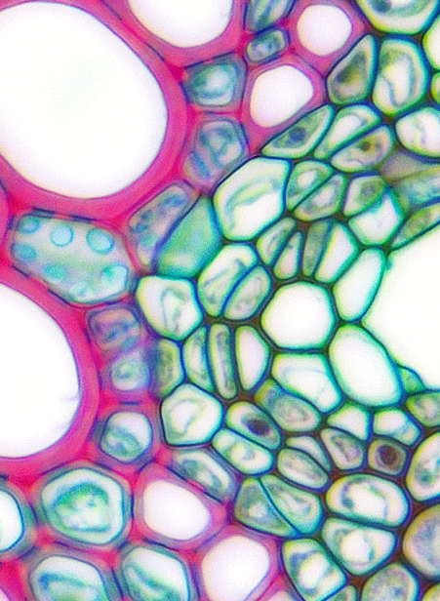
Dicot Root
Primary Growth
3 of 3
3
Epidermis
Hypodermis
Cortex
Endodermis
Passage cell
Vascular cylinder (stele)
Pericycle
Primary phloem
Vascular cambium
Protoxylem
Metaxylem
6
Transverse sections
Bar = 50 μm
Horton Lai and Carol Wenzel. 2020
4
1
1
1
3
7
5
2
2
2
2
4
8
4
3
9
8
11
9
5
10
5
10
11
10
11
11
10
9
11
8
9
8
8
9
10
11
8
7
7
10
4
5
10

