Slide 1
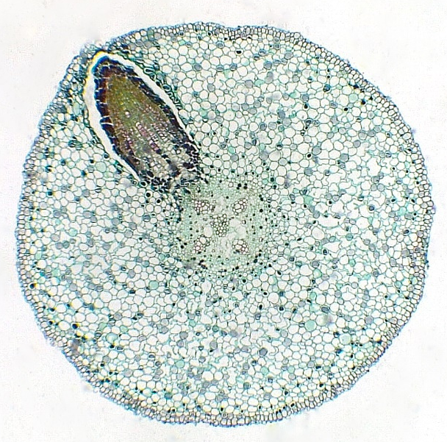
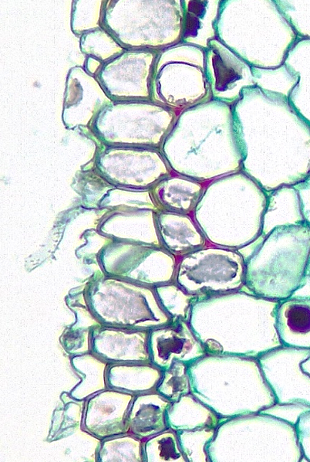
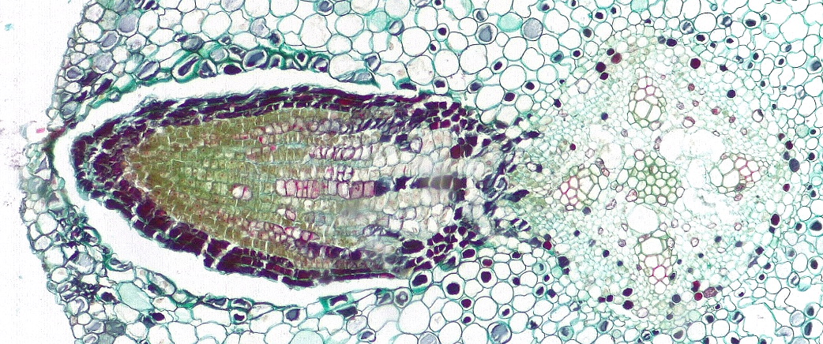
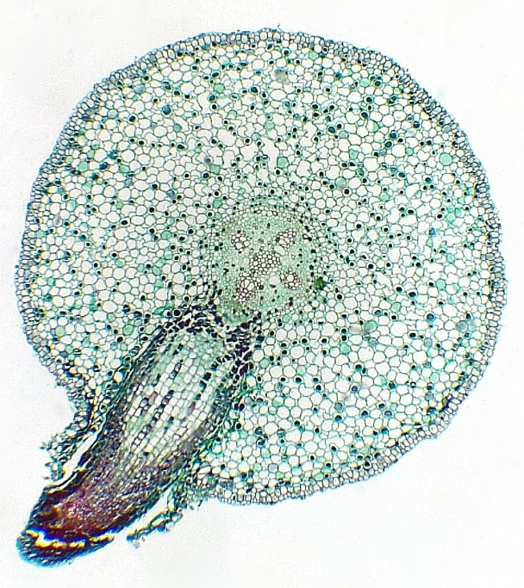
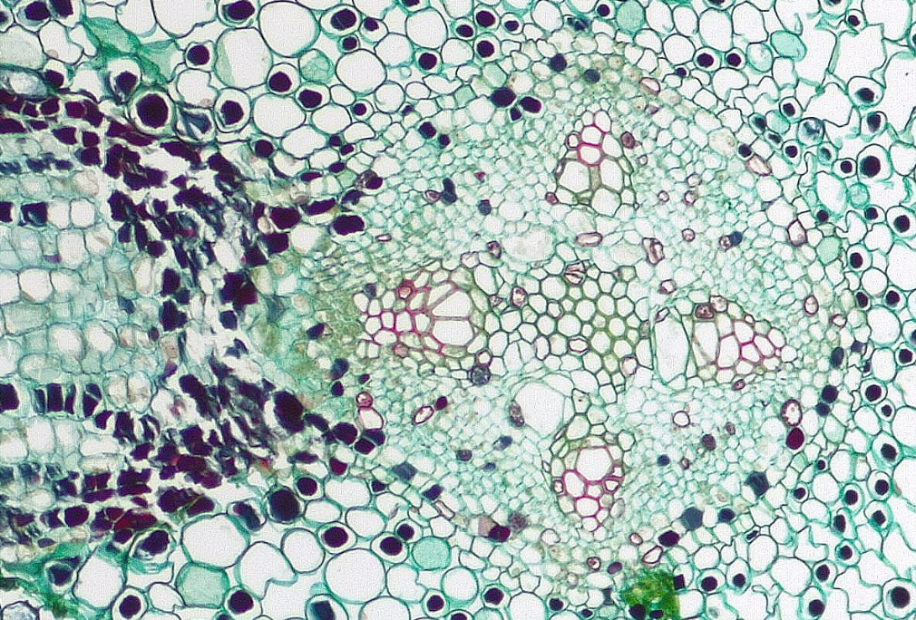
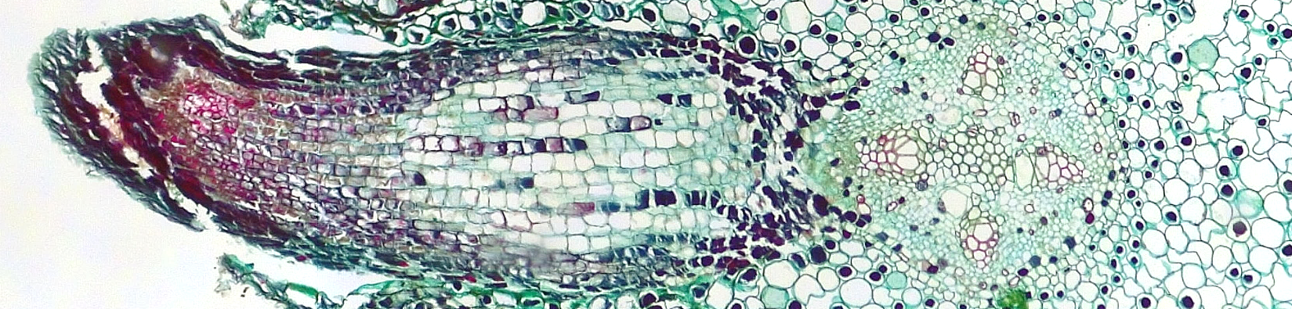
Lateral Root
Salix (Willow)
1 of 2
13
4
1
2
Epidermis
Root hair
Hypodermis
Cortex
Endodermis
Vascular cylinder (stele)
Pericycle
Primary phloem
Primary xylem
Protoxylem
Metaxylem
Pith
Emerging lateral root
Emerged lateral root
6
4
3
1
4
8
9
8
13
9
12
9
8
9
8
Transverse sections
Bar = 50 μm
Horton Lai and Carol Wenzel. 2020
4
5
10
4
7
5
8
11
8
7
6
14
10
11
12
11
10
14
8
8
11
5
10
7
8
9
8
14
9
12
9
4
8
9
8

Slide 2
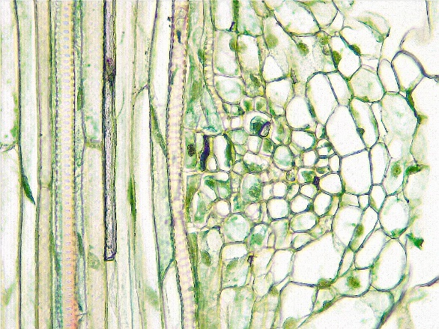
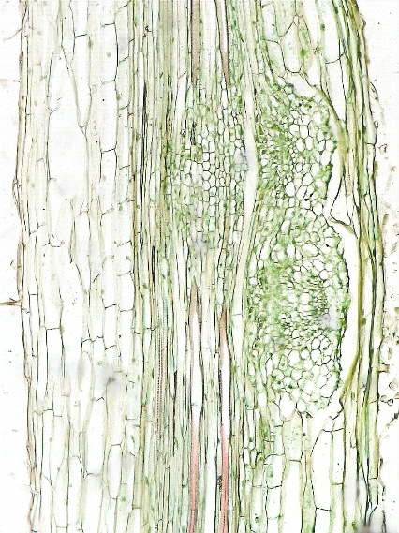
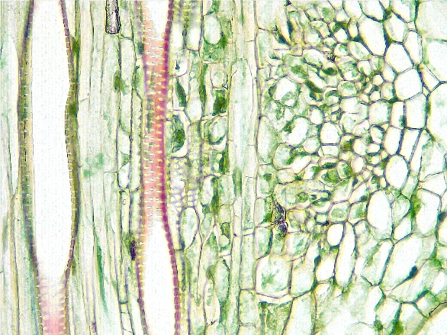
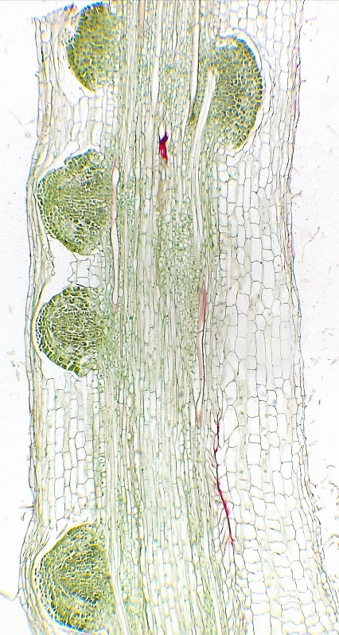
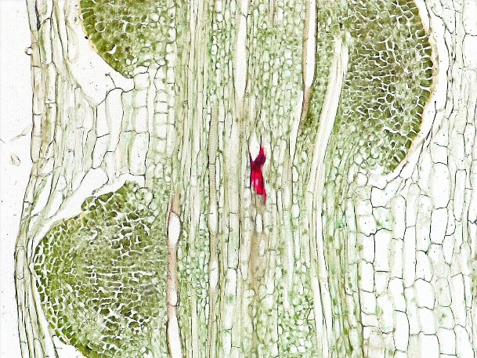
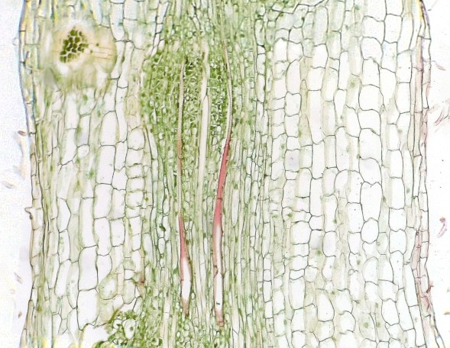
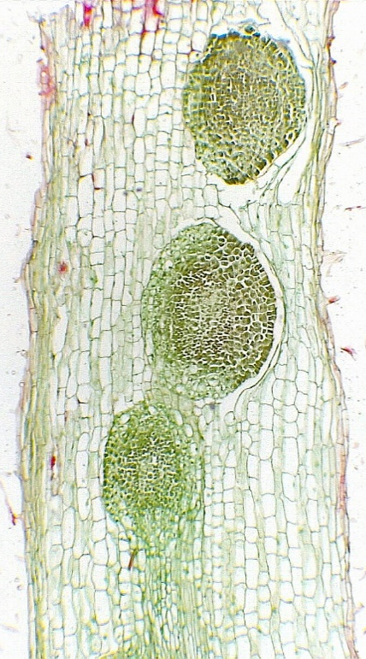
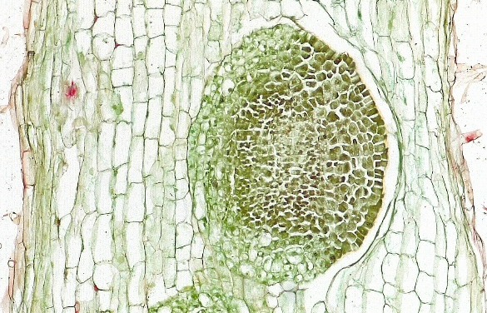
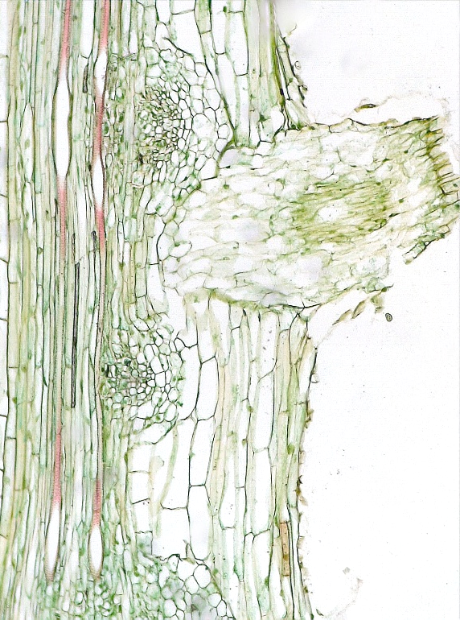
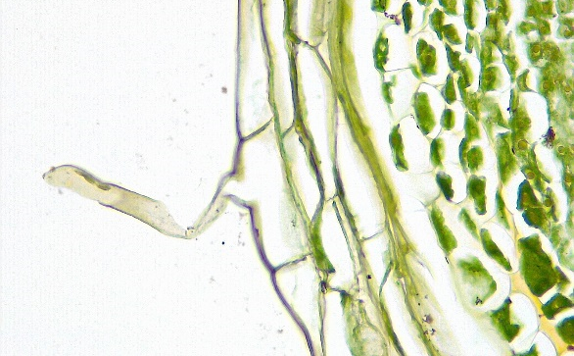
2 of 2
Lateral Root
Zea mays (Corn)
7
5
5
7
7
Epidermis
Root hair
Cortex
Vascular cylinder (stele)
Primary xylem
Reticulate 2° wall thickening
Emerging lateral root
Emerged lateral root
3
3
4
3
5
6
7
7
3
Radial longitudinal sections
unless otherwise stated
7
6
5
Bar = 100 μm
Horton Lai and Carol Wenzel. 2020
7
3
7
1
1
1
5
3
4
3
7
3
3
4
3
4
7
1
5
1
3
7
7
3
8
Tangential
longitudinal
7
1
7
2
3
7
1
3
4
3
Tangential
longitudinal

