Slide 1
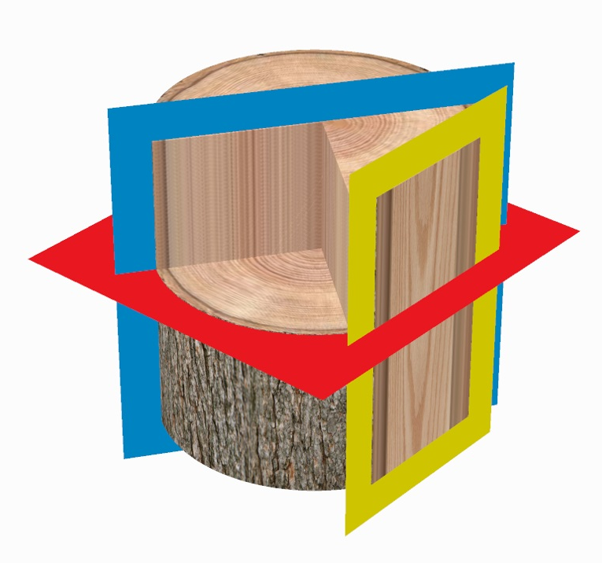
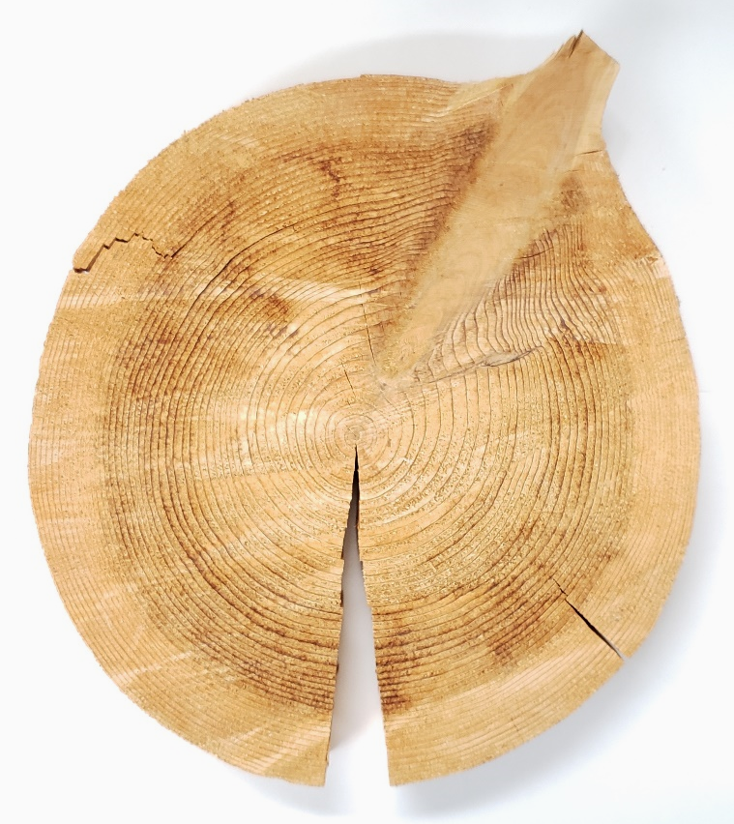
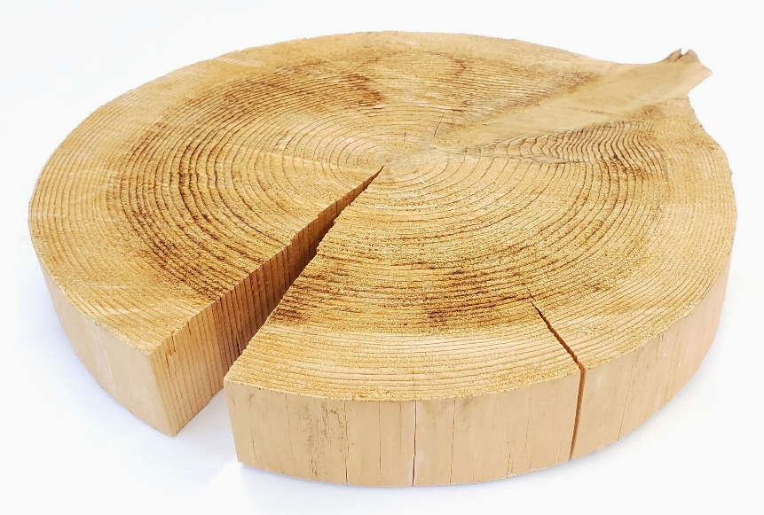
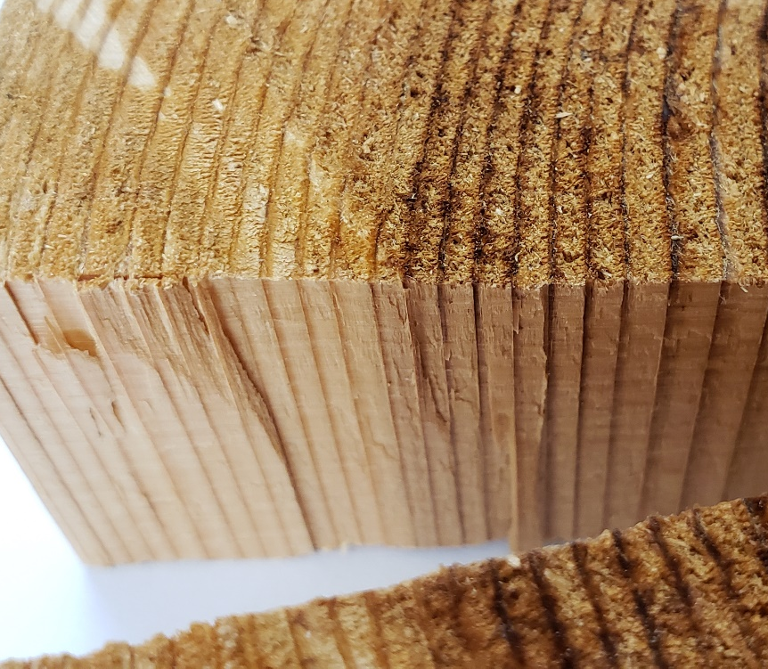
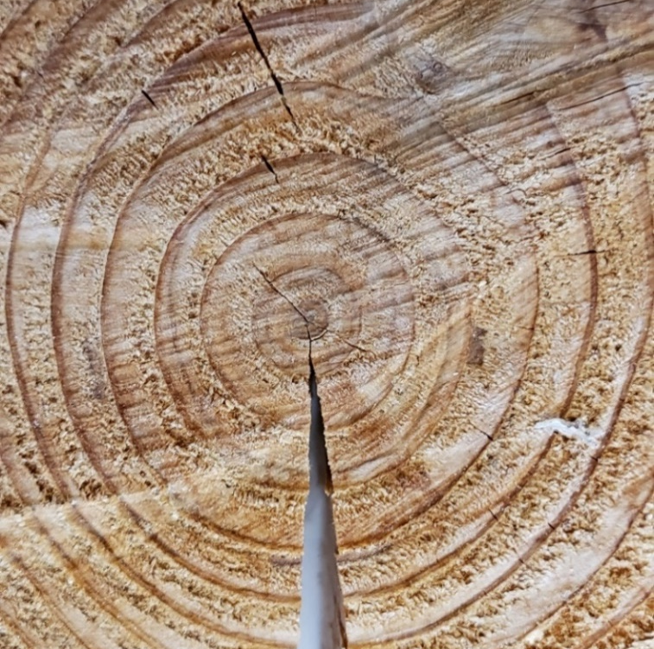
Wood Planes
1 of 4
Transverse plane
Radial longitudinal plane
Tangential longitudinal plane
Branch
Annular ring
3
2
1
Bar = 1 cm
Horton Lai and Carol Wenzel. 2020
4
4
1
1
5
5
2
1
5
1
5
2
5

Slide 2
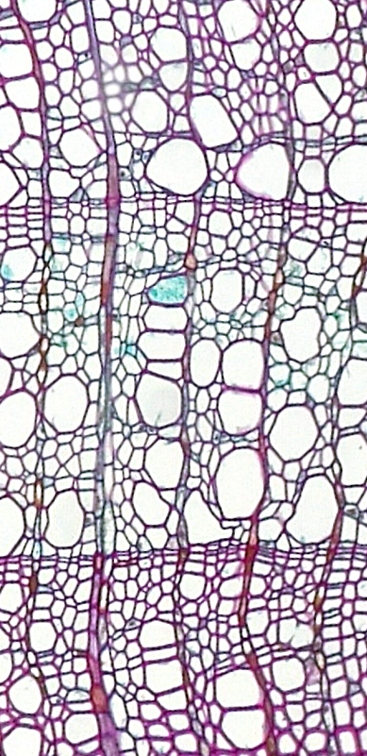
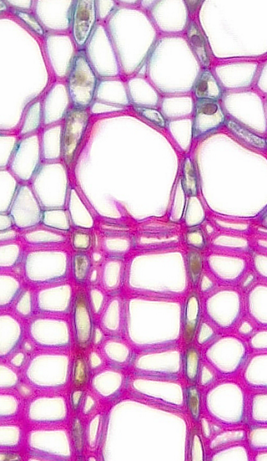
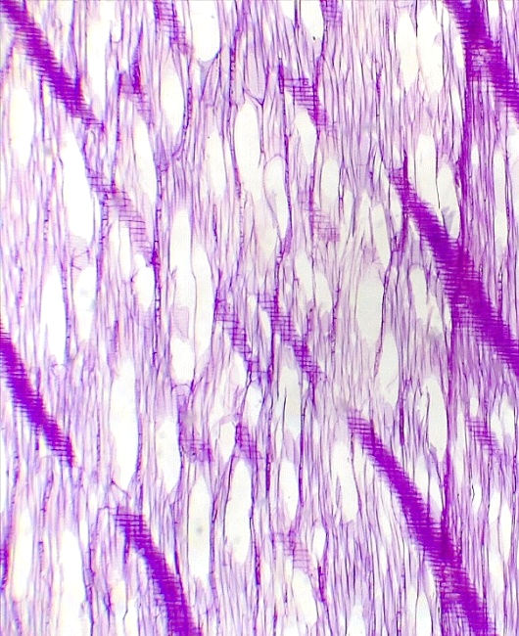
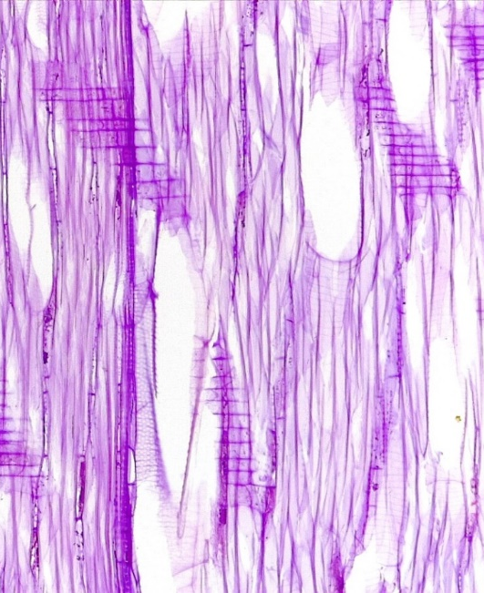
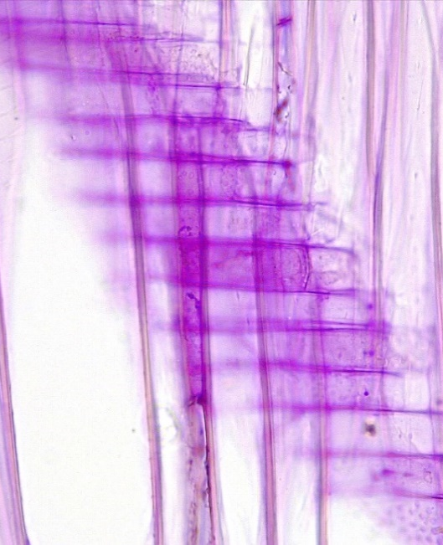
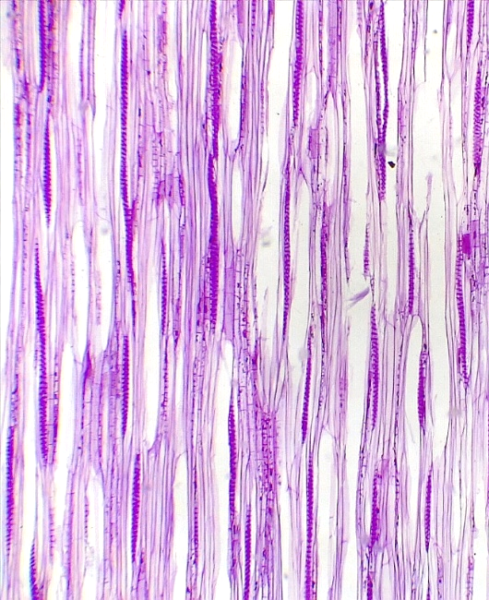
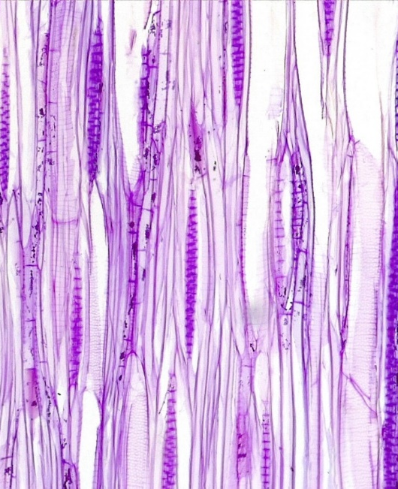
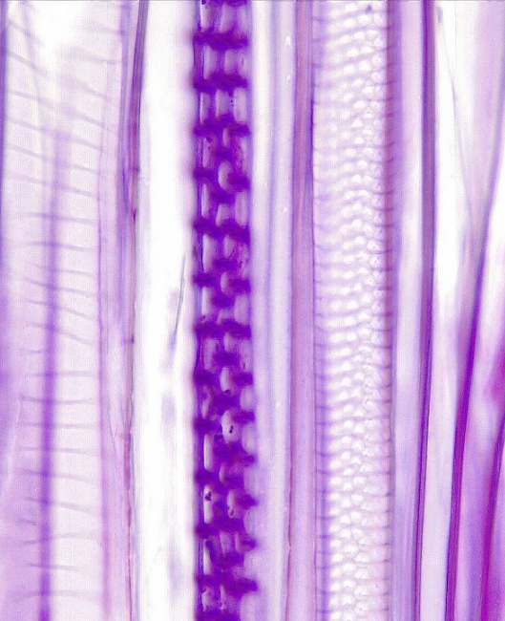
2 of 4
Angiosperm Wood
Tilia (Basswood)
Diffuse Porous
4
3
3
1
1
3
3
2
1
Tracheid
Rays
2*. Rays, glancing section
Xylem vessel element
Annular ring
Annular/spiral 2° wall thickening
Reticulate 2° wall thickening
4
4
4
3
1
4
3
2
2
1
3
3
Transverse
Transverse
Bar = 50 μm
Horton Lai and Carol Wenzel. 2020
2*
1
3
2*
1
3
2*
2*
4
3
2*
3
3
2*
6
1
5
Radial
longitudinal
Radial
longitudinal
Radial
longitudinal
3
3
3
2
3
3
2
1
5
6
1
2
1
Tangential
longitudinal
Tangential
longitudinal
Tangential
longitudinal

Slide 3
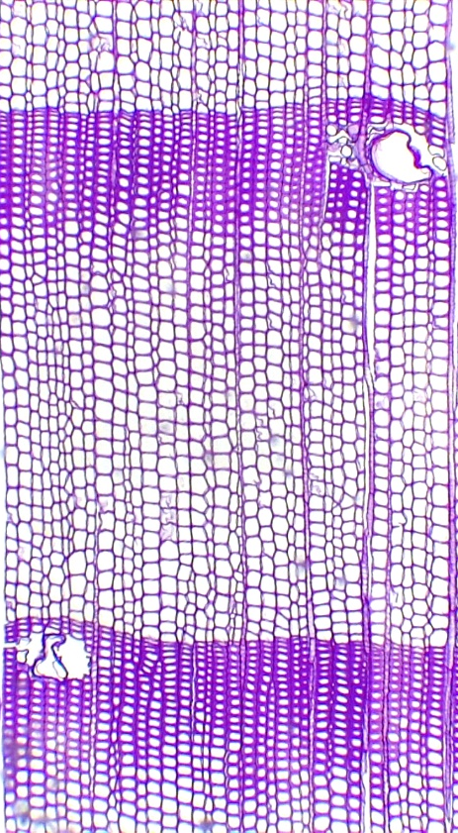
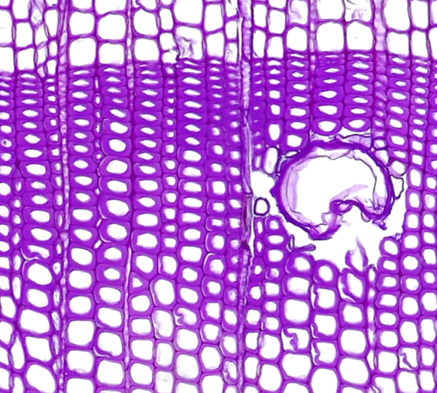
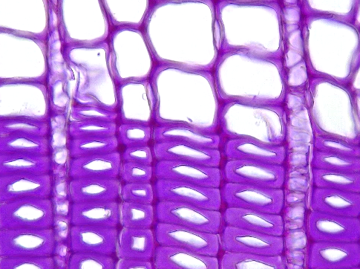
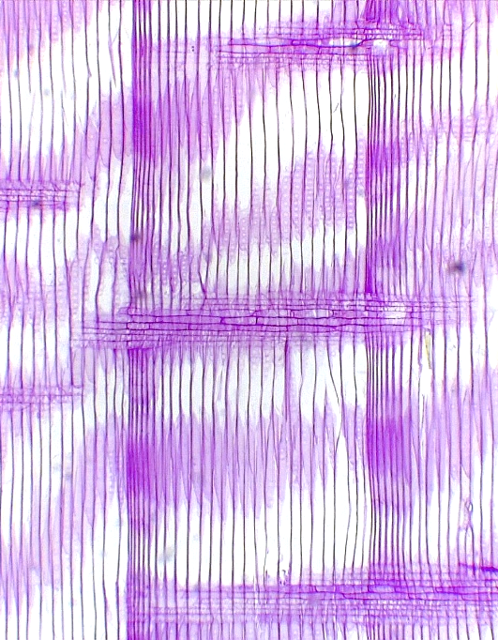
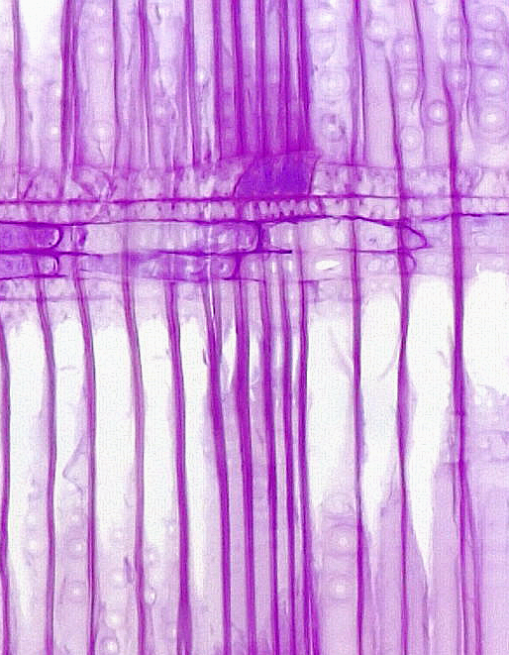
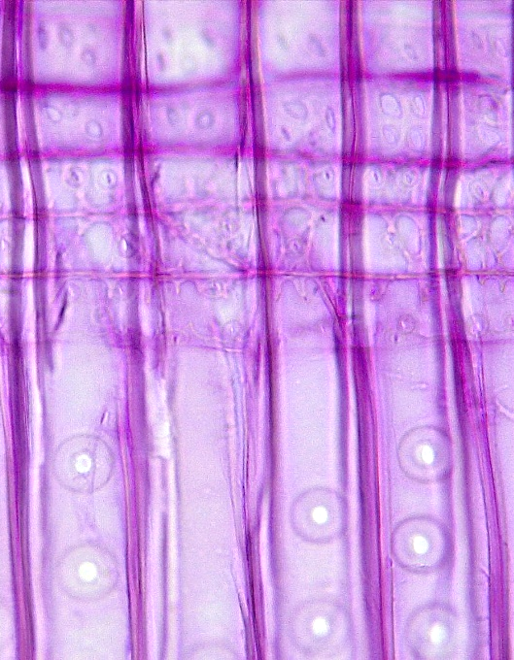
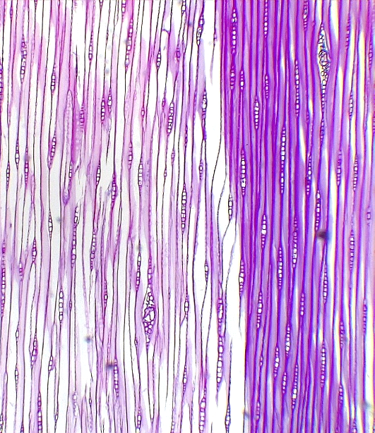
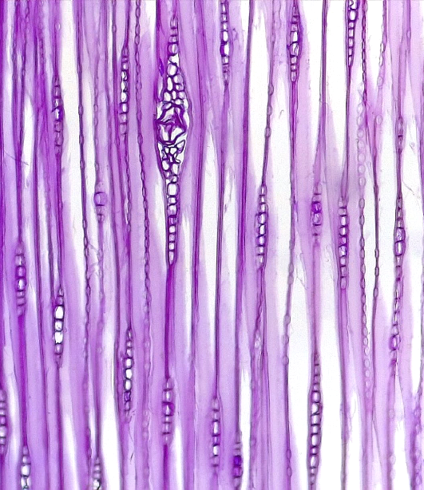
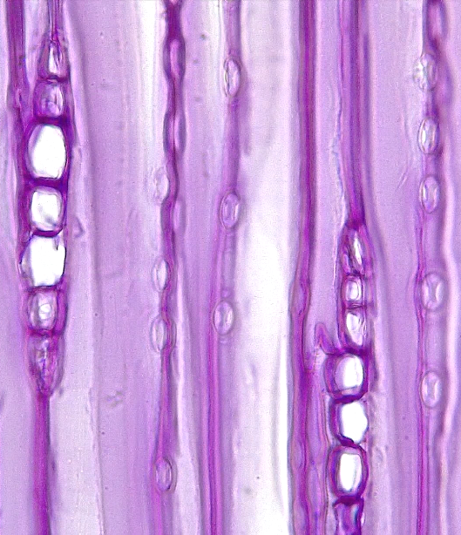
3 of 4
1
2
Gymnosperm Wood
Pinus (Pine)
3
4
3
4
2
Tracheid
Rays
2*. Rays, glancing section
Annular ring
Resin duct
Pitted 2° wall thickening
Cell wall pit
1
Transverse
2
2
1
1
1
4
2
3
1
1
Transverse
Transverse
Bar = 100 μm
Horton Lai and Carol Wenzel. 2020
2*
3
3
5
2
2
2*
1
1
1
1
1
1
1
1
1
6
Radial
longitudinal
Radial
longitudinal
Radial
longitudinal
1
1
2
1
1
1
2
2
2
1
2
2
1
2
2
Tangential
longitudinal
Tangential
longitudinal
Tangential
longitudinal

Slide 4
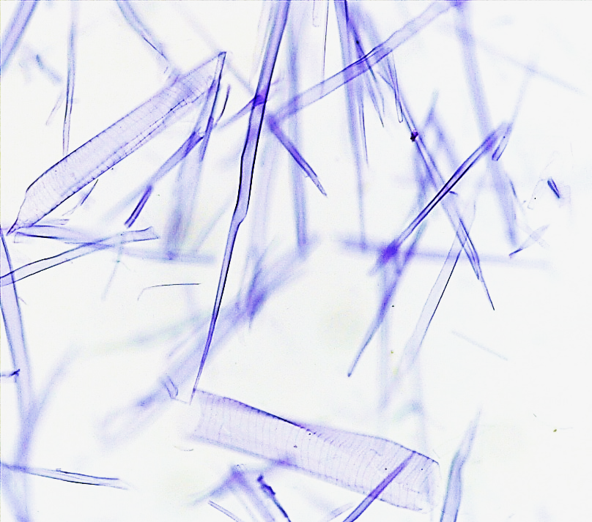
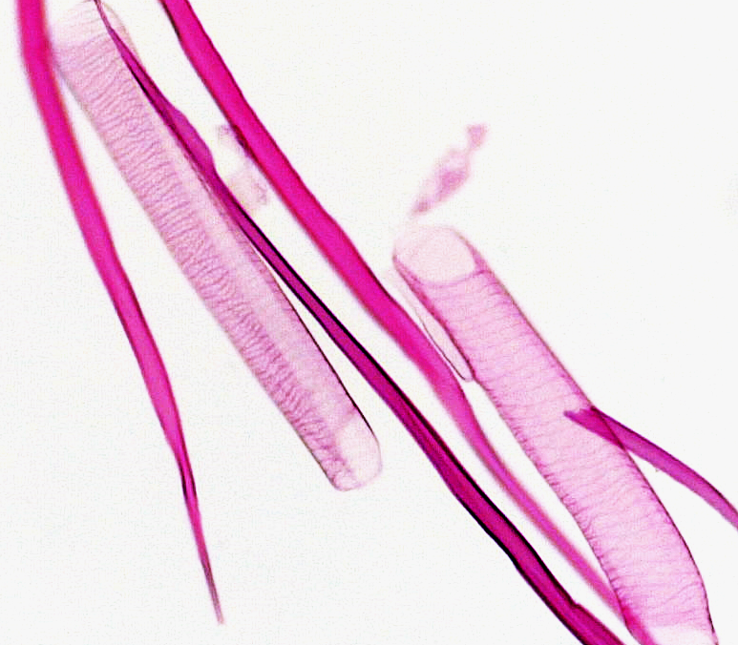
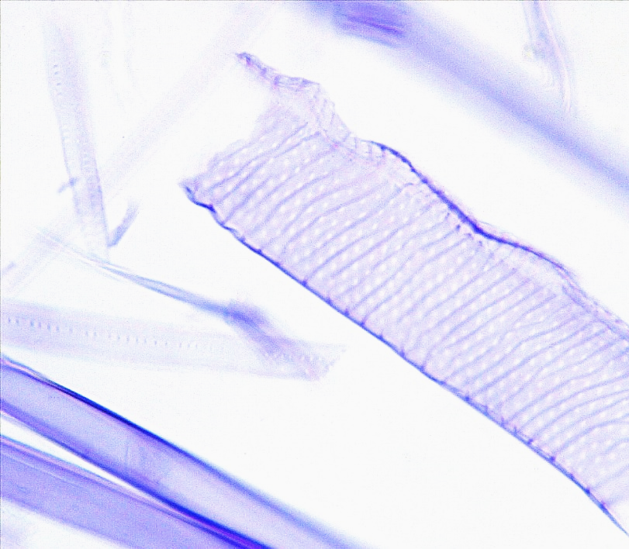
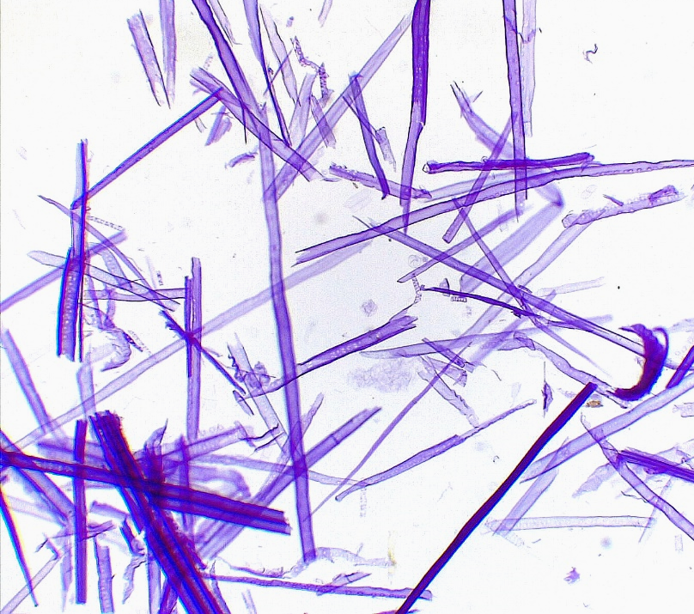
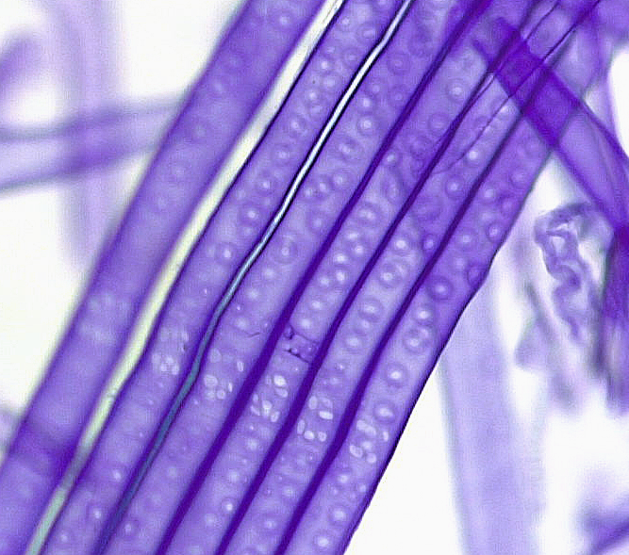
4 of 4
1
Wood Maceration
2
1
Tracheid
Xylem vessel element
Pitted 2° wall thickening
Cell wall pit
1
2
Angiosperm – Tilia (Basswood)
Bar = 100 μm
Horton Lai and Carol Wenzel. 2020
1
2
2
2
1
3
1
3
Angiosperm – Tilia (Basswood)
Angiosperm – Tilia (Basswood)
1
1
1
1
1
1
1
4
3
1
4
Gymnosperm – Pinus (Pine)
Gymnosperm – Pinus (Pine)

