Slide 1
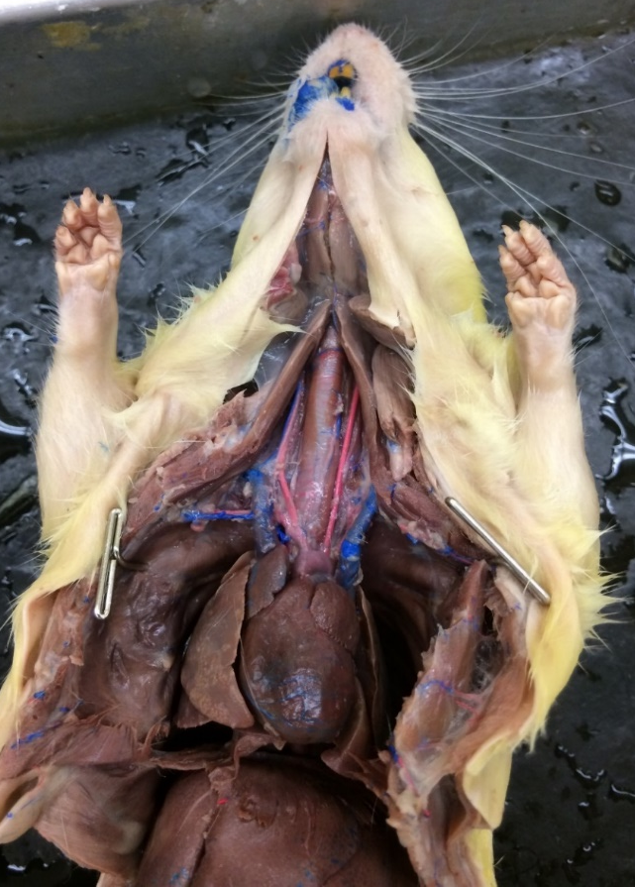
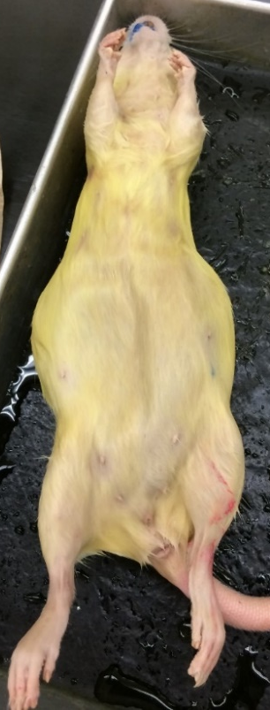
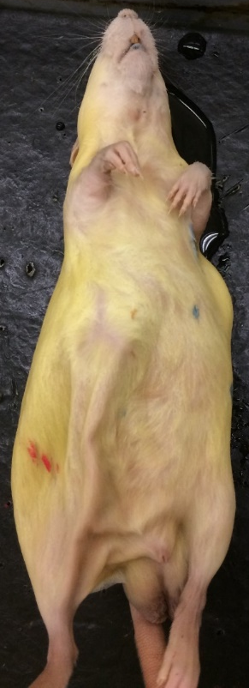
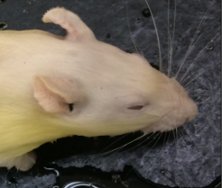
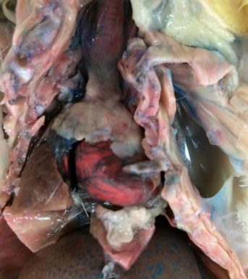
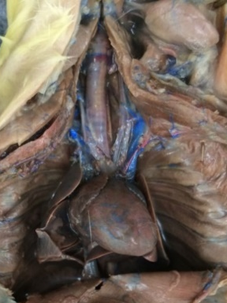
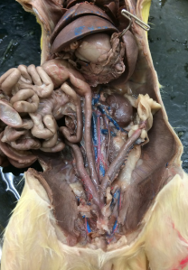
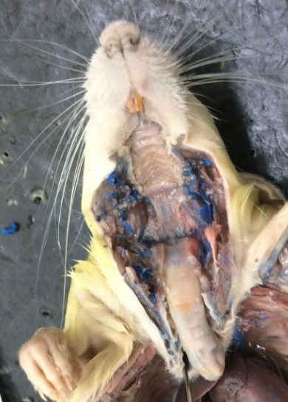
1
1
Rat
Rattus norvegicus
3
2
2
2
Nares
Vibrissae
Incisors
Pinnae
Prepuce (Penile)
Prepuce (Clitoral)
Urethral opening
Scrotum
Mammaries/Teats
Vaginal opening
Anus
Hard palate
Soft palate
Epiglottis
Tongue
Salivary gland
Trachea
Thyroid
Thymus
Carotid artery
Cranial vena cava
Aortic arch
Lung
Heart – ventricle
Heart – atrium
Diaphragm
Liver
Stomach
Spleen
Pancreas
Small intestine
Large intestine
Rectum
Kidney
Ureter
Uterine horn
Oviduct and ovary
Fat
Dorsal aorta
Posterior vena cava
18
9
20
17
16
9
9
21
6
7
5
7
10
11
25
25
22
8
8
23
24
23
Adult male
Adult female
26
26
27
27
4
Thymus removed
2
17
18
4
19
25
17
23
25
23
24
23
2
24
Thymus present
Thymus removed
1
27
27
1
27
2
28
29
2
3
32
30
34
12
31
40
38
35
37
14
13
33
39
36
36
38
15
Sabrina Cornish and Carol Wenzel. 2019
Adult female

Slide 2
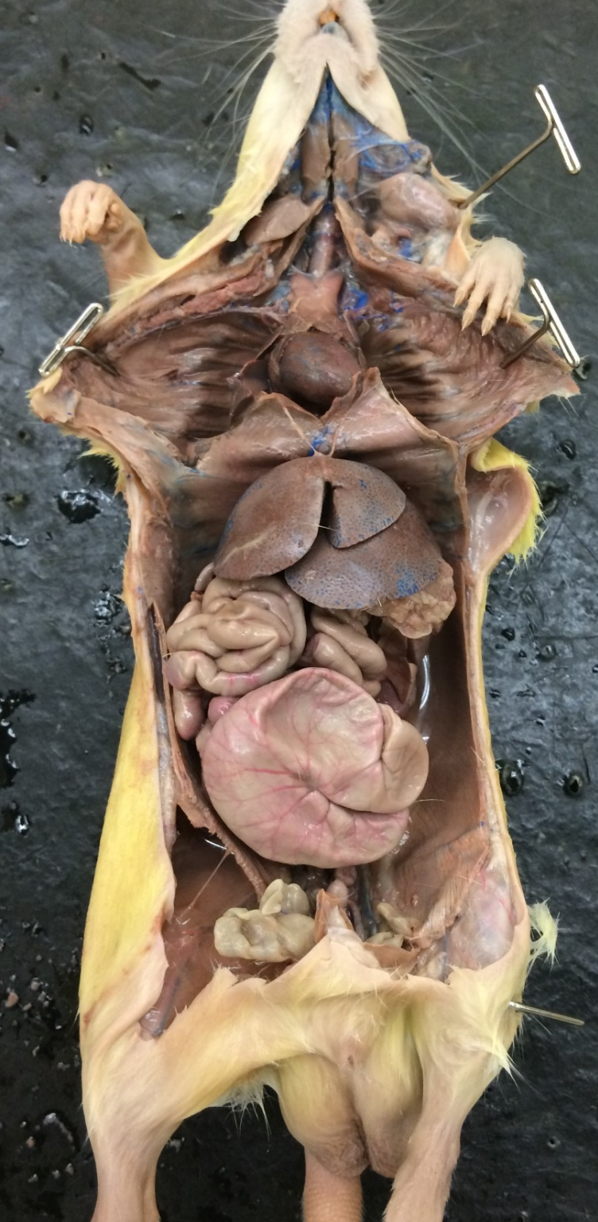
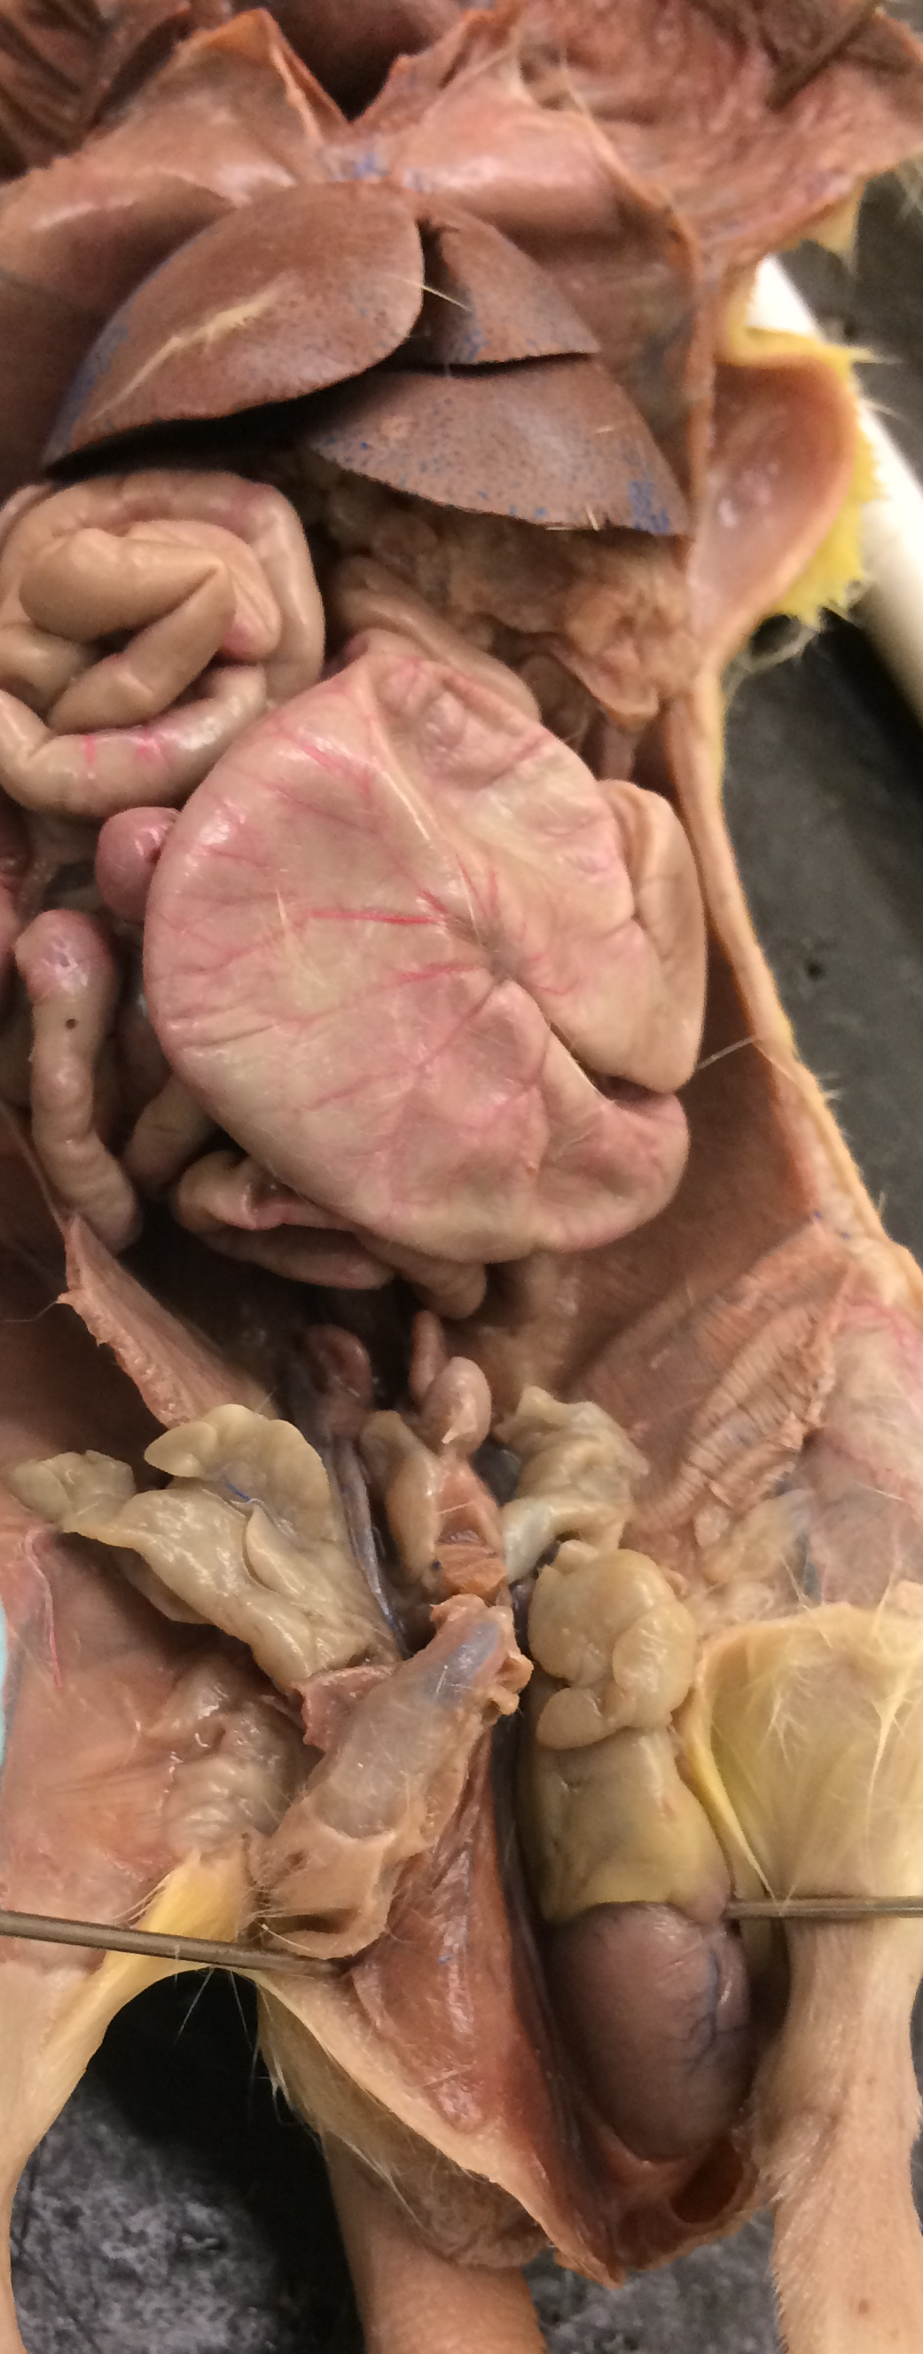
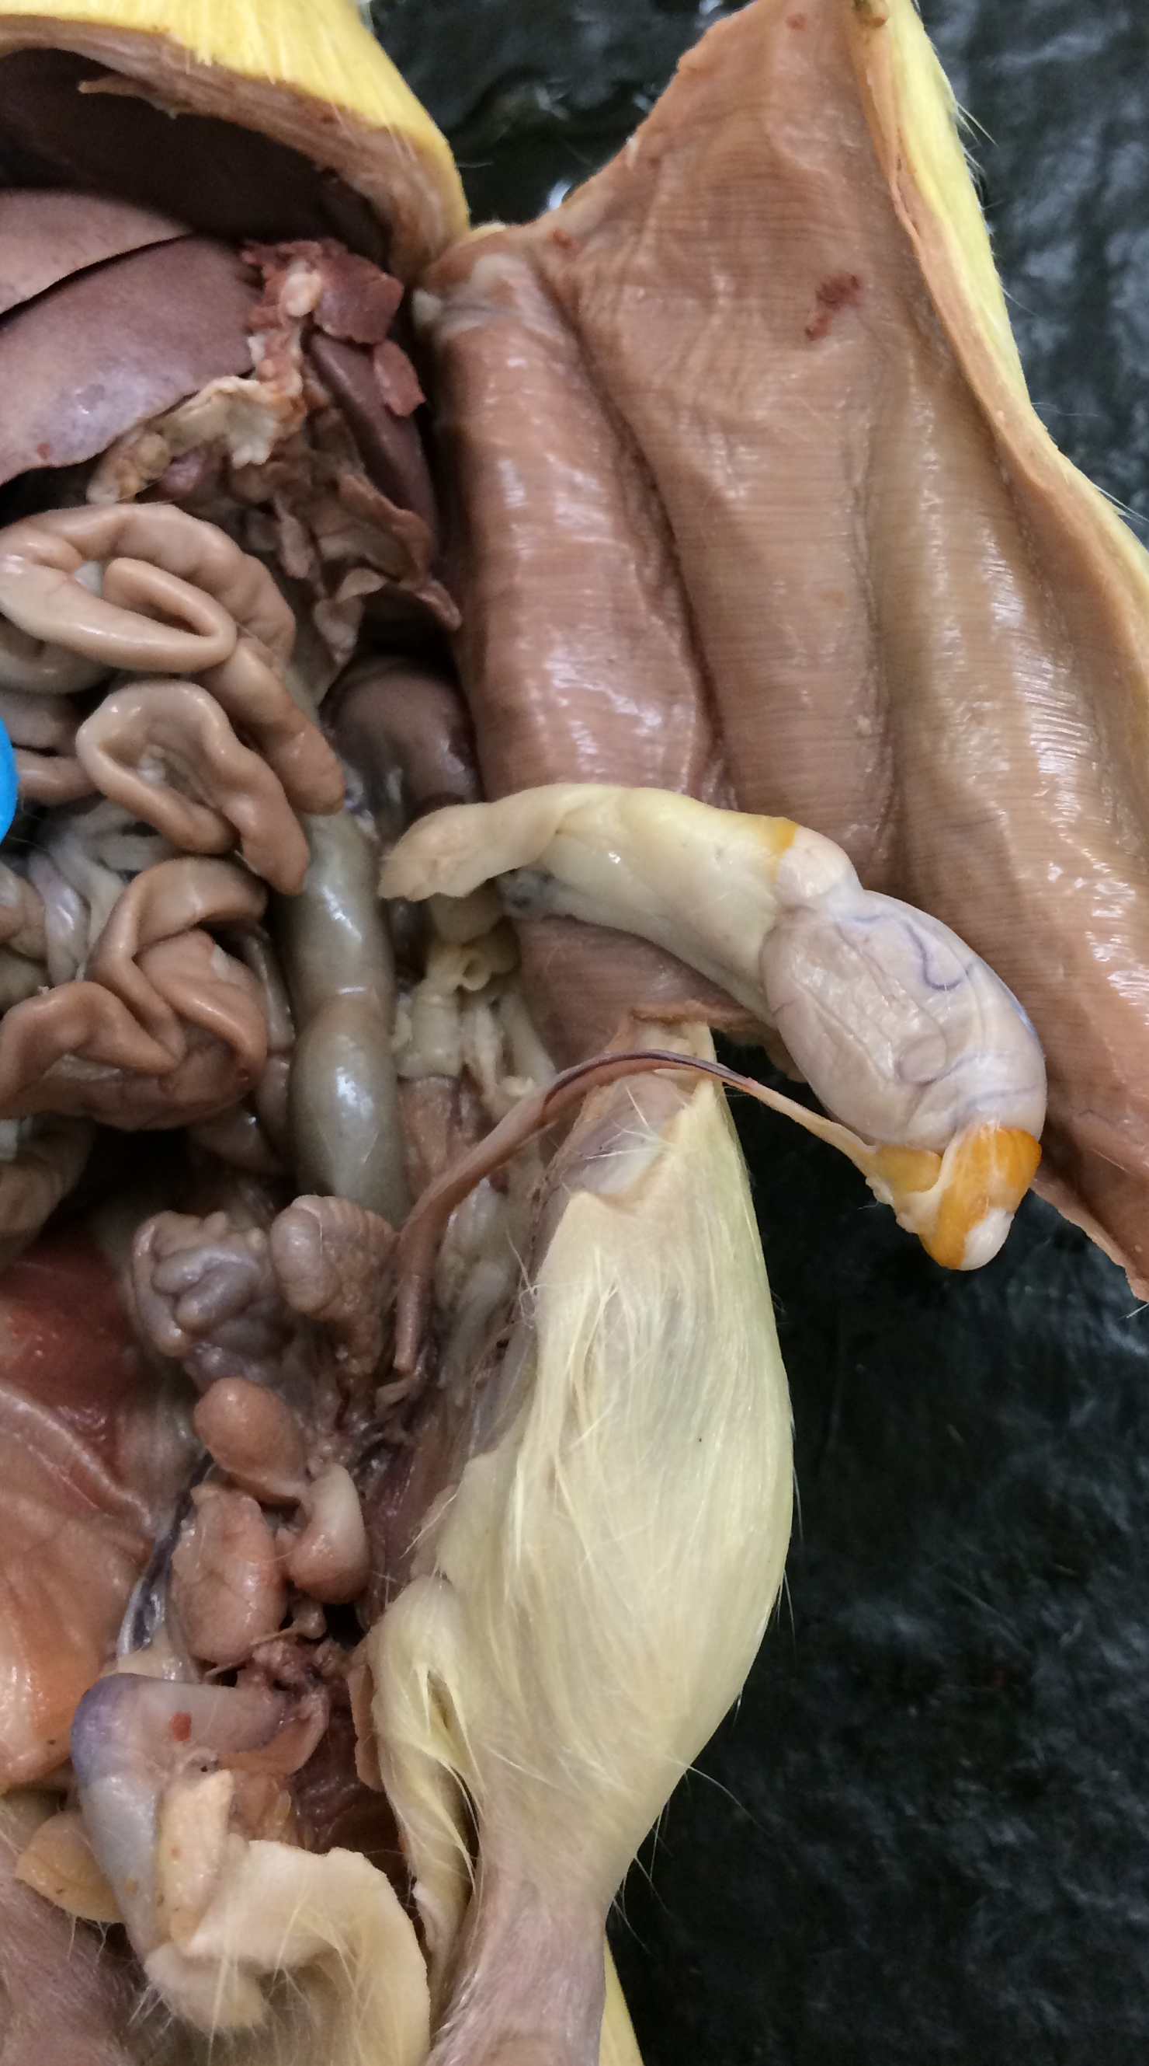
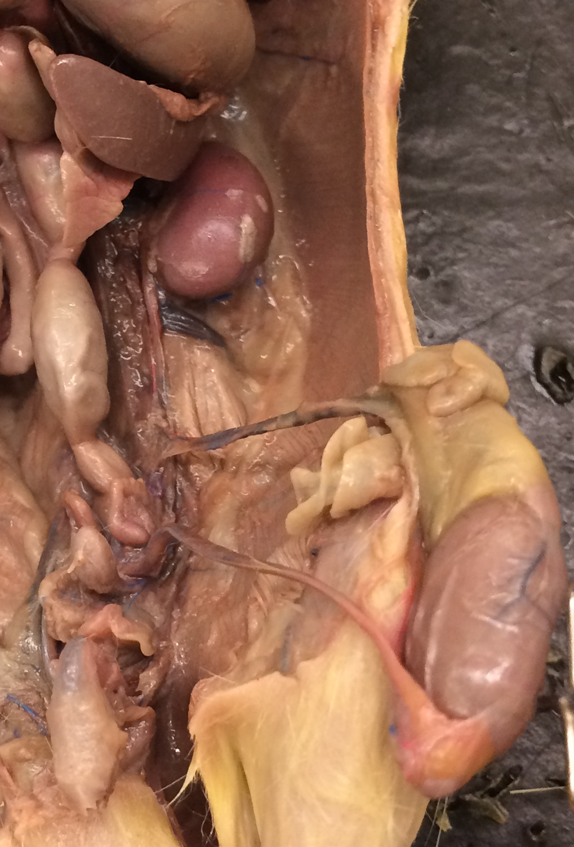
2
Male rat
Rattus norvegicus
6
6
2
7
7
1
7
Trachea
Thyroid
Thymus
Heart - ventricle
Lungs
Diaphragm
Liver
Fat
Spleen
Stomach
Small intestine
Large intestine
Cecum
Urinary bladder
Kidney
Ureter
Rectum
Penile prepuce
Scrotum
Testis
Epididymis
Vas deferens
Spermatic duct
Prostate
Seminal vesicles
Penis
3
11
Thoracic cavity
5
4
6
6
13
7
7
7
Abdominal cavity
11
8
12
9
14
13
8
14
26
8
21
18
20
19
19
Scrotum intact
Scrotum opened
Sabrina Cornish and Carol Wenzel. 2019
10
7
15
7
9
15
11
23
23
17
25
11
21
17
16
17
20
25
25
21
22
14
14
23
24
22
20
22
26
24
26
26
26
22
Scrotum opened
Scrotum opened
Scrotum opened

Slide 3
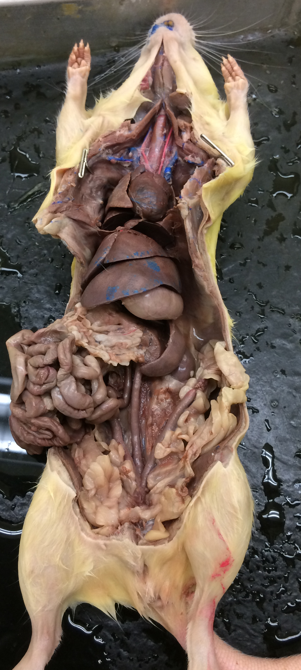
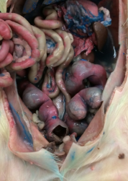
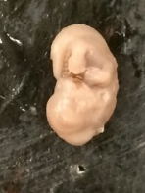
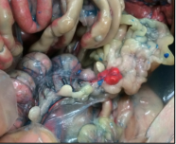
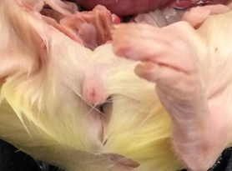
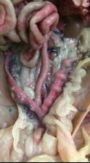
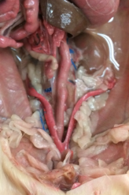
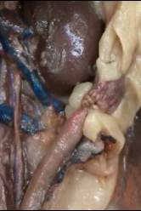
3
Female rat
Rattus norvegicus
Trachea
Thyroid
Heart - ventricle
Lungs
Diaphragm
Liver
Stomach
Spleen
Pancreas
Small intestine
Large intestine
Urinary bladder
Kidney
Rectum
Clitoral prepuce
Urethral opening
Vaginal opening
Anal opening
Uterine horn
Oviduct
Ovary
Embryo in uterine horn
Fat
10
2
9
8
1
19
4
3
22
22
4
22
22
5
6
6
5
6
7
22
23
9
8
13
late pregnancy
10
11
19
10
19
14
23
23
22
22
23
Sabrina Cornish and Carol Wenzel. 2019
16
mid pregnancy
17
16
15
18
17
10
8
7
13
23
20
13
14
14
22
21
22
19
19
20
19
19
23
23
23
19
23
not pregnant
early pregnancy

Slide 4
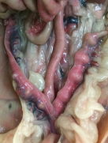
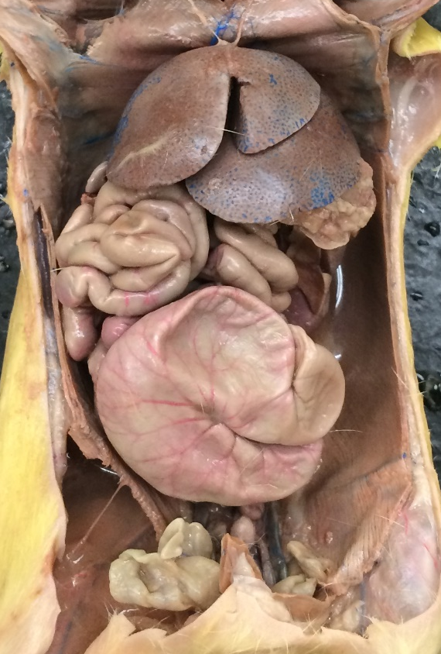
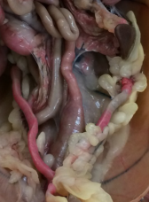
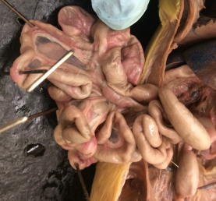
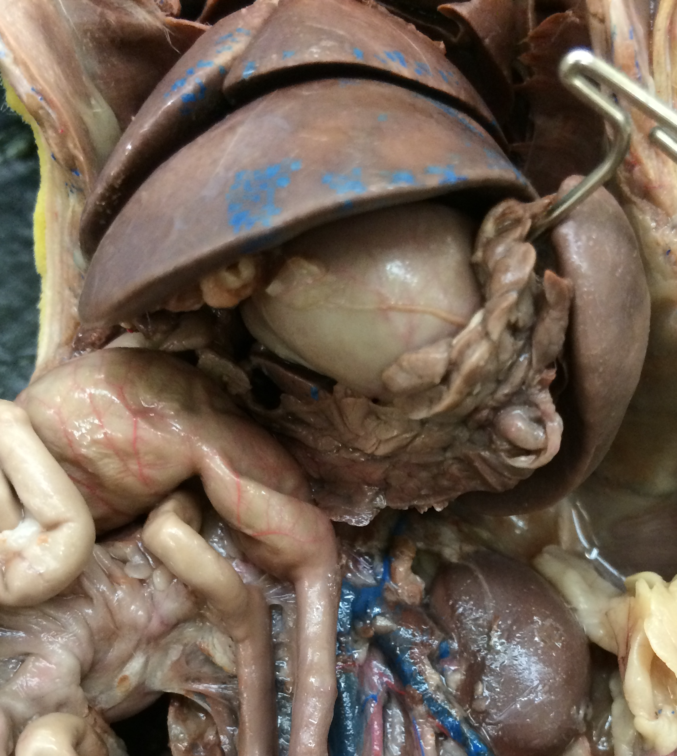
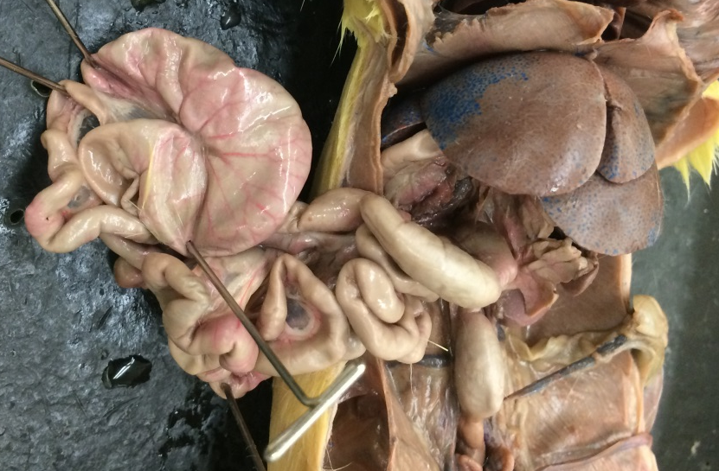
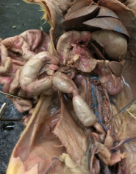
4
1
1
Rat
Digestive system
2
3
2
2
Diaphragm
Liver
Fat
Pancreas
Spleen
Stomach
Duodenum
Jejunum
Ileum
Mesentery
Cecum
Appendix
Large Intestine
Rectum
Kidney
Urinary bladder
Uterine horn
14
8
13
3
17
5
17
11
12
3
No fecal pellets in rectum
Female
16
3
27
Male
4
5
3
9
12
11
10
Sabrina Cornish and Carol Wenzel. 2019
2
2
14
17
13
2
17
10
6
5
13
4
8
13
Dorsal view of cecum.
Cecum is positioned between ileum and large intestine
14
15
Fecal pellets nearing elimination
Female
14
1
14
1
2
2
1
1
2
7
6
9
12
11
2
2
13
4
5
9
2
13
14
8
14
Ventral view of cecum.
Cecum is positioned between ileum and large intestine
Male
Fecal pellets in rectum and
large intestine
Male

