Slide 1
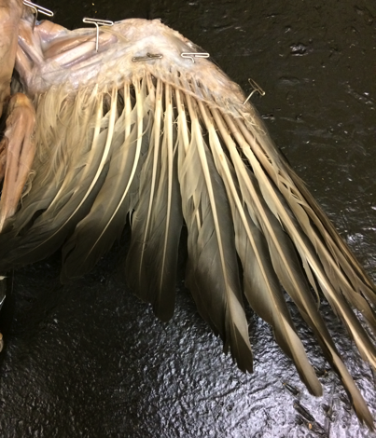
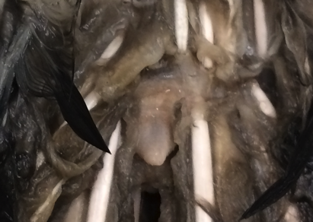
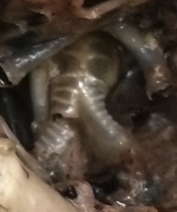
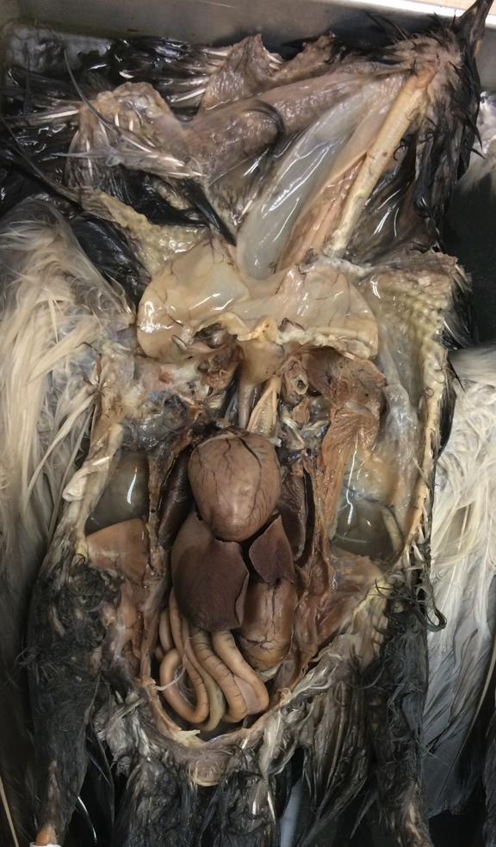
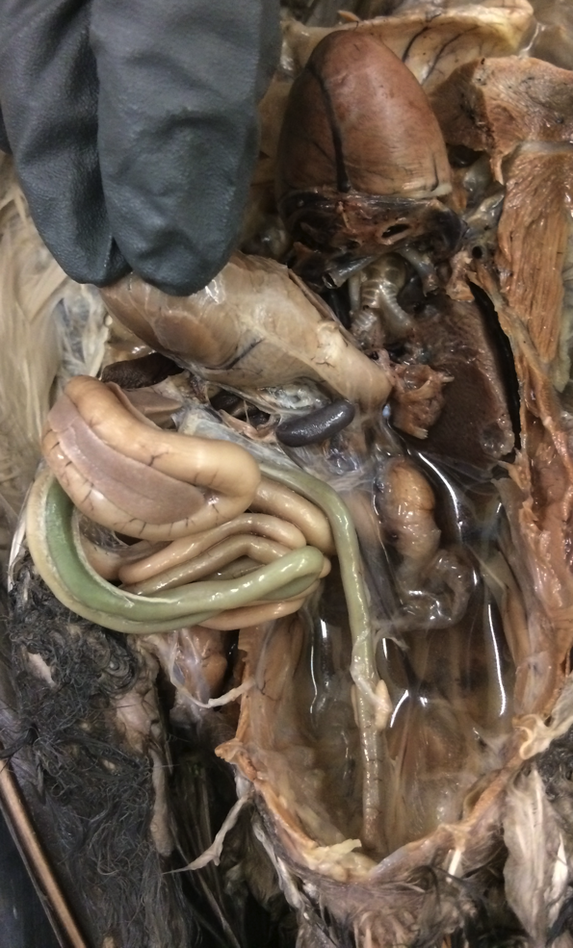
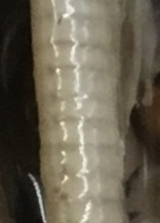
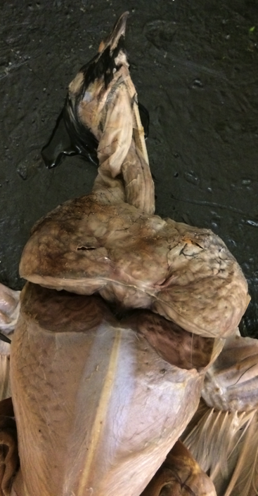
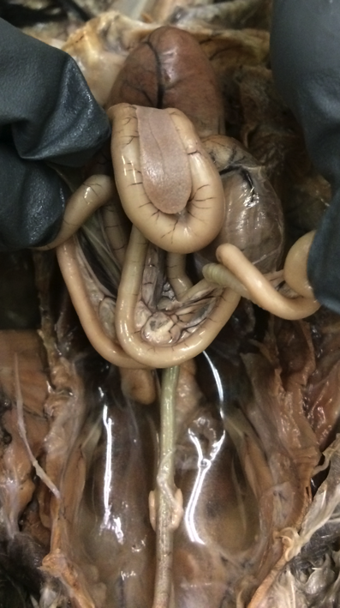
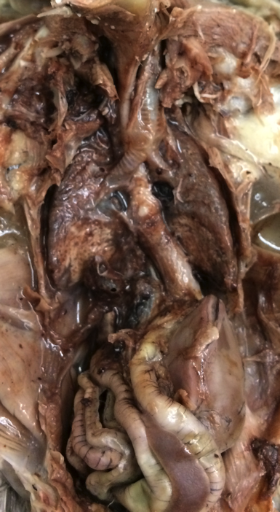
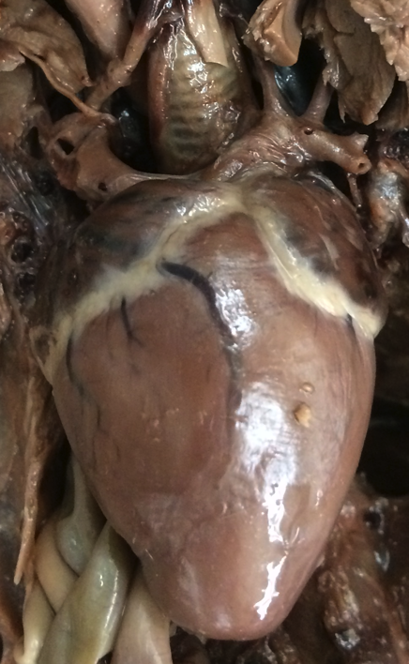
caudal
2
cranial
Pigeon
Columba livia
1
4
4
2
3
3
Cere
Uropegeal gland
Primary feather
Secondary feathers
Cloaca
Tracheal tube
Syrinx
Bronchus
Lung
Esophagus
Crop
Proventriculus
Ventriculus (gizzard)
Duodenum
Jejunum
Ileum
Large intestine
Colic cecum
Mesentery
Liver
Pancreas
Spleen
Heart – ventricle
Heart – atrium
Aortic arch
Testis
Keel of sternum
1
3
Cranial end
7
11
6
23
Dorsal view
10
6
8
7
11
13
11
Dorsal view
8
10
12
9
6
14
21
14
22
9
23
9
15
26
20
15
16
20
20
14
13
18
18
14
15
21
17
5
Caudal end
Liver intact
Male
Liver removed
Sabrina Cornish and Carol Wenzel. 2019
23
Dorsal view
Heart and liver removed
8
7
8
6
25
10
21
14
13
24
24
11
15
9
9
15
12
11
19
26
16
13
23
27
18
14
18
15
14
21
Feathers removed
Male
17

Slide 2
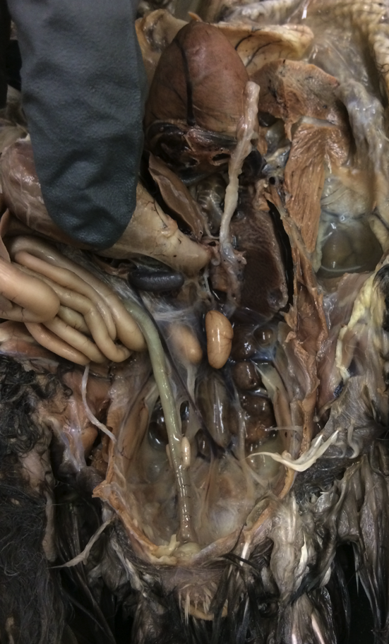
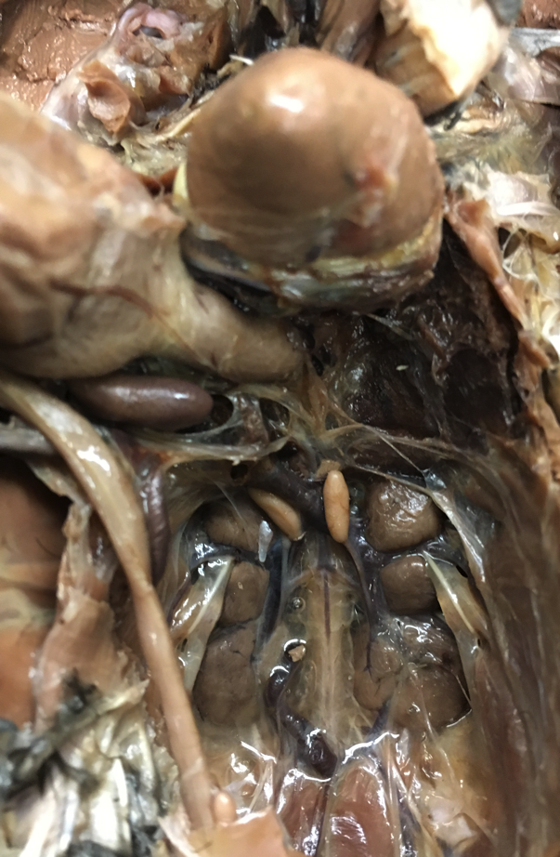
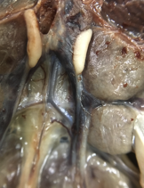
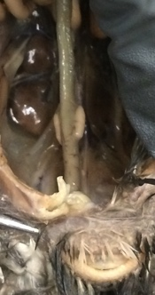
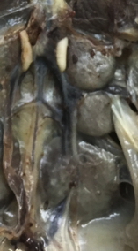
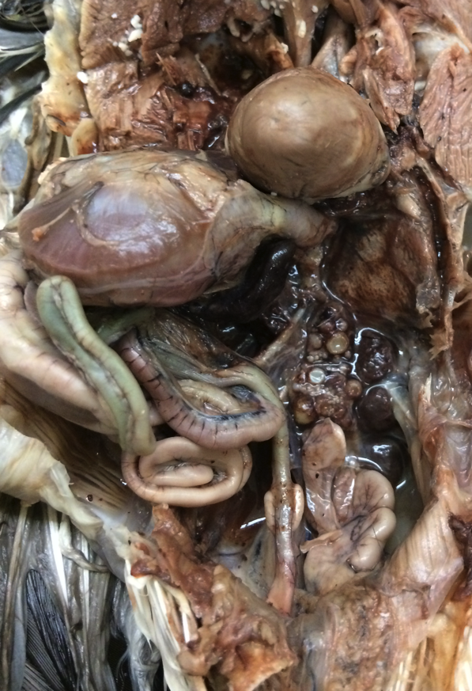
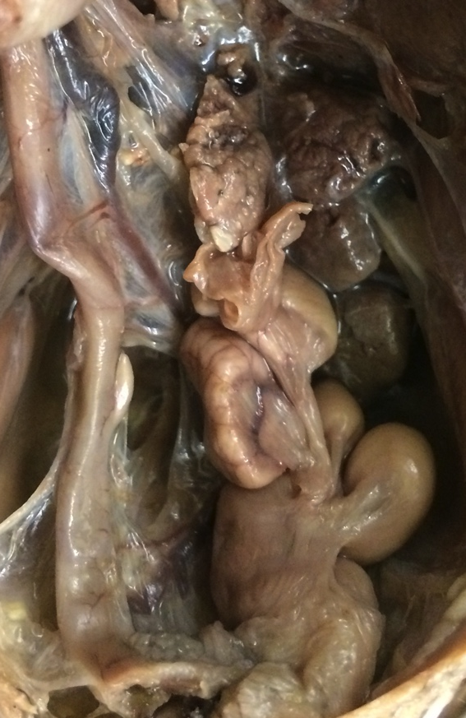
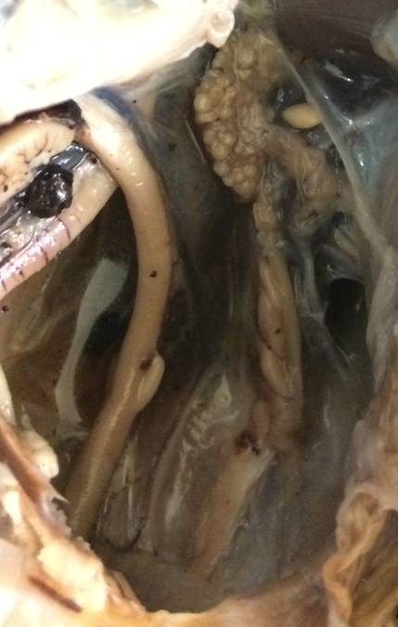
14
R
1
L
14
15
2
1
16
11
Pigeon
Columba livia
8
Dorsal view
12
11
2
16
11
Caudal view
Crop
Heart – ventricle
Lung
Liver
Proventriculus
Ventriculus (gizzard)
Jejunum
Ileum
Large intestine
Colic cecum
Kidney
Ureter
Spleen
Testis
Epididymis
Vas deferens
Ovary (with eggs)
Ostium
Oviduct
Uterus
Developing eggs in oviduct or uterus
Peritoneum
Cloaca
10
6
4
6
16: Broken at
caudal end
Dorsal
view
Dorsal view
13
5
3
5
3
7
22
14
13
8
14
8
11
11
11
11
11
8
12
14
11
11
11
10
10
Peritoneum removed
from L side
11
11
10
9
11
10
9
11
8
23
11
10
23
Most of liver removed
Most of liver removed
Mature male
Immature male
Testes are smaller
than in mature male.
2
Caudal view
3
Sabrina Cornish and Carol Wenzel. 2019
6
8
17
5
3
18
11
17
Dorsal view
17
18
7
17
19
11
7
8
10
19
21
7
11
10
19
7
8
19
9
21
19
10
20
20
9
9
20
Liver removed
Mature female
Large follicles in ovaries.
Enlarged oviduct and uterus
contains developing eggs.
More mature female
Eggs are larger within
the enlarged oviduct and uterus.
Immature female
Oviduct and uterus
are not enlarged.

Slide 3
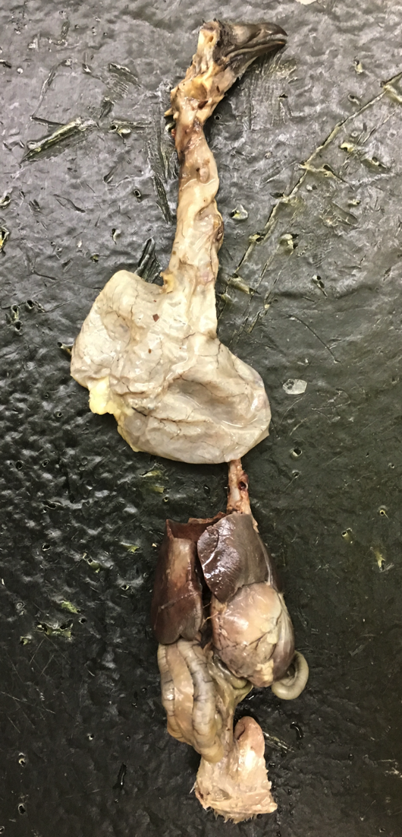
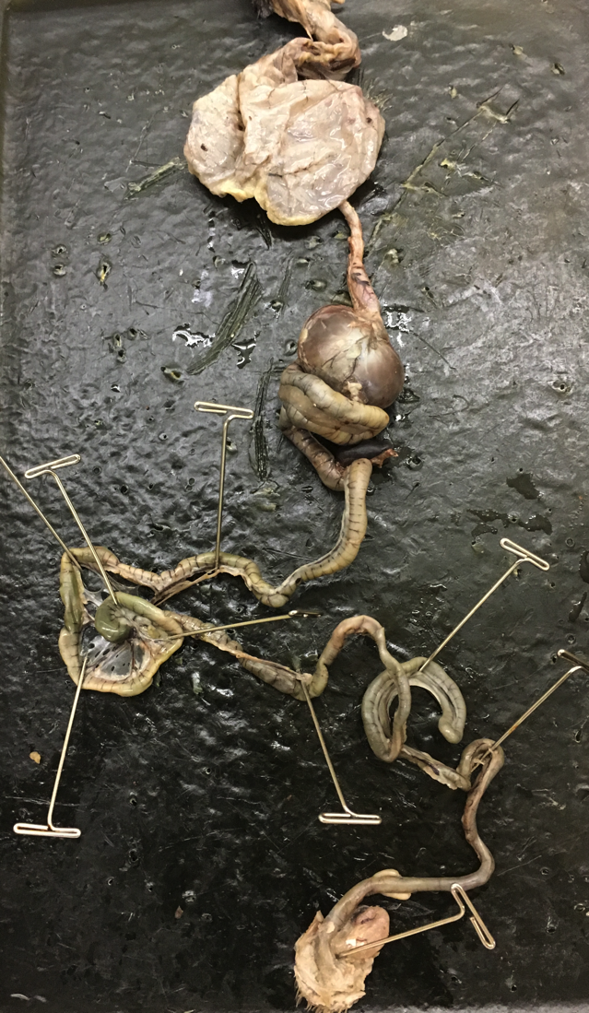
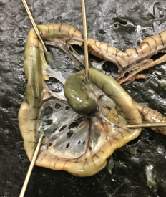
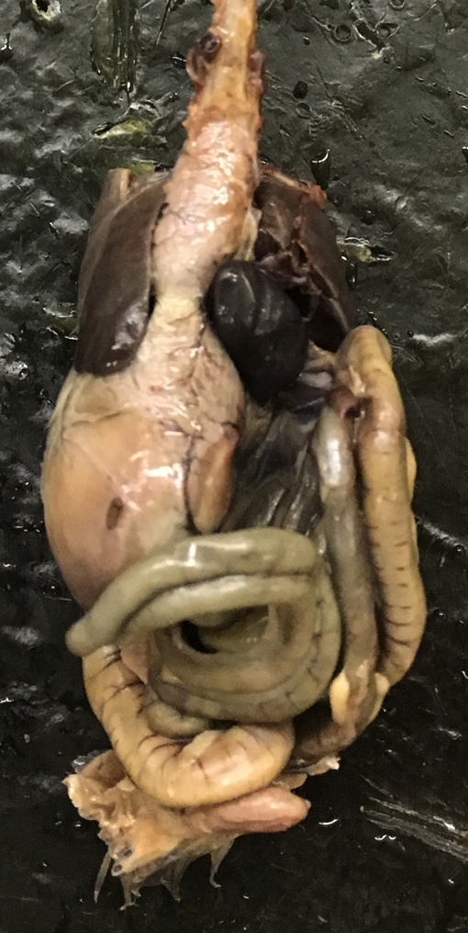
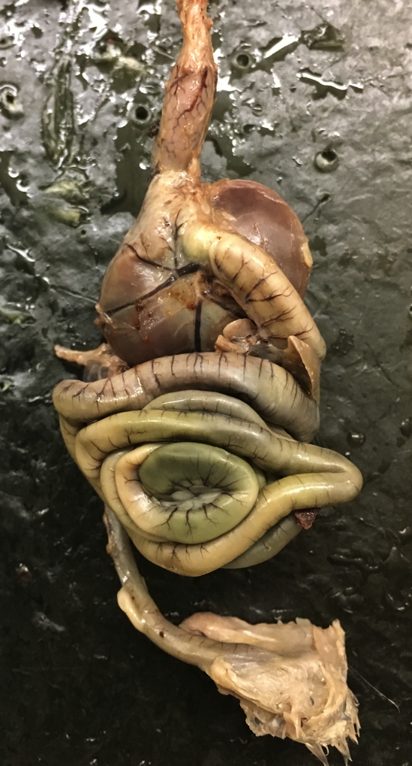
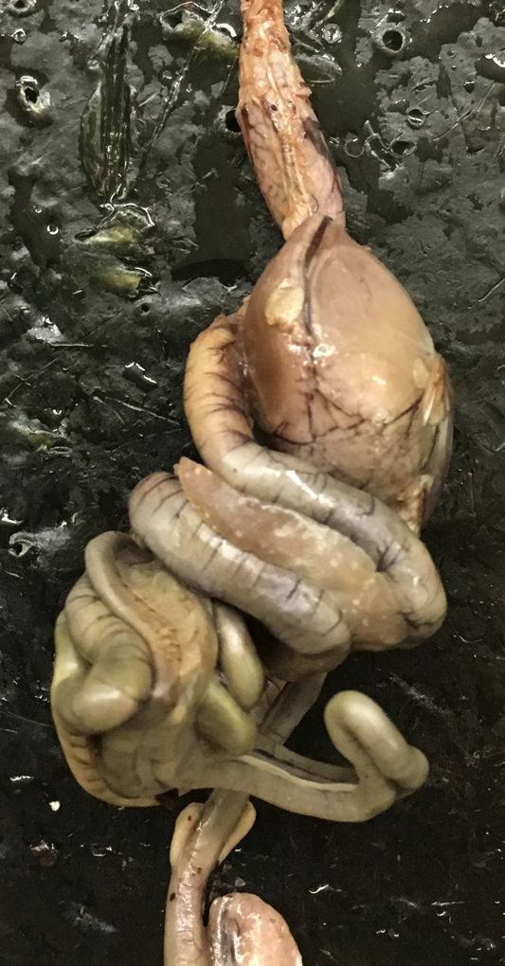
1
2
Pigeon
Columba livia
Isolated
digestive system
3
2
2
4
13
5
6
Beak
Esophagus
Crop
Proventriculus
Ventriculus (gizzard)
Duodenum
Jejunum
Ileum
Large intestine
Colic cecum
Mesentery
Liver
Pancreas
Spleen
3
6
6
14
4
12
11
7
12
5
6
8
13
6
10
7
7
9
11
Liver removed
Sabrina Cornish and Carol Wenzel. 2019
2
2
2
4
4
4
12
12
5
14
6
5
5
6
5
6
13
8
7
6
13
7
7
7
8
10
10
9
9
10
9
10
Liver removed
Liver removed

