Slide 1
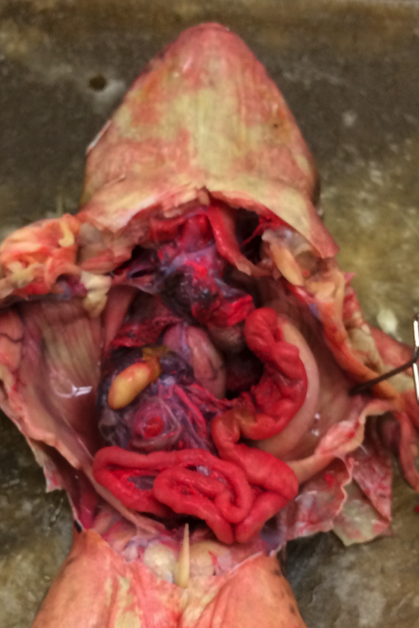
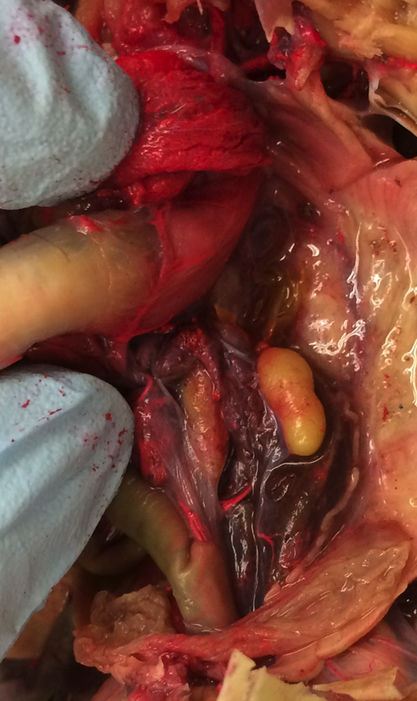
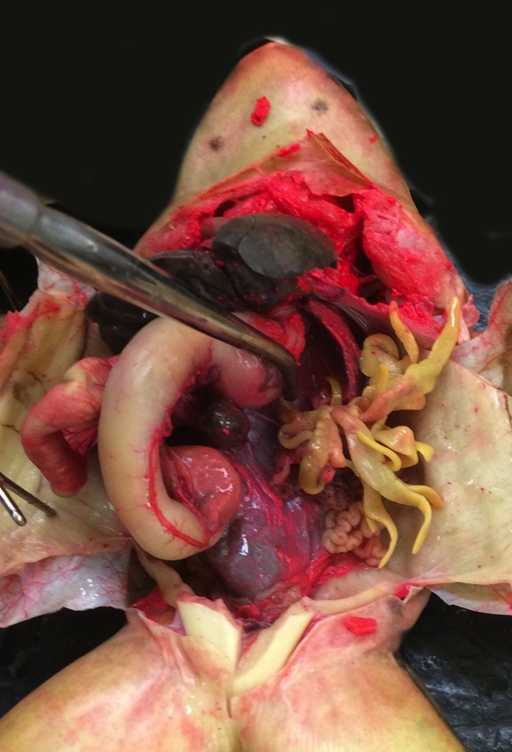
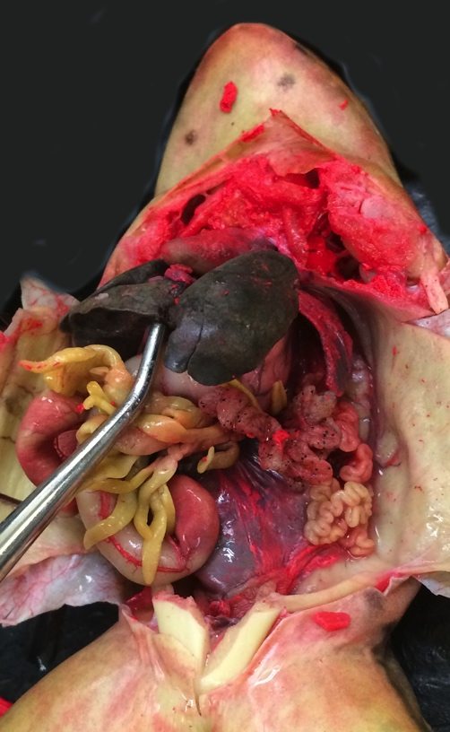
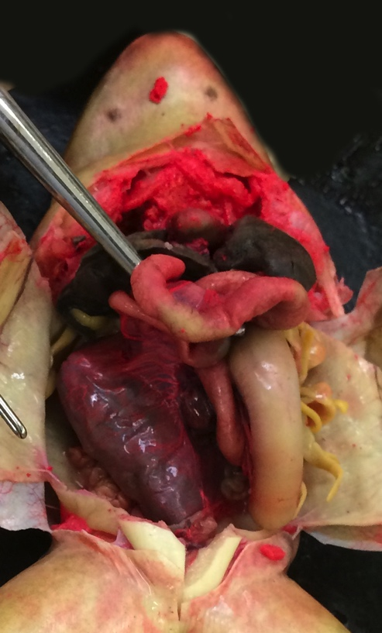
Frog
Family Ranidae
4
Heart (general)
Liver
Gall bladder
Lung
Stomach
Pylorus
Duodenum
Small intestine (general)
Large intestine
Kidney (covered in peritoneum)
Urinary bladder
Spleen
Mesentery
Fat bodies
Ovary (with eggs)
Oviduct
Testis
Vas deferens
5
4
4
17
5
17
17
7
8
9
10
18
8
11
11
11
Male – post-hibernation
Fat bodies are minimal and not obvious.
1
1
3
1
3
2
2
4
4
2
2
2
2
2
2
12
13
14
14
8
8
5
8
14
7
14
15
16
9
5
14
7
14
9
16
5
9
6
11
6
11
Female – pre-hibernation
Fat bodies are enlarged and obvious. Ovaries are small with immature eggs.
Large intestine is full.
Sabrina Cornish and Carol Wenzel. 2019

Slide 2
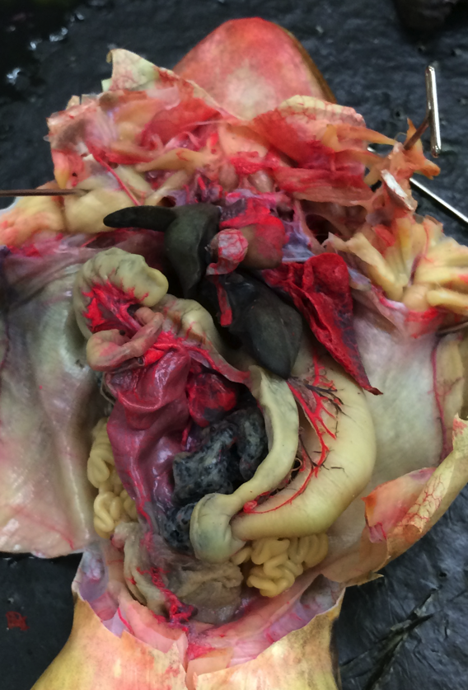
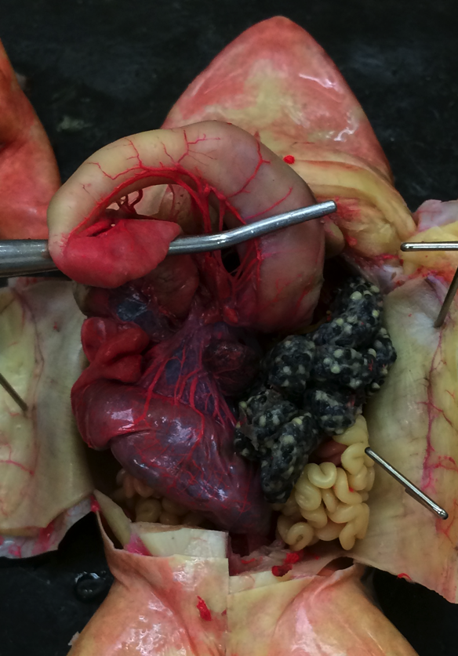
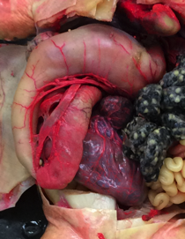
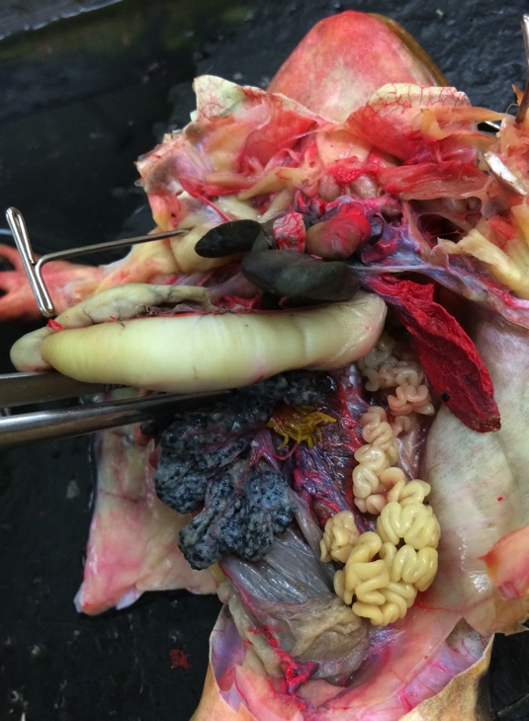
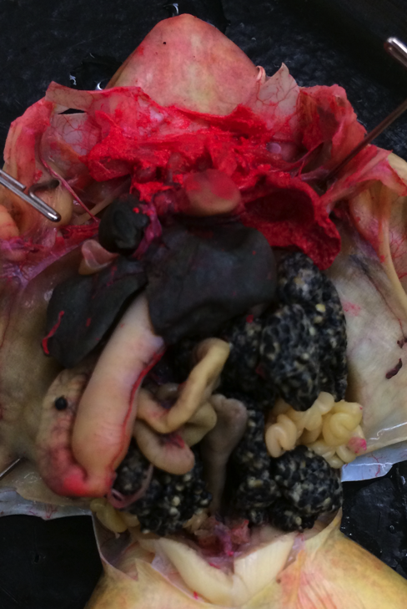
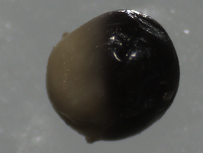
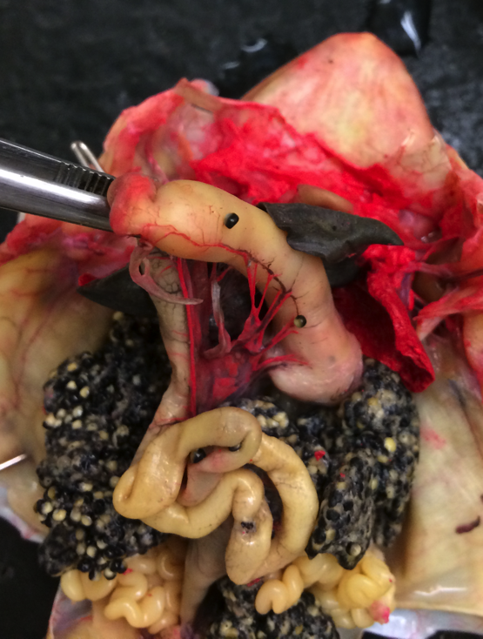
Frog
Family Ranidae
3
1
5
5
2
2
Heart (general)
Liver
Gall bladder
Lung
Stomach
Pylorus
Duodenum
Small intestine (general)
Large intestine
Kidney (covered in peritoneum)
Urinary bladder
Pancreas
Spleen
Mesentery
Fat bodies
Ovary (with eggs)
Oviduct
8
4
7
2
6
13
8
13
8
14
16
17
9
16
5
7
9
17
5
13
17
7
16
17
12
11
6
9
Female – post-hibernation, start of breeding
Fat bodies are small.
The ovaries are enlarged, and eggs are maturing.
Large intestine is full.
Animal pole
3
1
3
1
1
Vegetal pole
2
2
2
4
Egg
5
7
2
5
15
4
2
5
4
6
2
16
7
13, 14
16
10
5
8
17
16
17
7
16
8
9
16
8
9
16
8
11
6
9
17
11
17
Female – post-hibernation,
start of breeding
Fat bodies are small.
The ovaries are enlarged,
and eggs are maturing.
Large intestine is full.
Female – mature, breeding
Fat bodies are small.
The ovaries and eggs fill most of the abdominal cavity.
Large intestine is not full.
Sabrina Cornish and Carol Wenzel. 2019

